Slide 1
Bilingual Education Funding Priorities
Chloe Latham Sikes, Ph.D., Deputy Director of Policy
December 2, 2021

Slide 2
Focus Areas
Overview of Strategic Plan for Emergent Bilingual Students
Dual Language Expansion and What it Could Cost

Slide 3
Strategic Plan for Bilingual Education (SB 560, 87R)

Slide 4
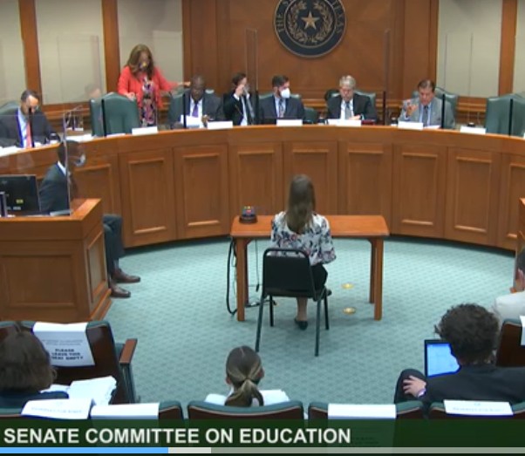
State Strategic Plan Objectives
Increase number of certified educations in bilingual education
Increase the number of dual language immersion/one-way and two-way program models in public schools
Educate families and school employees about importance of bilingual education in early childhood
Adopt a uniform process identifying students PK-12, monitoring bilingual learning, and collecting relevant data
Increase the number of bilingual and multilingual high school graduates
Notes:
Add needs that will require funding if planned appropriately, focus on DL expansion and Bilingual Ed through HS for Seal

Slide 5
State Strategic Plan Objectives
Increase number of certified educations in bilingual education
Increase the number of dual language immersion/one-way and two-way program models in public schools
Educate families and school employees about importance of bilingual education in early childhood
Adopt a uniform process identifying students PK-12, monitoring bilingual learning, and collecting relevant data
Increase the number of bilingual and multilingual high school graduates
Notes:
Add needs that will require funding if planned appropriately, focus on DL expansion and Bilingual Ed through HS for Seal

Slide 6
Types of Bilingual/ESL Education Programs
Bilingual Education
Transitional Early
Transitional Late
ESL
Content-based
Pull-Out
Dual Language One-Way
Dual Language Two-Way

Slide 7
Why Dual Language Immersion Programs?
Higher English Language Arts Achievement
Better Math Achievement
Social, Cultural, Health, Economic Benefits
Sources: Umansky, I., Valentino, R., Reardon, S. (2015). The promise of bilingual and dual immersion education (CEPA Working Paper No. 15-11). Retrieved from Stanford Center for Education Policy analysis: http://cepa.standford.edu/wp15-11

Slide 8
Dual Language Expansion: What does it take?

Slide 9
1 in 4 Emergent Bilingual Students PK-12 is in a Dual Language Program
Objective
Results
Add your objective here
Add your results here
Source: TEA 2019-2020 English Learner Program Report, EL Counts by Program
Notes:
EB Students in 2 ways has grown from 6 to 10% since 2017-18 year.

Slide 10
42% of Emergent Bilingual Students PK-3 in a Dual Language Program
Objective
Results
Add your objective here
Add your results here
Source: TEA 2019-2020 English Learner Program Report, EL Counts by Program

Slide 11
39% of Emergent Bilingual Students PK-5 in a Dual Language Program
Objective
Results
Add your objective here
Add your results here
Source: TEA 2019-2020 English Learner Program Report, EL Counts by Program
Notes:
62% of Ebs are in PK-5th grade, most in ESL or Transitional, growing number in 2-way DL

Slide 12
4% Emergent Bilingual Students 6th-12th in a Dual Language Program
Objective
Results
Add your objective here
Add your results here
Source: TEA 2019-2020 English Learner Program Report, EL Counts by Program
Notes:
38% of Ebs are in 6th-12th, most in ESL

Slide 13
What’s the Cost of Dual Language Programs?
Start Up Costs
Developing Program
Size of Program
Staff
Scheduling
Parent engagement
New staff/faculty hires
New materials
Class space
Professional development
Instructional materials
Cultural changes
Service delivery model
Teacher Evaluation practices
Small
Medium
Large
One-way, Two-way
Notes:
Range from Lara-Alecio, Galloway, Mahadevan, Mason, Irby, Brown & Gomez, 2005
Small program of $879/per student to larger program $290 per student
Start up costs: Small $38,500, Medium $64,750, and large, $118,000

Slide 14
What’s the Cost of Dual Language?
Pharr-San Juan- Alamo ISD
PreK-12 DL Program
Aldine ISD
EC-K DL Program
11,589 Bilingual Education ADA
Total bilingual allotment: $9,147,186
$616/Bilingual Regular student funding
$924/EB dual language student funding
$308/non-EB dual language student funding
Spends: $207/bilingual program student
$6,466,900 program expenditures
20,687 Bilingual Education ADA
Total bilingual allotment: $12,743,192
$616/Bilingual Regular student funding
$0 for EB and non-EB dual language
Spends: $104/bilingual program student
$6,536,385 program expenditures
Notes:
2020-2021 Summary of Finances- TEA
PSJA:
Bilingual Regular ADA/Allotment: 2,770,792, $1,706,808
Bilingual EB DL one or two way: 7,669.027, $7,086,181
Bilingual Non-EB DL two way: 1,149.989, $354,197
Total Bilingual ADA/Allotment: 11,589.809, $9,147,186
Aldine:
Bilingual Regular ADA/Allotment: 20,687, $12,743,192
Bilingual EB DL one or two way: 0
Bilingual Non-EB DL two way: 0
Total Bilingual ADA/Allotment: 20,687, $12,743,192

Slide 15
What’s the Cost of Dual Language?
Pharr-San Juan- Alamo ISD
PreK-12 DL Program
Aldine ISD
EC-K DL Program
11,589 Bilingual Education ADA
Total bilingual allotment: $9,147,186
$616/Bilingual Regular student funding
$924/EB dual language student funding
$308/non-EB dual language student funding
Spends: $207/bilingual program student
$6,466,900 program expenditures
20,687 Bilingual Education ADA
Total bilingual allotment: $12,743,192
$6,536,385 program expenditures
$118,000+ (103*20,687)=$2,248,761
New expenditures: $8,785,146
Notes:
2020-2021 Summary of Finances- TEA
PSJA:
Bilingual Regular ADA/Allotment: 2,770,792, $1,706,808
Bilingual EB DL one or two way: 7,669.027, $7,086,181
Bilingual Non-EB DL two way: 1,149.989, $354,197
Total Bilingual ADA/Allotment: 11,589.809, $9,147,186
Aldine:
Bilingual Regular ADA/Allotment: 20,687, $12,743,192
Bilingual EB DL one or two way: 0
Bilingual Non-EB DL two way: 0
Total Bilingual ADA/Allotment: 20,687, $12,743,192
34% increase in expenditures, minimum

Slide 16
What’s the Cost of Dual Language?
Pharr-San Juan- Alamo ISD
Aldine ISD
$6,466,900 ÷ $9,147,186 =
70.6%
on direct program costs
$6,536,385 ÷ $12,743,192=
51.2%
on direct program costs
New expenditures of $8,785,146 =
69%
Notes:
Aldine potential costs:
Start up of $118,000 + (103x20687)= $2,248,761
+ 6,536,385= NEW total program expenditure estimate of $8,785,146

Slide 17
Recommendations
Increase regular bilingual weight to at least 25% (.25)
Increase spending requirement from 55% to 90% of program allotment (SB 2065, 87R)
Support DL expansion PreK- 12 and promote Seal of Biliteracy/Performance Acknowledgement

Slide 18
Intercultural Development Research Association
Celina Moreno, J.D., President & CEO
5815 Callaghan Road, Suite 101
San Antonio, Texas 78228
210-444-1710 • contact@idra.org
www.idra.org
www.facebook.com/IDRAed
Subscribe to our email newsletter:
https://idra.news/Subscribe
Text to join our email list!
Text JOINIDRAEMAIL
To 22828 to get started
Achieving equal educational opportunity for every child through strong public schools
that prepare all students to access and succeed in college

