Slide 1
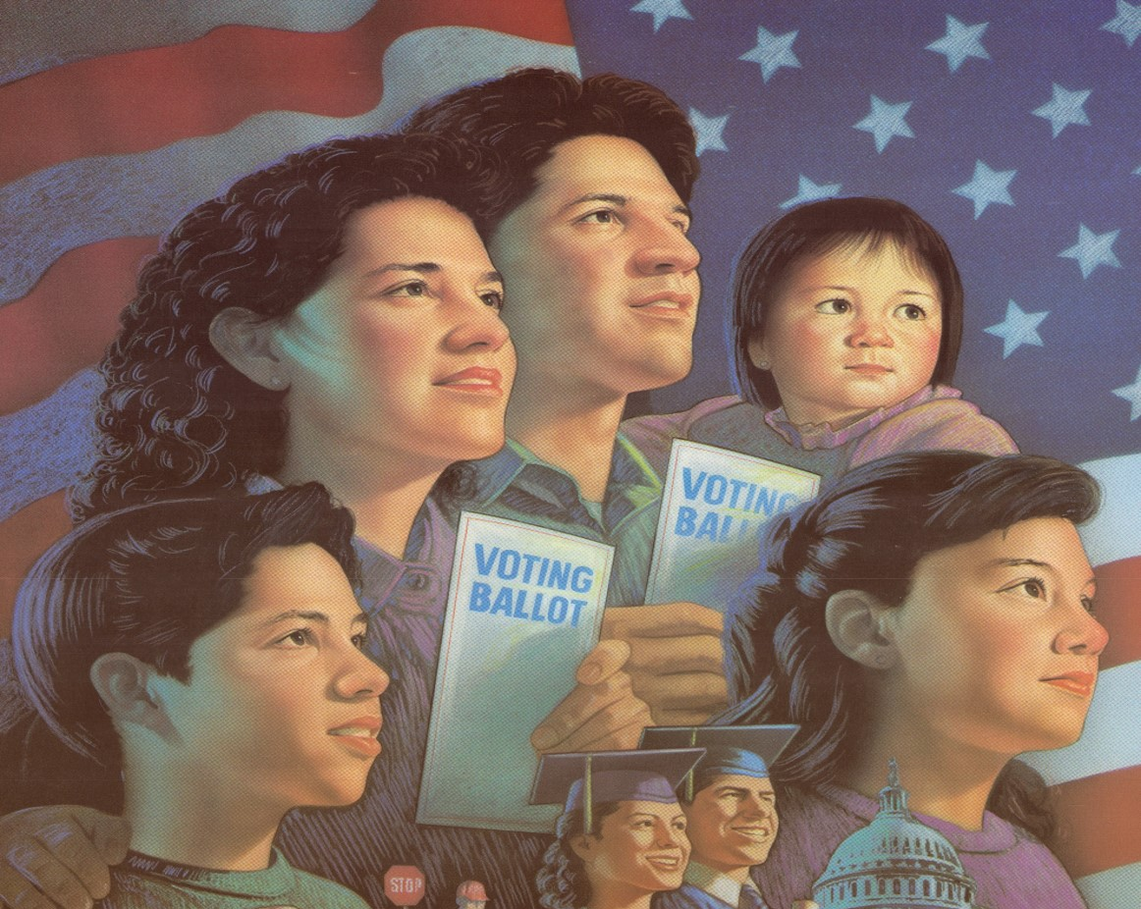
LATINO VOTE

Slide 2
Latino Vote
Challenges, Opportunities and Solutions to Get America to Vote!

Slide 3
LATINO VOTE
29 MILLION LATINO VOTERS ARE ELIGIBLE TO VOTE.
18.6 MILLION LATINO VOTERS WERE REGISTERED TO VOTE IN PREPARATION TO THE 2020 GENERAL ELECTION
16.6 MILLION LATINO VOTERS CAST THEIR VOTE
SVREP ESTIMTATES THAT BY THE 2024 PRESIDENTIAL GENERAL ELECTION, 20.6 MILLION LATINO VOTERS WILL BE REGISTERED TO VOTE!

Slide 4
Latino Vote
Every Year 800,000 US Latinos turn 18 years old!
That’s is 3.2 Million Latino voters who are eligible to vote and must be registered to vote
Median Age of the Latino Voter is
22 years old!

Slide 5
Latino Vote

Slide 6
National Latino Vote Presidential and Midterm Elections 1994 to 2020
Latino Vote

Slide 7
Latino Vote Every Year 800,000 to 1 million Latinos turn 18 years old who are US citizens and can register to vote. By 2024, an estimated 14.6 Million Latinos Latino will be voters eligible to vote if we register them to vote!
State | Online Voter Registration | US Citizens, Voting Age (CVA) Latinos Eligible to vote | Latinos Registered to Vote | Latinos Unregistered Eligible to vote
Arizona | X | 1,188,000 | 617,760 | 570,240
California | X | 7,885,000 | 4,494,450 | 3,390,550
Colorado | X | 659,000 | 351,906 | 307,094
Florida | X | 3,143,000 | 1,775,795 | 1,367,205
Georgia | X | 377,000 | 139,113 | 237,887
Illinois | X | 1,053,000 | 502,281 | 550,719
Michigan | X | 261,000 | 132,588 | 128,412
New York | X | 2,033,000 | 1,101,886 | 931,114
Nevada | X | 407,000 | 188,034 | 218,966
New Mexico | X | 665,000 | 416,955 | 248,045
North Carolina | X | 338,000 | 114,920 | 224,080
Ohio | X | 241,000 | 128,694 | 112,306
Pennsylvania | X | 521,000 | 279,256 | 241,744
Texas |  | 5,628,000 | 2,785,860 | 2,842,140
Wisconsin | X | 163,000 | 82,350 | 80,650
Total |  | 24,562,000 | 13,111,848 | 11,451,152

Slide 8
Latino Vote

Slide 9
Latino Vote
Sates | Electoral Votes | 2020 | 2020 | Margin of Victory | Latino Vote Turnout | Latino Votes for Biden | % of Support for Biden | % of Support for Trump
 |  | General Presidential | General Presidential
 |  | Election Results | Election Results
 |  | Biden Turnout | Trump Turnout
Arizona | 11 | 1,672,143 | 1,661,686 | 10,457 | 846,324 | 600,890 | 71% | 26%
Georgia | 16 | 2,473,633 | 2,461,854 | 11,779 | 105,852 | 73,038 | 69% | 28%
Michigan | 16 | 2,804,040 | 2,649,852 | 154,188 | 112,698 | 140,250 | 76% | 22%
Pennsylvania | 20 | 3,459,923 | 3,378,263 | 81,660 | 237,367 | 263,783 | 69% | 26%
Wisconsin | 10 | 1,630,866 | 1,610,184 | 20,682 | 57,645 | 40,356 | 70% | 25%
Totals | 73 | 12,040,605 | 11,761,839 | 278,766 | 1,359,886 | 1,118,317

Slide 10
Latino Vote

Slide 11
Latino Vote
California Latino Vote
1996 to 2020
In Millions

Slide 12
Texas Latino and Black Voting, 1980-2016 Numbers in Thousands
Latino Vote

Slide 13
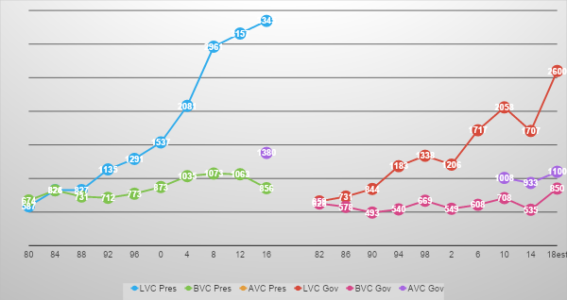
Latino Vote
California: Latino, Black and Asian Voting, 1982-2018

Slide 14
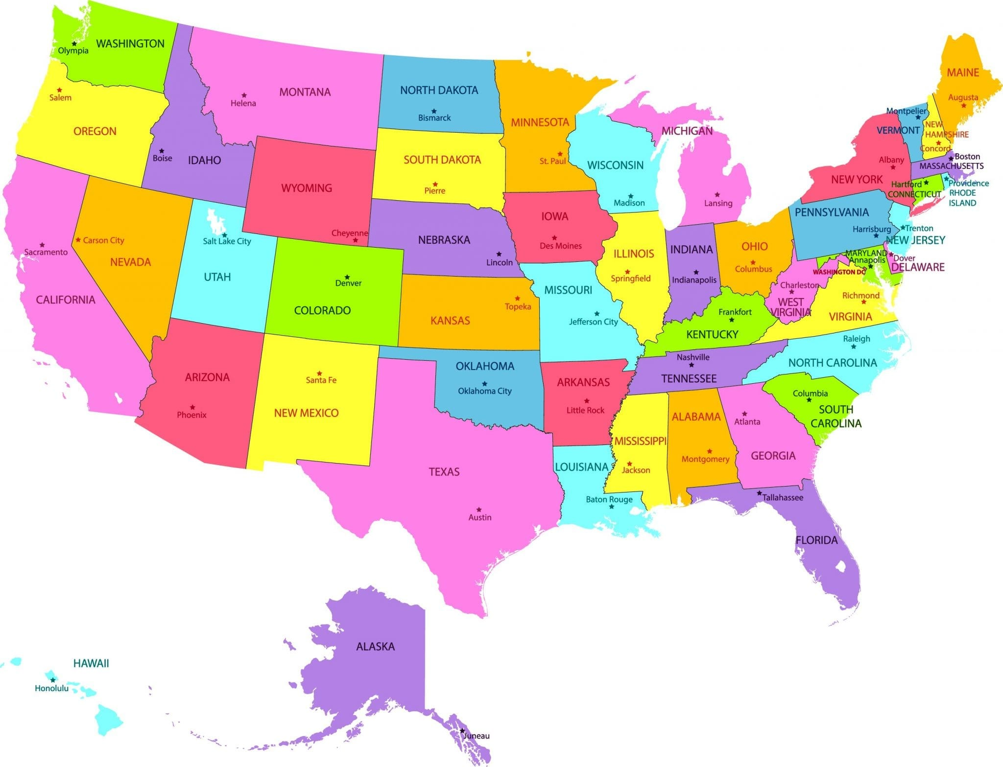
Latino Vote Redistricting and Reapportionment
States that Gained New congressional districts
CO +1 FL +1 MT +1 NC +1 OR +1 TX +2
States that lost congressional districts
CA -1 IL -1 MI -1 NY -1 OH -1 PA -1 WV -1
The US Census Bureau delivered the population numbers per state and determined apportionment numbers.

Slide 15
Latino Vote

Slide 16
Latino Vote

Slide 17
Latino Vote

Slide 18
Latino Vote According to the US Census Count, US population is made up of 331,449,281 men, women and children.
On April 30th, the US Census provided the population numbers. The US population grew by 7.4% compared to the last census count (2000 to 2010).
The states that gained new congressional seat CO, FL, MT, NC, and OR. TX gained 2 new congressional seats.
States that lost one congressional seat each are CA, IL, MI, NY, OH, PA and WV.

Slide 19
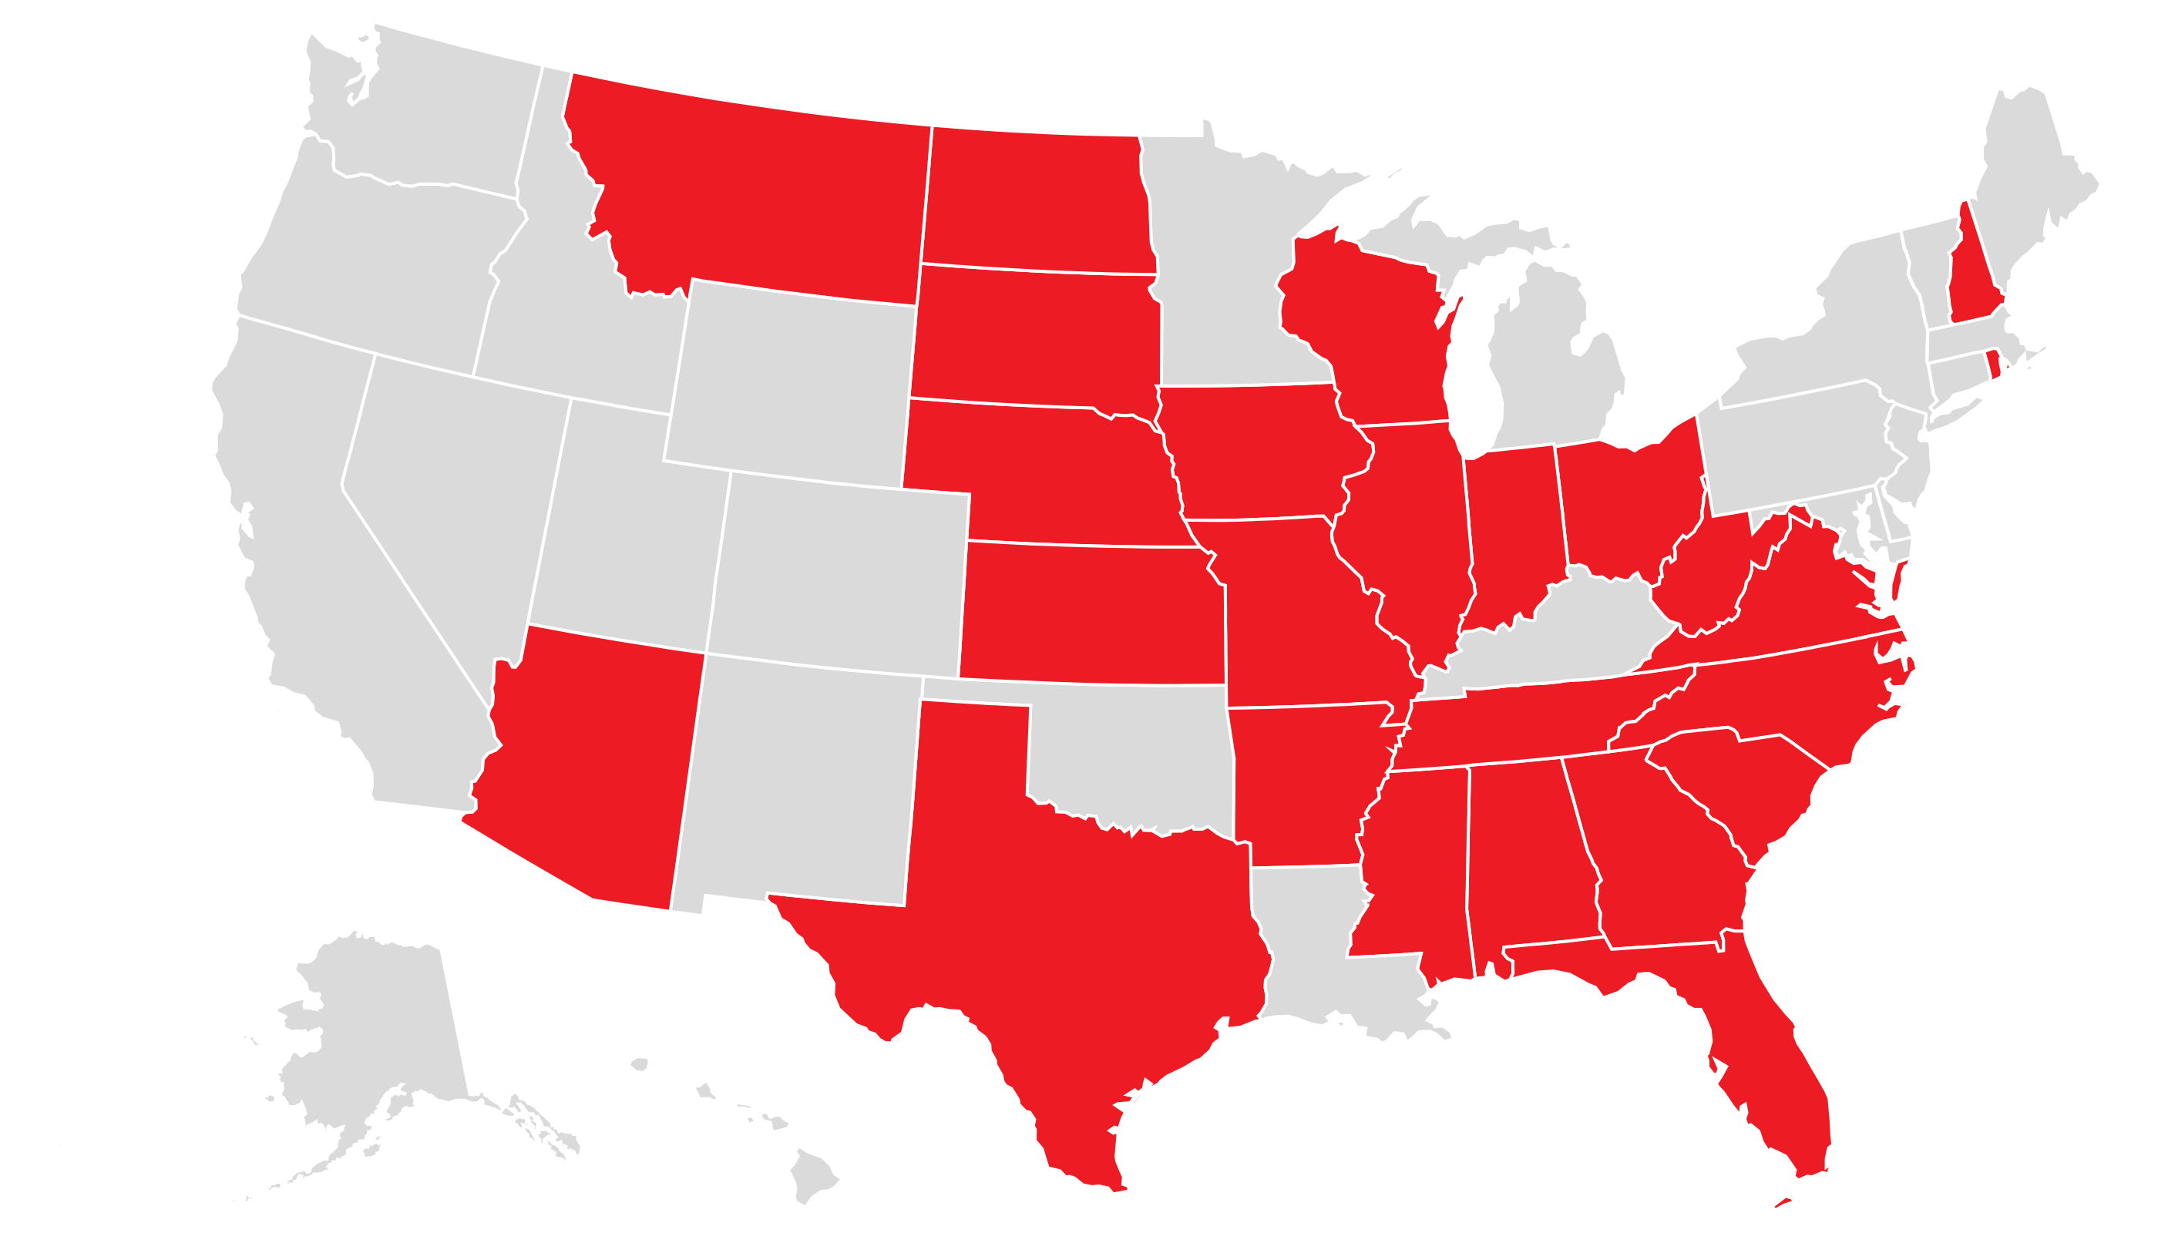
Latino Vote Voter Suppression in Red are states where the GOP is working to pass restrictive voter suppression laws
47 states are under attack with voter suppression proposed legislation. AZ, GA, FL, and TX are among the states with voter suppression bills.

Slide 20
LATINO VOTE
Increase the number of Latino voters,
Change the Outcome!
Su Voto Es Su Voz

Slide 21
Latino Vote
Lydia Camarillo, SVREP President
Patricia Gonzales, SVREP Director of Operations
Manuel Garza, SVREP Senior Field Advisor
SVREP
320 El Paso Street, San Antonio, Texas 78207; Office 210-922-0225
2914 N. Main Street, Los Angeles, CA 90031; Office 323-205-2190
www.svrep.org
Su Voto Es Su Voz

