Slide 1
Latino Family Bienestar (Well-Being): Demographic, Political, and Socio-Economic Standing Across Texas Regions
Rogelio Sáenz
University of Texas at San Antonio
rogelio.saenz@utsa.edu
Select Highlights from the Texas Latino Policy Symposiums ( 2017,2018) San Antonio

Slide 2
The Demographic Reality of Latinos in Texas Today

Slide 3
Texas Population Estimates by Race/Ethnic Group, 2016 and 2017
Race/Ethnic Group | 2016 | 2017 | Abs. Chg. 2016-2017 | Pct. Chg. 2016-2017 | Pct. of Texas Change
Latinos | 10,922,506 | 11,156,514 | 234,008 | 2.1 | 58.5
Whites | 11,862,697 | 11,886,381 | 23,684 | 0.2 | 5.9
Others | 5,119,659 | 5,261,701 | 142,042 | 2.8 | 35.5
Total | 27,904,862 | 28,304,596 | 399,734 | 1.4 | 100.0
Source: 2016 and 2017 U.S. Bureau of the Census Population Estimates for Texas. [American FactFinder]

Slide 4
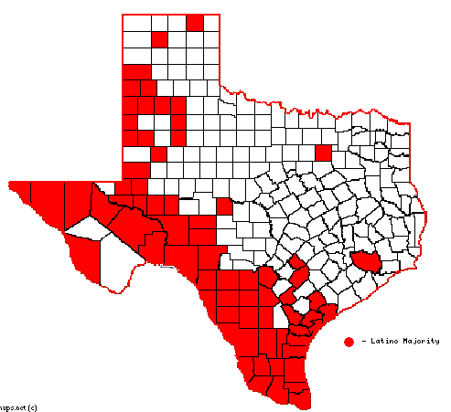
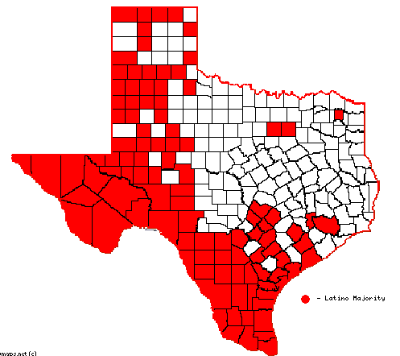
Texas Counties with Majority Latino Total Population and Children Population, 2013-2017 [Source: 2017 American Community Survey 5-Year Estimates (American FactFinder)]
Total Population [69 counties]
Children Population [104 counties]

Slide 5
Age Structure Differences between Texas Latino and White Populations and Implications for Future of Texas, 2017
Race/Ethnic Group | Median Age | Pct. 0-17 of Age | Pct. 65 and Older | Ratio Children: Elderly
Latino | 28.7 | 32.7 | 7.1 | 4.60
White | 42.2 | 19.6 | 18.5 | 1.06
Source: 2017 U.S. Bureau of the Census Population Estimates for Texas. [American FactFinder]

Slide 6
Percentage of Latinos and Whites in Texas Population by Age Group, 2017

Slide 7
Latino and White Population by Age Groups, 2017
Age Group | Latino | White | Latino-to-White Ratio
Under 18 | 3,645,511 | 2,330,125 | 1.56
18 to 24 | 1,274,642 | 953,289 | 1.34
25 to 44 | 3,283,154 | 3,061,141 | 1.07
45 to 64 | 2,160,399 | 3,345,782 | 0.65
65 and older | 83,844 | 2,196,044 | 0.04
Total | 11,156,514 | 11,886,381 | 0.94
Source: 2017 U.S. Bureau of the Census Population Estimates for Texas. [American FactFinder]

Slide 8
Modal Age for Latinos and Whites in Texas, 2017
________________________________
Group Modal Age Number
________________________________
Latino 10 227,216
White 60 184,349
________________________________
Source: 2017 American Community Survey Public-Use File

Slide 9
Population Transformation in the Texas Latino and White Populations, 2010-2018

Slide 10
Texas Population Projections by Race/Ethnic Group for Selected Periods
Race/Ethnic Group | 2018 | 2030 | 2050 | 2018-2050 Absolute Change | 2018-2050 Percent Change
Latino | 11,311,352 | 14,452,949 | 20,191,750 | 8,880,398 | 78.5
White | 11,994,710 | 12,774,056 | 13,523,839 | 1,529,129 | 12.7
Black | 3,414,806 | 4,322,983 | 6,030,795 | 2,615,989 | 76.6
Asian | 1,389,935 | 2,414,732 | 5,782,908 | 4,392,973 | 316.1
Other | 605,410 | 929,709 | 1,813,125 | 1,207,715 | 199.5
Total | 28,716,213 | 34,894,429 | 47,342,417 | 18,626,204 | 64.9
Source: Texas Demographic Center, 2018 Population Projections, https://demographics.texas.gov/Data/TPEPP/Projections/Index

Slide 11
Percentage Distribution of Projected Texas Population Change between 2018 and 2050 Attributed to Race/Ethnic Groups [Source: Texas Demographic Center, 2018 Population Projections]

Slide 12
The Political Reality of Texas

Slide 13
The Political Reality of Texas
Historical background
Loss of land and making of a proletariat workforce
Second-class citizens
Violence, including lynching, against Mexicans
Separate and unequal schools
Disenfranchisement and the poll tax
Civil Rights era
Some temporary social, economic, and political gains in the 1960s-1970s
Undoing of Civil Rights gains beginning with Reagan presidency
Texas continuing ‘minimalist’ policy-making approach regarding ‘equitable’ capital investment in its people
Contemporary Latino impending majority population era
Systemic efforts to minimize Latino political power and socioeconomic standing
Barriers to Latino family economic mobility and wealth building
Implications for state and local economies

Slide 14
Voting-Related Demographics of Latinos and Whites, 2017
Race/Ethnic Group | Total | Citizen Voting Age Pop. | 0-17 Population | 18+ Adult Non-Citizens
Latino | 11,158,751 | 5,424,880 | 3,647,003 | 2,086,868
White | 11,855,092 | 9,359,397 | 2,319,181 | 176,514
Pct. Distribution
Latino | 100.0 | 48.6 | 32.7 | 18.7
White | 100.0 | 78.9 | 19.6 | 1.5
Source: 2017 American Community Survey 1-Year Estimates [American FactFinder].

Slide 15
Latino and White Children Turning 18 Years of Age in Texas, 2017
Segment | Latino Children | White Children
Total number children in 2017 | 3,647,003 | 2,319,181
Total number of children turning 18 every….
Year | 202,611 | 128,843
Month | 16,884 | 10,737
Week | 4,221 | 2,684
Day | 603 | 383
Hour | 25 | 16
10 minutes | 4.19 | 2.67
Source: 2017 American Community Survey 1-Year Estimates [American FactFinder].

Slide 16
Challenges to Voting Rights and Political Representation
The Texas Civil Rights Project’s 2017 Impact Report notes: “For more than a decade, certain politicians have manipulated the rules to keep themselves in power by advancing a dangerous agenda designed to prevent millions of Americans, particularly people of color and low-income communities, from exercising their constitutional right to vote. From a complex of rules for voter registration to strict voter identification rules that prevent people from casting a ballot; this agenda has gained traction in Texas” (p. 4).
Redistricting – Gerrymandering
Voter ID
High school voter registration
Focus on political representation based on adult and citizenship status
Evenwel v. Abbott (2016 Supreme Court decision)
Underfunding of Census 2020 and 2020 citizenship question
The specter of voting fraud

Slide 17
Socioeconomic Standing of Latino Population in Texas

Slide 18
Texas Children Socioeconomic Measures for Latinos, Whites, and Blacks, 2016
Socioeconomic Measures | LATINO | WHITE | BLACK
Pct. of 3 and 4 year olds in preschool | 39.1 | 48.5 | 44.2
Pct. of 14-17 year olds in high school or high school graduates | 97.1 | 97.6 | 98.1
Pct. of children 0-17 with health insurance coverage | 87.4 | 94.1 | 94.0
Pct. of children 0-17 at or above poverty level | 69.5 | 89.7 | 71.1
Source: 2016 American Community Survey Public Use Microdata Sample.

Slide 19
Texas Ranking on Adult Socioeconomic Measures for Latinos, Whites, and Blacks, 2016
Adult Socioeconomic | LATINO | WHITE | BLACK
Pct. of householders homeowners | 55.9 | 69.9 | 40.3
Pct. of persons 25+ with bachelor’s degree or higher | 14.2 | 37.5 | 23.2
Number STEM majors per 1,000 persons in labor force | 31.0 | 91.3 | 47.5
Pct. of persons 25-64 years of age employed | 72.6 | 75.2 | 70.9
Median household income | $44,535 | $69,866 | $42,419
Pct. of persons 18-64 with health insurance coverage | 62.9 | 86.4 | 79.0
Pct. of persons 18 and older at or above poverty level | 81.8 | 91.4 | 82.7
Source: 2016 American Community Survey Public Use Microdata Sample.

Slide 20
Texas 12 Economic Regions [Source: Texas Comptroller’s Office]

Slide 21
Ranking of Economic Regions by Percent of Latinos 25 and Older with College Degree [Comparison to Whites in Texas]

Slide 22
Ranking of Economic Regions by Number of Latino STEM Majors Per 1,000 Workers [Comparison to Whites in Texas]

Slide 23
Ranking of Economic Regions by Percentage of Latino Workers in Highest Level Occupations [Comparison to Whites in Texas]

Slide 24
Ranking of Economic Regions by Latino Median Family Income [Comparison to Whites in Texas]

Slide 25
Ranking of Economic Regions by Percentage of Latino Families in Poverty [Comparison to Whites in Texas]

Slide 26
Ranking of Economic Regions by Percentage of Latino Housing Units Owner-Occupied [Comparison to Whites in Texas]

Slide 27
Ranking of Economic Regions by Percentage of Latinos Without Health Insurance Coverage [Comparison to Whites in Texas]

Slide 28
Ranking of Economic Regions by Percentage of Citizen Voting-Age Population that is Latino

Slide 29
Latino and White Children Turning 18 Years of Age in Texas, 2016
Segment | Latino Children | White Children
Total number children in 2016 | 3,597,069 | 2,325,338
Total number of children turning 18 every….
Year | 199,837 | 129,185
Month | 16,653 | 10,765
Week | 4,163 | 2,691
Day | 595 | 384
Hour | 25 | 16
10 minutes | 4.13 | 2.67
Source: 2016 American Community Survey 1-Year Estimates [American FactFinder].

Slide 30
Overall Ranking of Economic Regions
Ranking | Economic Region | Average Ranking | Pct. Latino | Pct. Foreign-Born | Pct. CVAC Latino
1 | Alamo | 3.1 | 53.0 | 15.7 | 46.7
2 | Capital | 3.4 | 31.2 | 26.4 | 22.5
3 | Upper Rio Grande | 4.9 | 81.2 | 28.8 | 75.6
4 | Northwest Texas | 5.1 | 37.6 | 11.7 | 32.3
5 | West Texas | 6.0 | 47.6 | 20.0 | 38.8
6 | Gulf Coast | 6.3 | 36.1 | 38.8 | 23.7
7 | South Texas | 6.6 | 87.5 | 25.9 | 81.4
8 | Central Texas | 7.4 | 22.6 | 24.1 | 15.6
9 | Metroplex | 7.6 | 27.7 | 37.6 | 16.2
10 | Southeast Texas | 9.0 | 14.4 | 34.7 | 8.0
11 | High Plains | 9.1 | 36.5 | 18.9 | 28.0
12 | Upper East Texas | 9.4 | 14.5 | 36.7 | 7.2

