Slide 1
Affordable Housing: Local Level Response
Texas Latino Policy Symposium III
Latinos Bienestar During and Post COVID-19
Presented by: Verónica R. Soto, FAICP, Director
Neighborhood & Housing Services Department
October 1, 2020

Slide 2
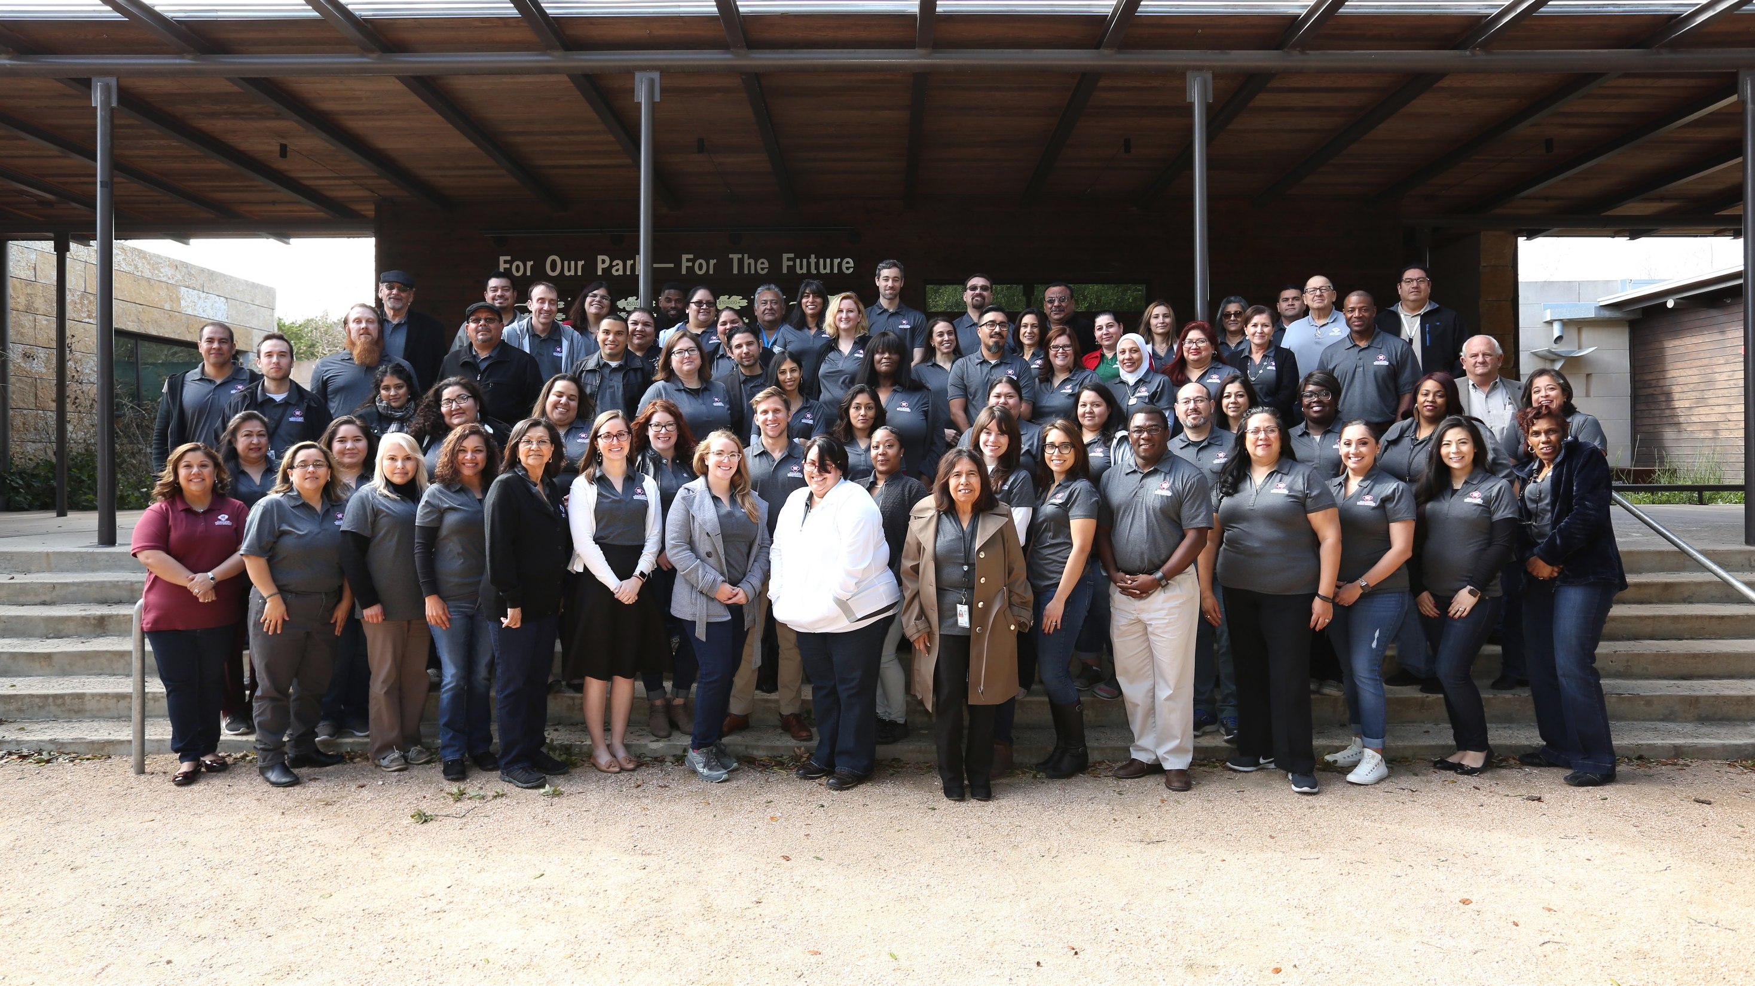
About San Antonio, Texas
1.5 Million residents
2nd largest city in Texas; 7th largest city in the U.S.
63% Hispanic/Latino
20% Poverty rate
500,000 Households
170,000 Households are Cost-burdened
95,667 Households deemed most vulnerable
Notes:
Department Mission: Create stable and diverse neighborhoods through the delivery of programs focused on providing safe and affordable housing for our community.

Slide 3
Identifying Community Need
Total Households 500,000
Cost-burdened households 170,000
Housing Policy Framework 18,681
Most vulnerable households 95,667
Total households in Bexar County
Cost burden households paying more than 30% income on housing
Identified most vulnerable:
Cost burden of affordable AMI ranges
Supply vs demand of units
Need by regional center
Vulnerability factors: low education attainment, disabilities, concentration of low-income housing, unemployment, veterans, overcrowding, seniors
Stabilize community cost-burden
Neighborhood & Housing Services
Notes:
FY2020 has been a challenging year but we have been able to shift resources for emergency assistance and still provide funding for our standard housing programs, our basic operations:
Redirected resources to COVID-19 emergency assistance
12,825 families assisted, $36.5 spent
Court support and Right to Counsel
Establish Counseling Resource Center
Through our partners and other programs, we added over 6,000 units to our housing pipeline and we track these as they close, get under construction, and come on-line to serve our residents
Rehabilitate 412 homes
We had 93 families become first time home buyers thanks to our down payment assistance programs
And we provide non-profit and for-profit developers Gap funding for 283 affordable housing units, including 33 infill homes for homeownership
Many of these programs and initiatives will continue in FY2021 including our Court support and Right to Counsel programs, and work that started before the pandemic that was paused as we could not hold our tradition public meetings will continue with virtual and other creative public input gathering processes for the ForEveryoneHome anti-displacement initiative, and Strategic Housing Implementation Plan . The next slide shows the funding that will help us deliver on both our basic operations and the items related to response and recovery from our community.

Slide 4
Response & Recovery
COVID-19 emergency assistance
17,099 families assisted, $48.8M spent
Court support and Right to Counsel
Establish Counseling Resource Center
Eviction Information Sharing & Protections
CARES Act and eviction protections
Notice of Tenants Rights
CDC Eviction Moratorium
Announced Court Diversion Program
Neighborhood & Housing Services
Notes:
FY2020 has been a challenging year but we have been able to shift resources for emergency assistance and still provide funding for our standard housing programs, our basic operations:
Redirected resources to COVID-19 emergency assistance
12,825 families assisted, $36.5 spent
Court support and Right to Counsel
Establish Counseling Resource Center
Through our partners and other programs, we added over 6,000 units to our housing pipeline and we track these as they close, get under construction, and come on-line to serve our residents
Rehabilitate 412 homes
We had 93 families become first time home buyers thanks to our down payment assistance programs
And we provide non-profit and for-profit developers Gap funding for 283 affordable housing units, including 33 infill homes for homeownership
Many of these programs and initiatives will continue in FY2021 including our Court support and Right to Counsel programs, and work that started before the pandemic that was paused as we could not hold our tradition public meetings will continue with virtual and other creative public input gathering processes for the ForEveryoneHome anti-displacement initiative, and Strategic Housing Implementation Plan . The next slide shows the funding that will help us deliver on both our basic operations and the items related to response and recovery from our community.

Slide 5
Emergency Housing Assistance
Applications
28,409
Processed
26,052
Approved
16,950
Denied*
9,044
In Progress
2,357
Pending Info
296
Under Review
2,061
Pending Manager Approval/Denial
58
As of
Sept. 29
1:55 PM
Total
Expended
$48.4M
Total
Committed
$55.4M
*Denied applications that were Ineligible because they are outside of the city limits, over income or duplicates.
Actuals in City’s accounting system differ from dashboard totals due to next day processing time
Neighborhood & Housing Services
Notes:
Those Council members who sit on the Culture and Neighborhood Services Committee are familiar with this dashboard that is one way in which we are sharing information about the program. You can view this dashboard on the city’s website and see in real time how many applications have been submitted for assistance, how many have been approved or denied and how many our staff is processing. You can also see how much funding has been expended and the uses of this funding with over 85% of the funding helping families be stabilized in their housing by helping with rent or mortgage assistance, and smaller though not insignificant amounts helping with utilities including internet and a direct cash assistance component. And you can look at this in real time so the numbers in front of you are as of yesterday and if you look at the dashboard today, you will see those numbers have changed and this is one of the ways we are being transparent and accountable for this program and funding. The next slide also highlights another way our department is responding to the pandemic that will continue in the next fiscal year.

Slide 6
Emergency Housing Assistance
$48,445,116
Rent& Mortgage
$40,877,992
CPS
$3,240,089
SAWS
$548,602
Internet
$137,483
Direct Cash Assistance (FII)
$3,640,950
Actuals in City’s accounting system differ from dashboard totals due to next day processing time
Neighborhood & Housing Services
Notes:
Those Council members who sit on the Culture and Neighborhood Services Committee are familiar with this dashboard that is one way in which we are sharing information about the program. You can view this dashboard on the city’s website and see in real time how many applications have been submitted for assistance, how many have been approved or denied and how many our staff is processing. You can also see how much funding has been expended and the uses of this funding with over 85% of the funding helping families be stabilized in their housing by helping with rent or mortgage assistance, and smaller though not insignificant amounts helping with utilities including internet and a direct cash assistance component. And you can look at this in real time so the numbers in front of you are as of yesterday and if you look at the dashboard today, you will see those numbers have changed and this is one of the ways we are being transparent and accountable for this program and funding. The next slide also highlights another way our department is responding to the pandemic that will continue in the next fiscal year.

Slide 7
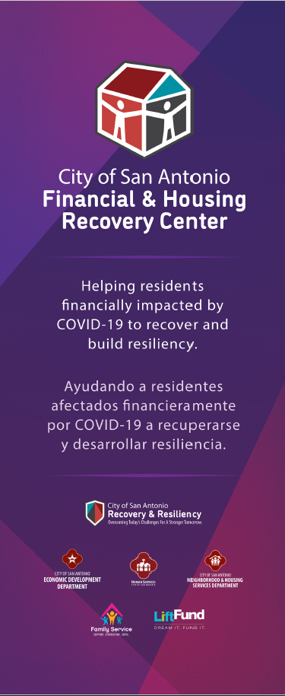
June 15th Follow Up: Renters Commission
Financial & Housing Recovery Center
Central Library, Neighborhood Place, Claude Black Community Center
Equity & Engagement Strategies
Financial Security
Behanioral Health Referral
Financial Counseling
Public
Benefits
Enrollment
Financial Assistance
Connection to Workforce Assistance
VITA & Tax Assistance
Housing & Utility Assistance
Fair Housing Counseling
$27.9 M
Neighborhood & Housing Services
Notes:
On July 1, we opened the Financial and Housing Recovery Center in conjunction with DHS. We know housing stability is linked to financial security and we know that many clients needing fair housing counseling or emergency housing assistance could benefit from additional programs so the center provides this connection to those services. And the folks at the Recovery Center are quite busy as the next slide illustrates.
Services & Programs:
Financial Counseling – Financial coaching including budgeting, debt management, credit report education, and linking to financial products through BankOn, etc.
Benefits Navigation/Enrollment – Assist with eligibility assessment and enrollment working with federal, state and local benefits providers and with community partners including unemployment assistance, TANF, health insurance, housing authority programs, Financial Independence Initiative, transportation, utility assistance, rent/mortgage assistance, etc.
Fair Housing Counseling and Rent/Mortgage Assistance – Counseling to assist with landlord/tenant disputes, eviction procedures, foreclosure prevention, and financial rental and mortgage, and utility assistance.
Housing Repair and Rehab Assistance – Provide access to housing programs like the minor repair program, Under 1 Roof, and owner-occupied rehab program.
Right to Counsel Program - Legal mediation and representation for eligible eviction cases through Texas Rio Grande Legal Aid and San Antonio Legal Services Associates
Workforce assistance – Enrollment with Family Service’s occupation counselors, DHS Training for Job Success program, and NXT Level and referral to Alamo Promise, Workforce Solutions Alamo, Project Quest, Goodwill, and other community workforce programs
Small Business recovery assistance – Financial Counseling for simple small business recovery assistance tied to family finances and referral to EDD, LaunchSA, and other community partners.

Slide 8
Eviction Prevention
Right to Counsel Program
Pro bono legal services
Know your rights training
Expand Risk Mitigation Fund ($5.25M)
Emergency Housing and Relocation
Stabilize at least 1,600 households
Court Support
Partnership with JP Courts to provide resources
Before arriving to court and in-court presence
Notice of Tenants Rights
Provides resources & information to residents on eviction
Extends beyond emergency period
Newer Information
CDC Eviction Moratorium
Court Diversion Program from State
Neighborhood & Housing Services
Notes:
Our eviction prevention programs that help prevent displacement include the Right to Counsels program that provides pro bono legal services and know your rights training to tenants through contracts with TRLA and SALSA.
For those families facing an eviction hearing, we have a partnership with the Courts and the County to have staff present—virtually or in person—at the courts to help families and we do outreach to families with scheduled hearings even before their scheduled court dates and we are able to connect families with a slew of resources that ultimately have helped families avoid homelessness in some cases and avoid increased housing insecurity in others. Part of this work includes the recently adopted Notice of Tenants Rights ordinance where our team helps provide resources and information to residents that receive a notice to vacate, the first step in an eviction process and we will work to make sure landlords are indeed complying with this ordinance and providing the required Notice. There are many outcome and success stories with many cases being dismissed or reset as families facing eviction have applied for EHAP or have signed up for legal representation. And even as we have pivoted to respond and recover from the pandemic, the next slide shows what we expect to deliver for what constitute our basic operations.
And the primary way we are addressing housing insecurity as part of our response is through the emergency housing assistance program. With the proposed budget for the Risk Mitigation Fund increasing from $1M this year to $5.25M in the proposed budget. In addition to this direct assistance, our team –fair housing staff and the coordinated housing system staff—will continue with the Right to Counsel program and our partnership at the Justice of the Peace Courts. So in the next slide let me expand on this work to prevent displacement.

