Slide 1
Education and Labor Force Trends for Latino Men in Texas: Policy Implications for Our Progress of 60X30TX
Dr. Victor B. Sáenz, University of Texas at Austin
Dr. Jorge Burmicky, University of Texas at Austin
Dr. Wonsun Ryu, University of Texas at Austin

Slide 2
Problem Statement
Racial and Gender Achievement Gaps
Key Barriers: Pandemic, Racial Climate, Economy
Statewide Efforts: 60X30TX
Educational and Labor Workforce Data Patterns
Policy Implications

Slide 3
Policy Brief Purpose
Institutional-level Data
Integrated Postsecondary Data System (IPEDS)
Labor Market Data
Current Population Survey (CPS)
To examine educational outcomes of Latino male students in TX:

Slide 4
Context
Latino Workforce and the COVID-19 Pandemic

Slide 5
Latino Workforce: Key Aspects from Sáenz and Sparks (2020)
“Latinos are a relatively young workforce, with 42 percent being less than 35 years of age compared to 32 percent of Whites” (p. 2)
Consistent with our data patterns in Texas, Latinos are less likely to have a bachelor’s degree as compared to Whites.
As a result, Latinos are disproportionally represented in jobs that were more vulnerable to the pandemic. For example, approximately 22% of Latinos work in the service sector, compared to 14% of Whites.

Slide 6
Data Patterns: Key Highlights
Latino male students’ total enrollment composition has consistently increased over time, especially in community colleges. Yet, proportion gaps have remained persistent.
Degree attainment, particularly for bachelor’s degrees, has not kept up with the state’s Latino population growth.
Unemployment of all male groups continues to be highly elevated as of August after some recovery since April’s peak, but Latino males have experienced exceptionally high level of unemployment in April.

Slide 7
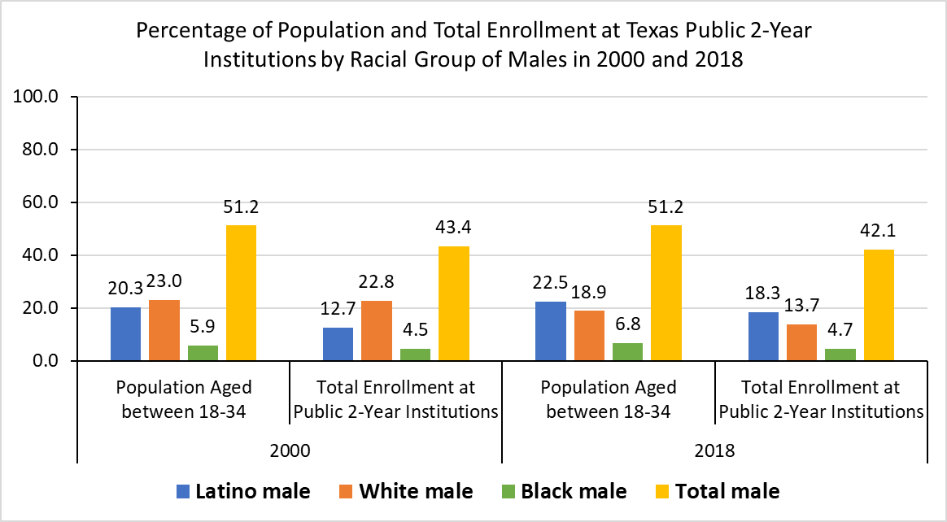
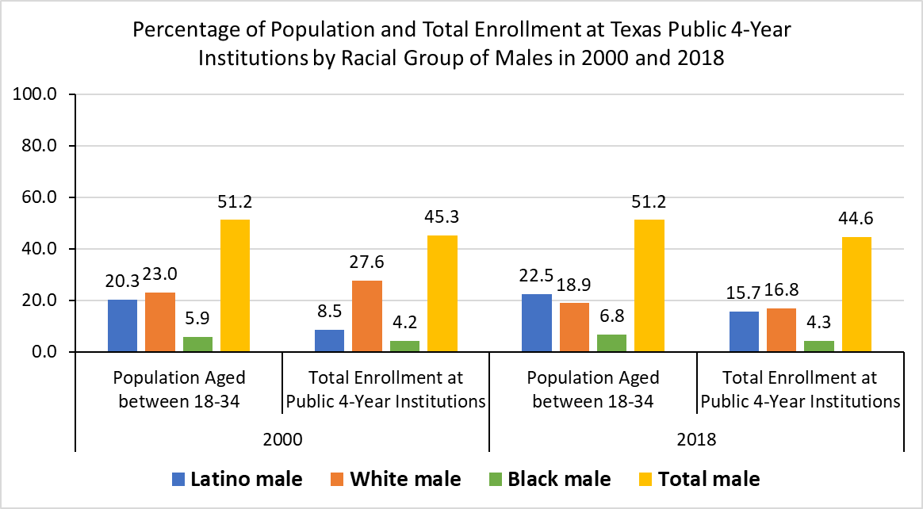
Composition: Texas Population and Total Enrollment at Texas Public 2-Year and 4-Year Institutions by Racial Group of Males (2000-2018)

Slide 8
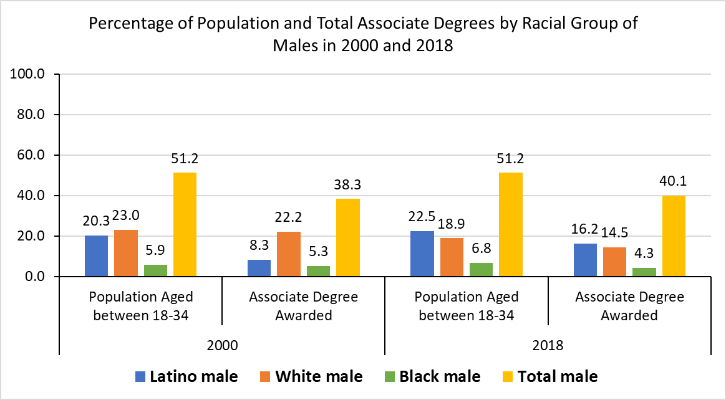
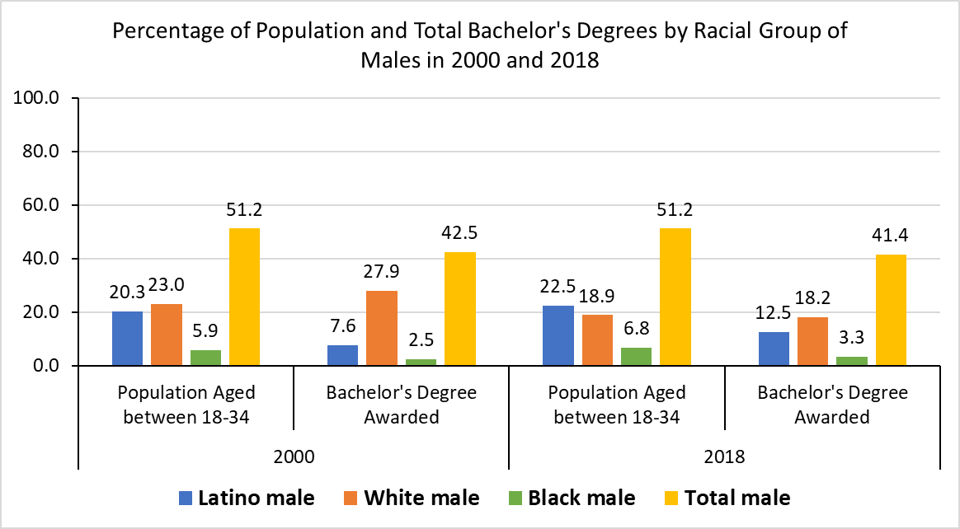
Composition: Texas Population and Conferred Associate Degree and Bachelor’s Degree by Racial Group of Males (2000-2018)

Slide 9
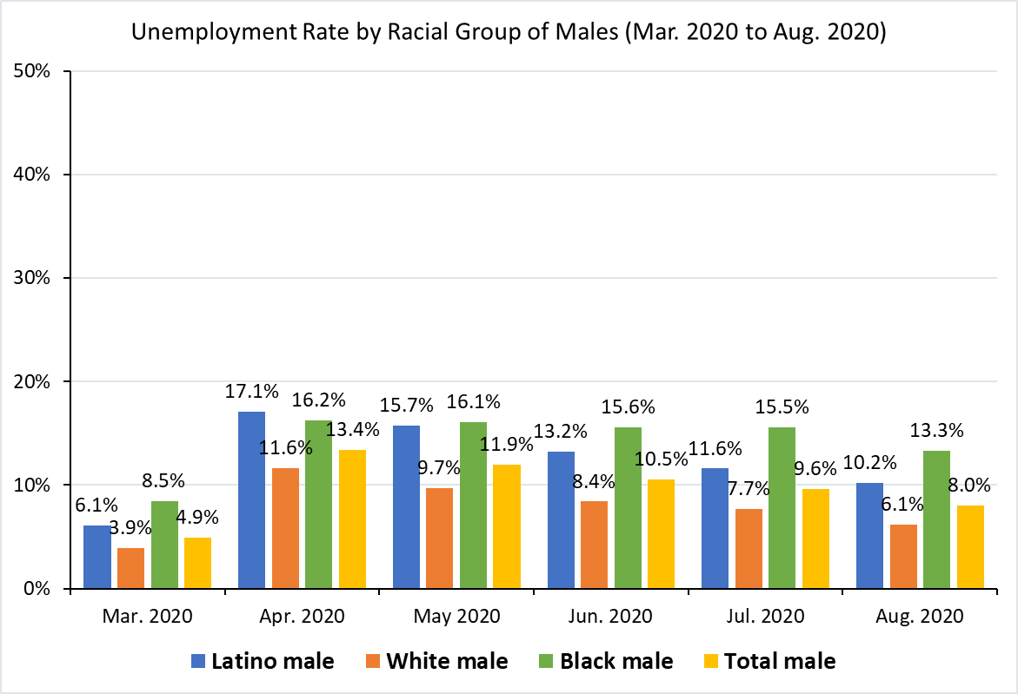
Texas Unemployment Rate by Racial Group of Males: People in the Labor Force with Age 16 or Higher (Mar. 2020-Aug. 2020)

Slide 10
Policy Implications
Upcoming 87th Legislative Session: Imperative to be aware about where these data trends are being magnified.
Statewide Investment: Workforce training and retooling to be more adept to new market norms (e.g., healthcare professionals demand)
Long-term Future: Leveraging future generations of Latino boys and young men to our advantage instead of our detriment

Slide 11
Questions?

