Slide 1
Effects of House Bill 3 on Young English Learners
Chloe Latham Sikes, Ph.D., Deputy Director of Policy
Ana Ramón, Deputy Director of Advocacy
Presented at the Texas Latino Policy Symposium III​
October 1, 2020

Slide 2
Who are our young English Learner students in Texas?
1.1 million (over 20%) Texas public school students
83% of ELs are Latino/a
89% speak Spanish home language
36% increase since 2009-10
Over 1 in 4 pre-K through 3rd graders is an English Learner
Notes:
Sources: Park, M., O’Toole, A., and Katsiaficas, C. (2017). Texas Fact Sheet, Dual Language Learners: A National Demographic Policy Profile. Migration Policy Institute, https://www.migrationpolicy.org/research/dual-language-learners-national-demographic-and-policy-profile; PEIMS Standard Reports. (2019). EL Students by Home Language and Grade. Texas Education Agency.

Slide 3
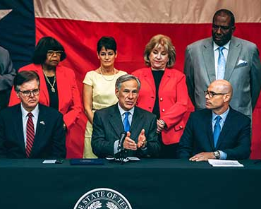
What is House Bill 3 (2019)?
School finance bill
2019 Texas legislative session (86th Legislature)
Invested $6.5 Billion in schools
Mandated full-day Pre-K
Increased per-pupil funding for specific student populations
Photo source: https://tea.texas.gov/about-tea/government-relations-and-legal/government-relations/house-bill-3

Slide 4
What did HB 3 do for young English Learners?
Pre-House Bill 3
House Bill 3
ELs = 10% more per-pupil funding
Pre-K offered half or full-day
No state formula funding for pre-K, grants or up to district
Dual Language Allotment: 5% more for ELs AND non-ELs in DL programs
Early Education Allotment: 10% more for ELs and low-income students in K-3
Full-Day Pre-K expansion

Slide 5
BUT….just over 20% of ELs are in these programs.
Source: Craven, 2019. IDRA.

Slide 6
IDRA Recommendations
Prioritize
Prioritize safe learning environments for underserved groups: Young children, English learners, and students with special needs
Sustain
Sustain education funding by using the Rainy Day Fund (Economic Stabilization Fund) of $8.8 Billion
Protect
Protect student-based funding amounts and allowable spending, particularly for students in early grades and vulnerable student populations such as English learners.
Encourage
Encourage the federal government to approve and issue additional stimulus funds directed to sustaining education and social services funding and supplementing funds to address specific COVID-19 expenses.

Slide 7
Questions?
Chloe Latham Sikes, Ph.D.
Deputy Director of Policy
Chloe.Sikes@idra.org, @csikesrun
Ana Ramón
Deputy Director of Advocacy
Ana.Ramon@idra.org, @Ana122

Slide 8
Intercultural Development Research Association
Celina Moreno, J.D., M.P.P., President & CEO
5815 Callaghan Road, Suite 101
San Antonio, Texas 78228
210-444-1710 • contact@idra.org
www.idra.org
www.facebook.com/IDRAed
Subscribe to our email newsletter:
https://idra.news/Subscribe
Text to join our email list!
Text JOINIDRAEMAIL
To 22828 to get started
Achieving equal educational opportunity for every child through strong public schools
that prepare all students to access and succeed in college

