Slide 1
Latino Household Experiences during the covid-19 pandemic
Uriel Lomelí Carrillo

Slide 2
Measuring Latino health experience during the COVID-19 pandemic
Household Pulse Survey (HPS)
Phase 1-HPS asked individuals about their experiences
Employment status
Food security
Housing
Physical and mental health
Access to health care
Educational disruption
Weeks April 23 – May 5/July 16 – July 21

Slide 3
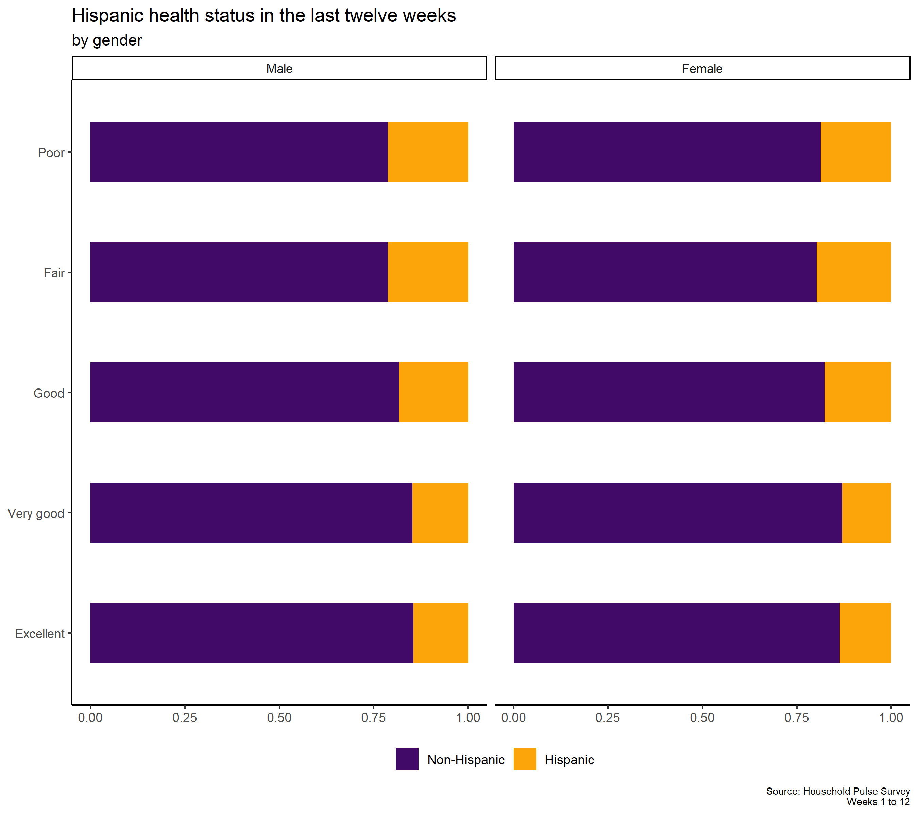
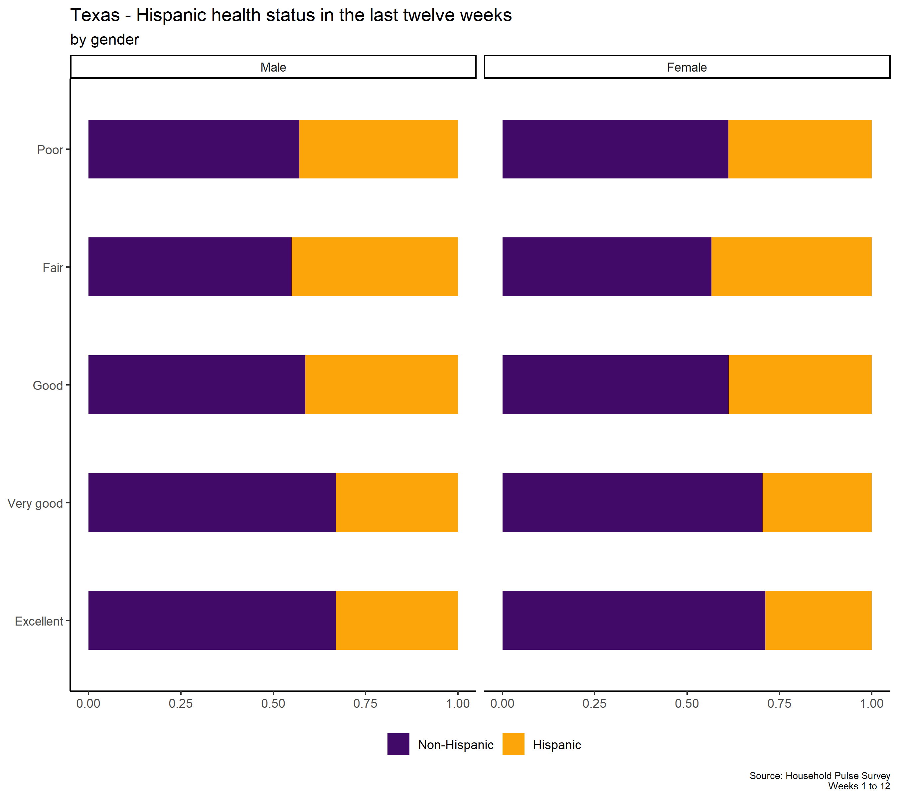
In the US, 50% of Latino households and 59% of the non-Hispanic households reported Excelent/Very Good health.
In Texas, 45% of Latino households and 57% of the non-Hispanic households reported Excelent/Very Good health.

Slide 4
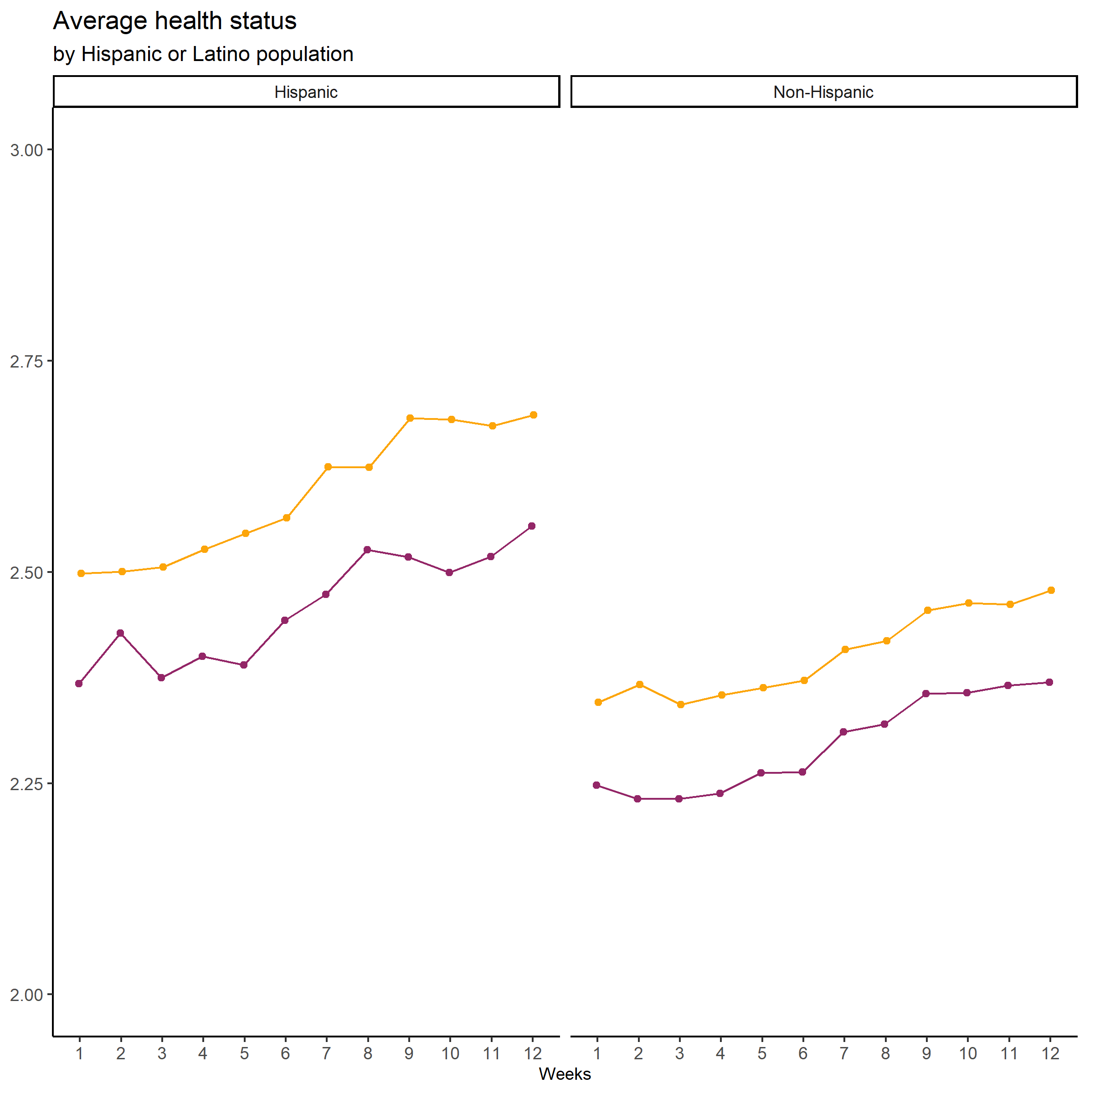
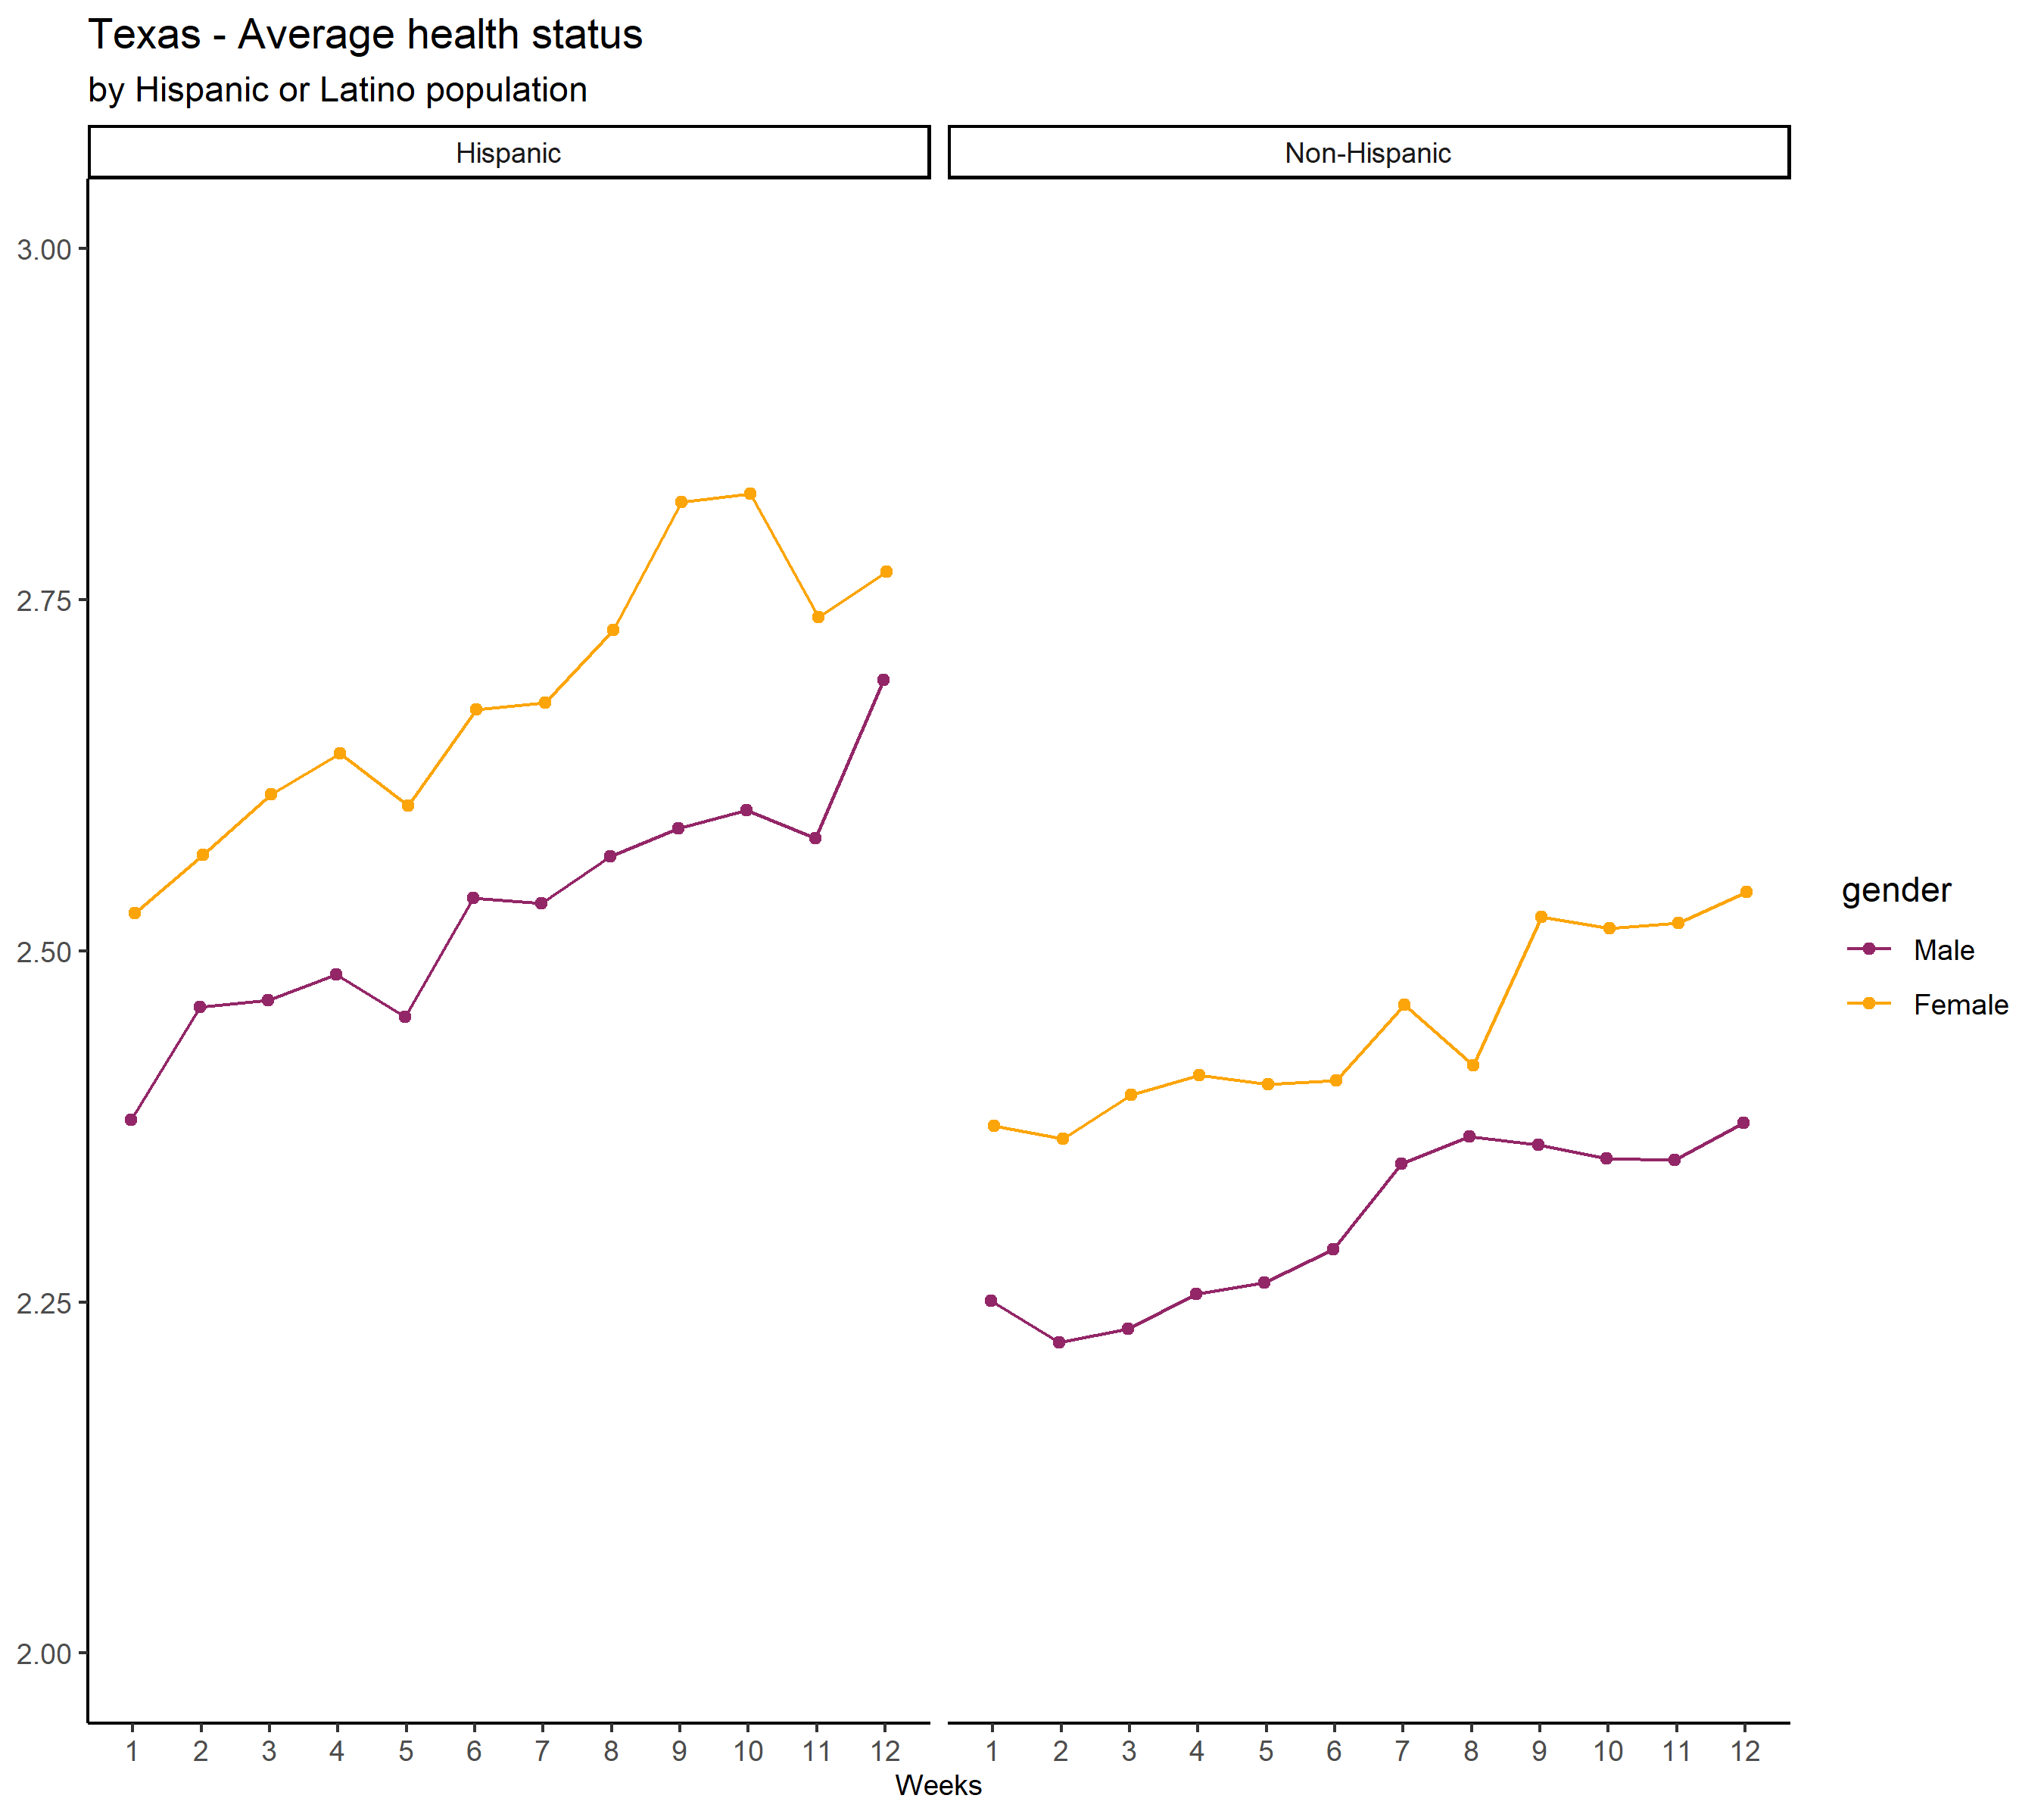
On average, worse health

Slide 5
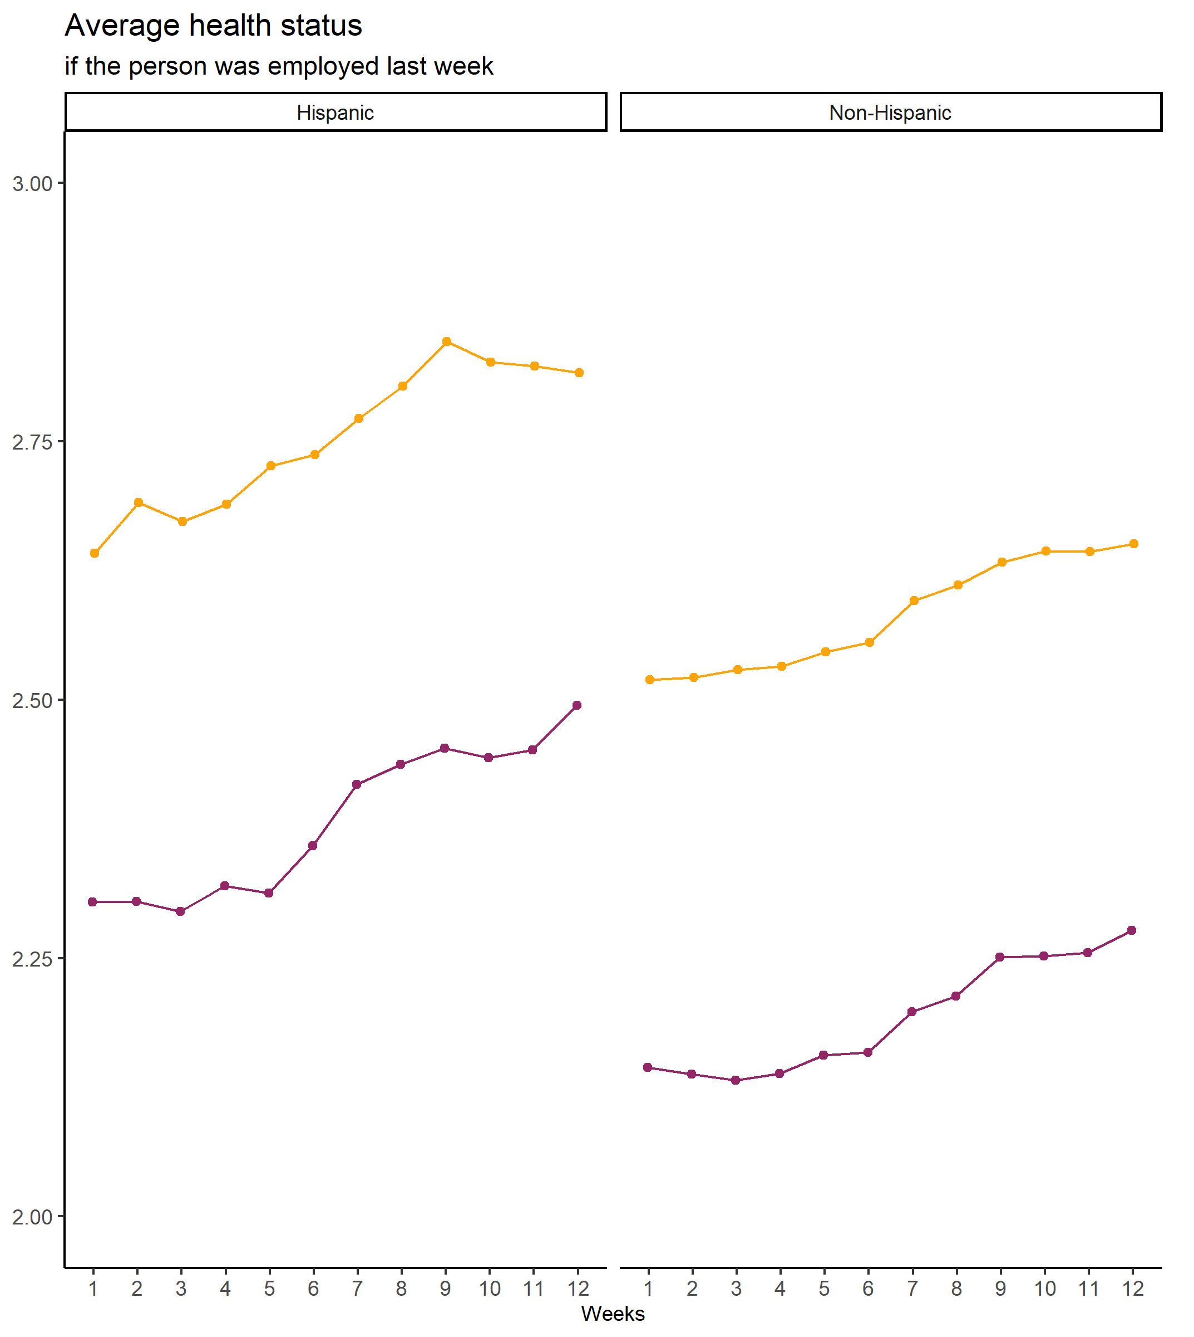
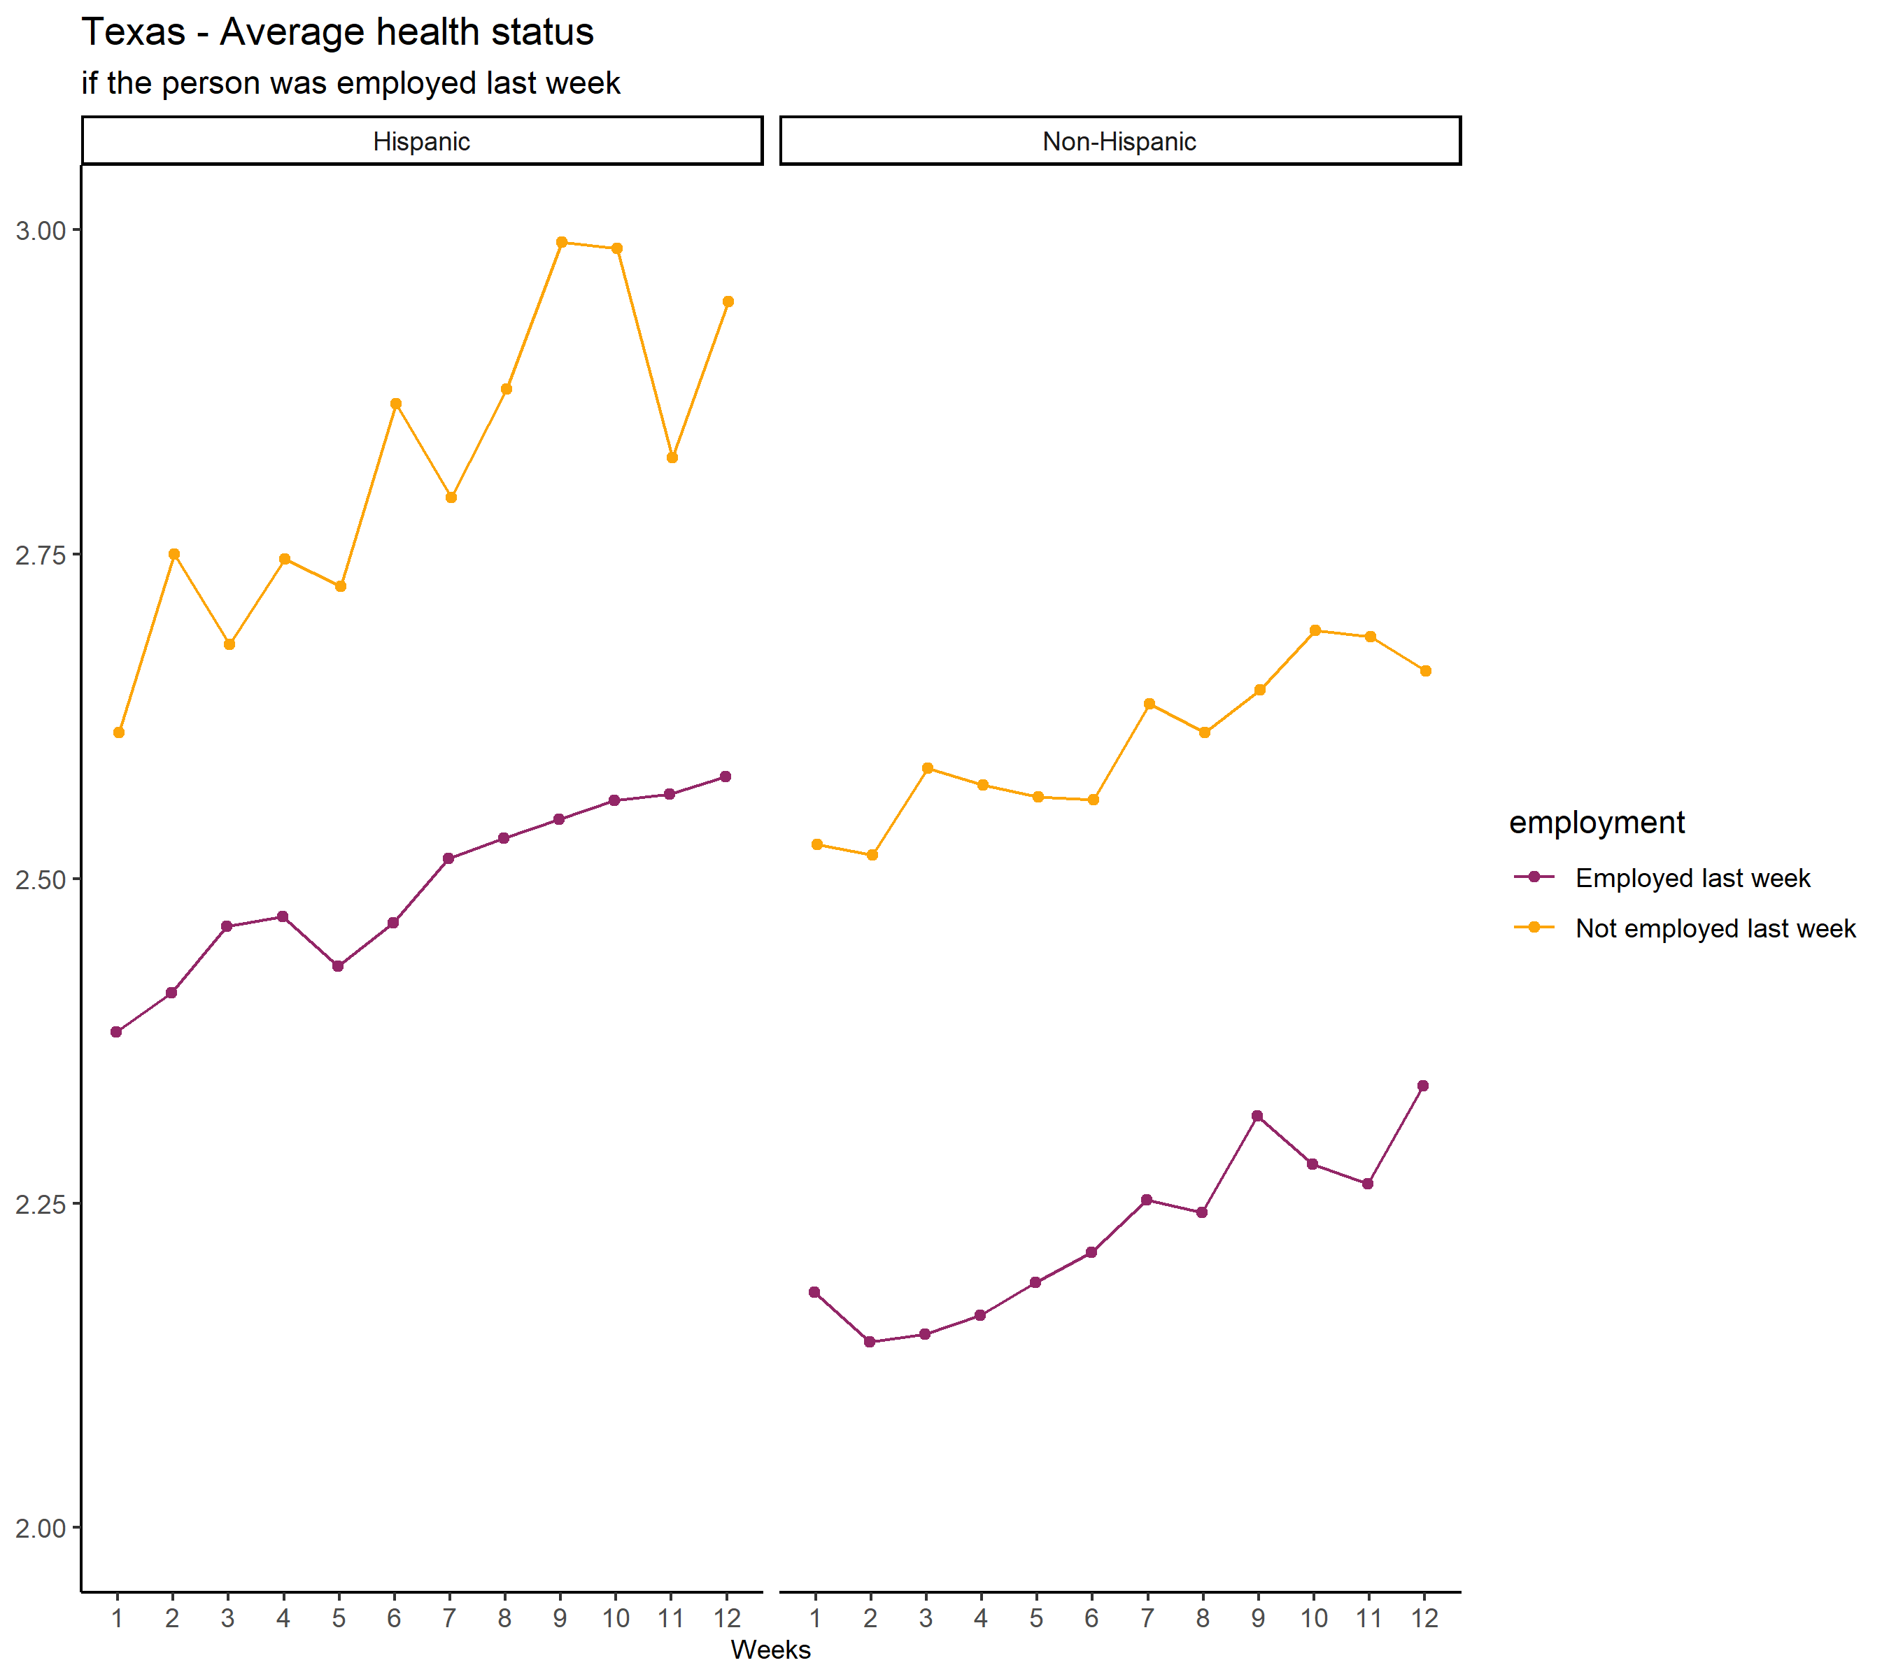

Slide 6
Health index and health status
Health index
Health in general - Excellent(1) to Poor (5)
Feeling nervous, anxious, or on edge
Not being able to stop or control worrying
Having little interest or pleasure in doing things
Feeling down, depressed, or hopeless

Slide 7
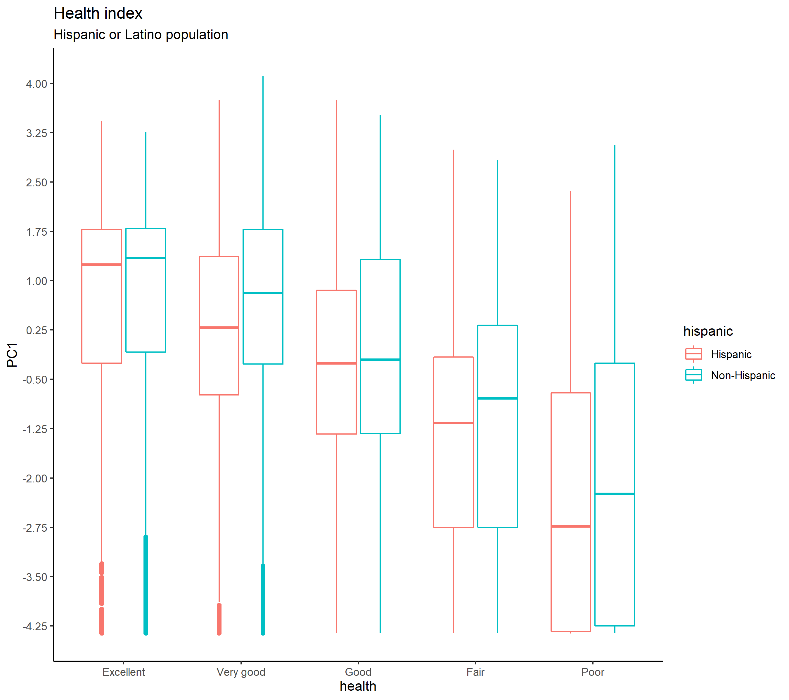
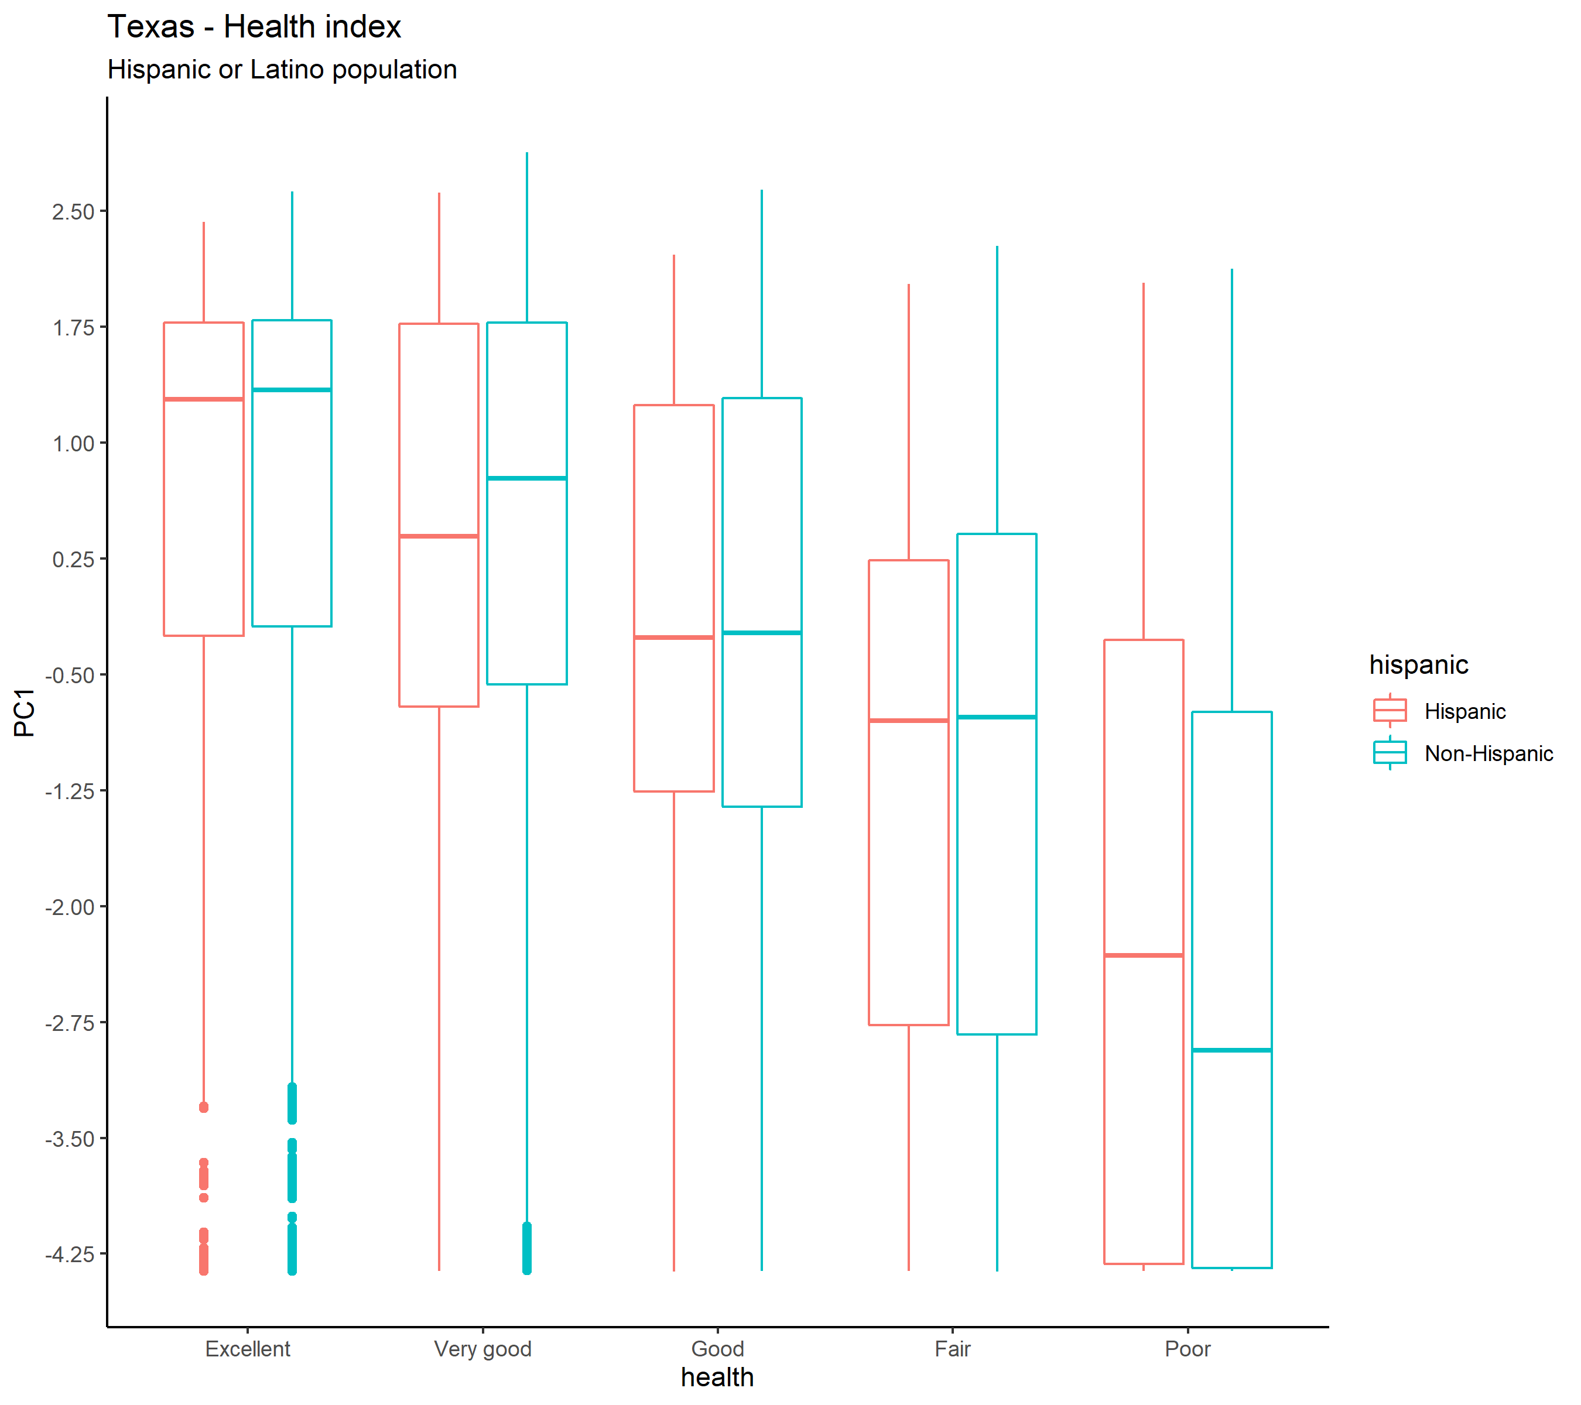

Slide 8
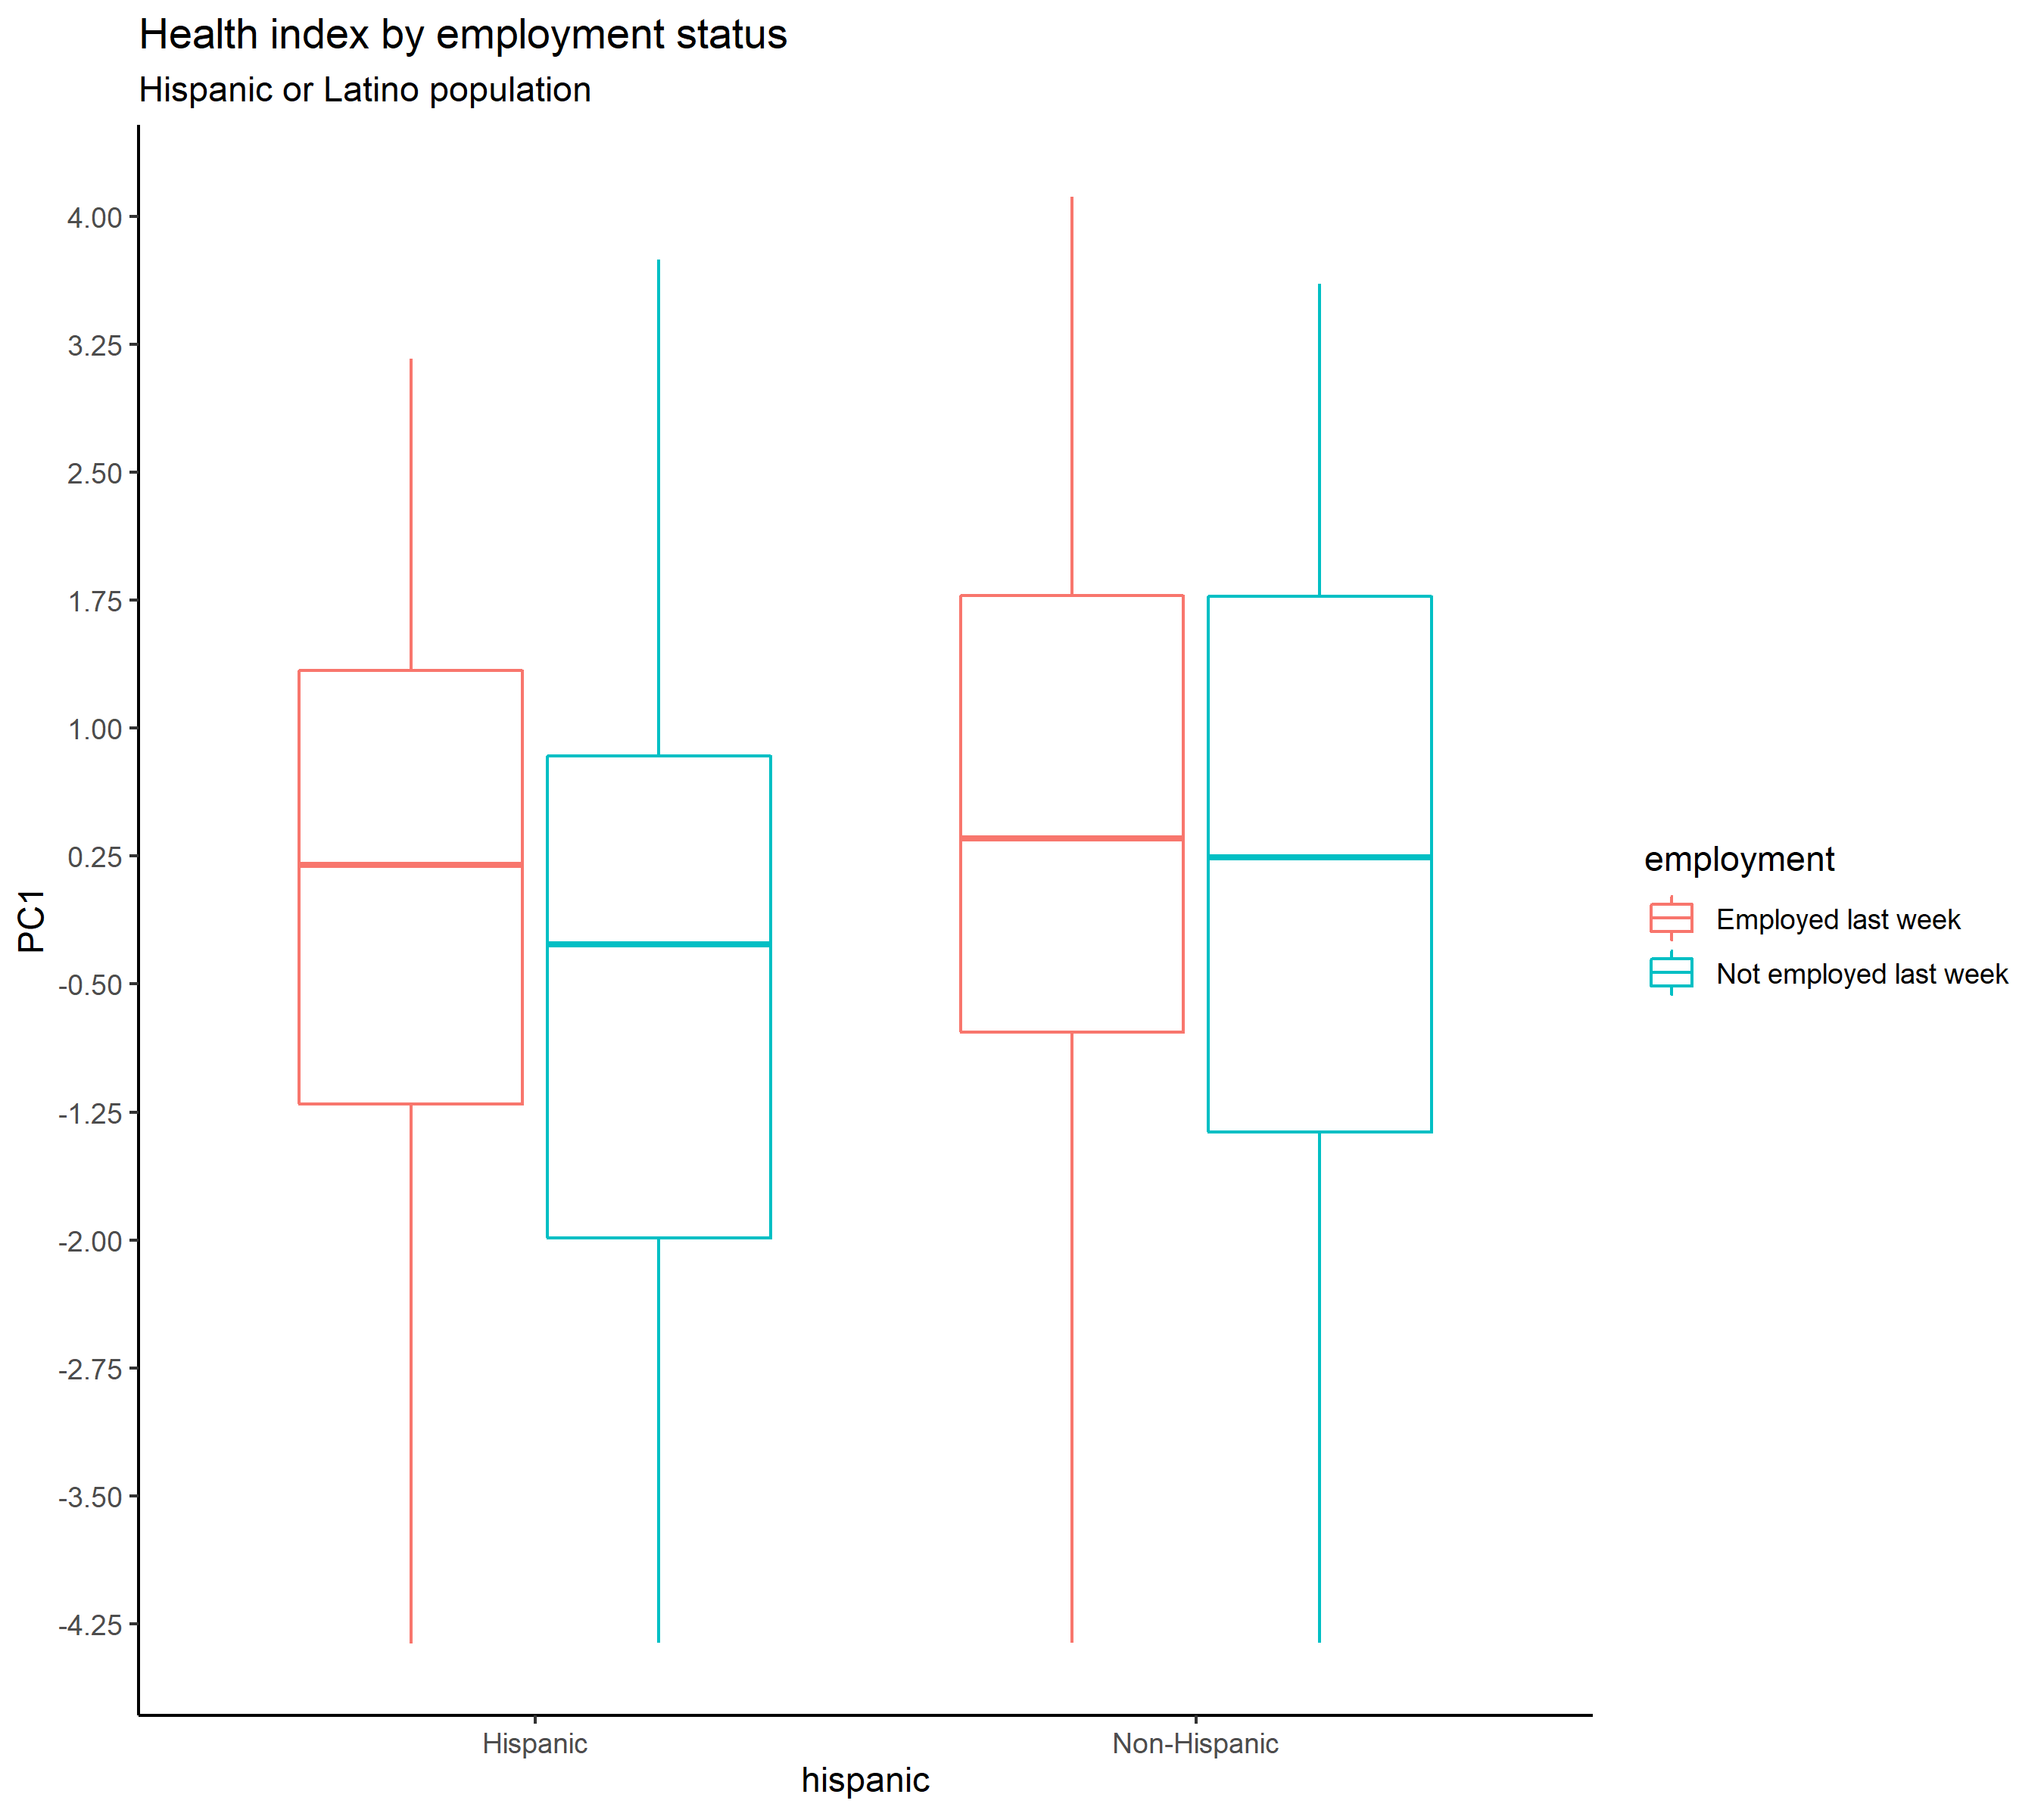
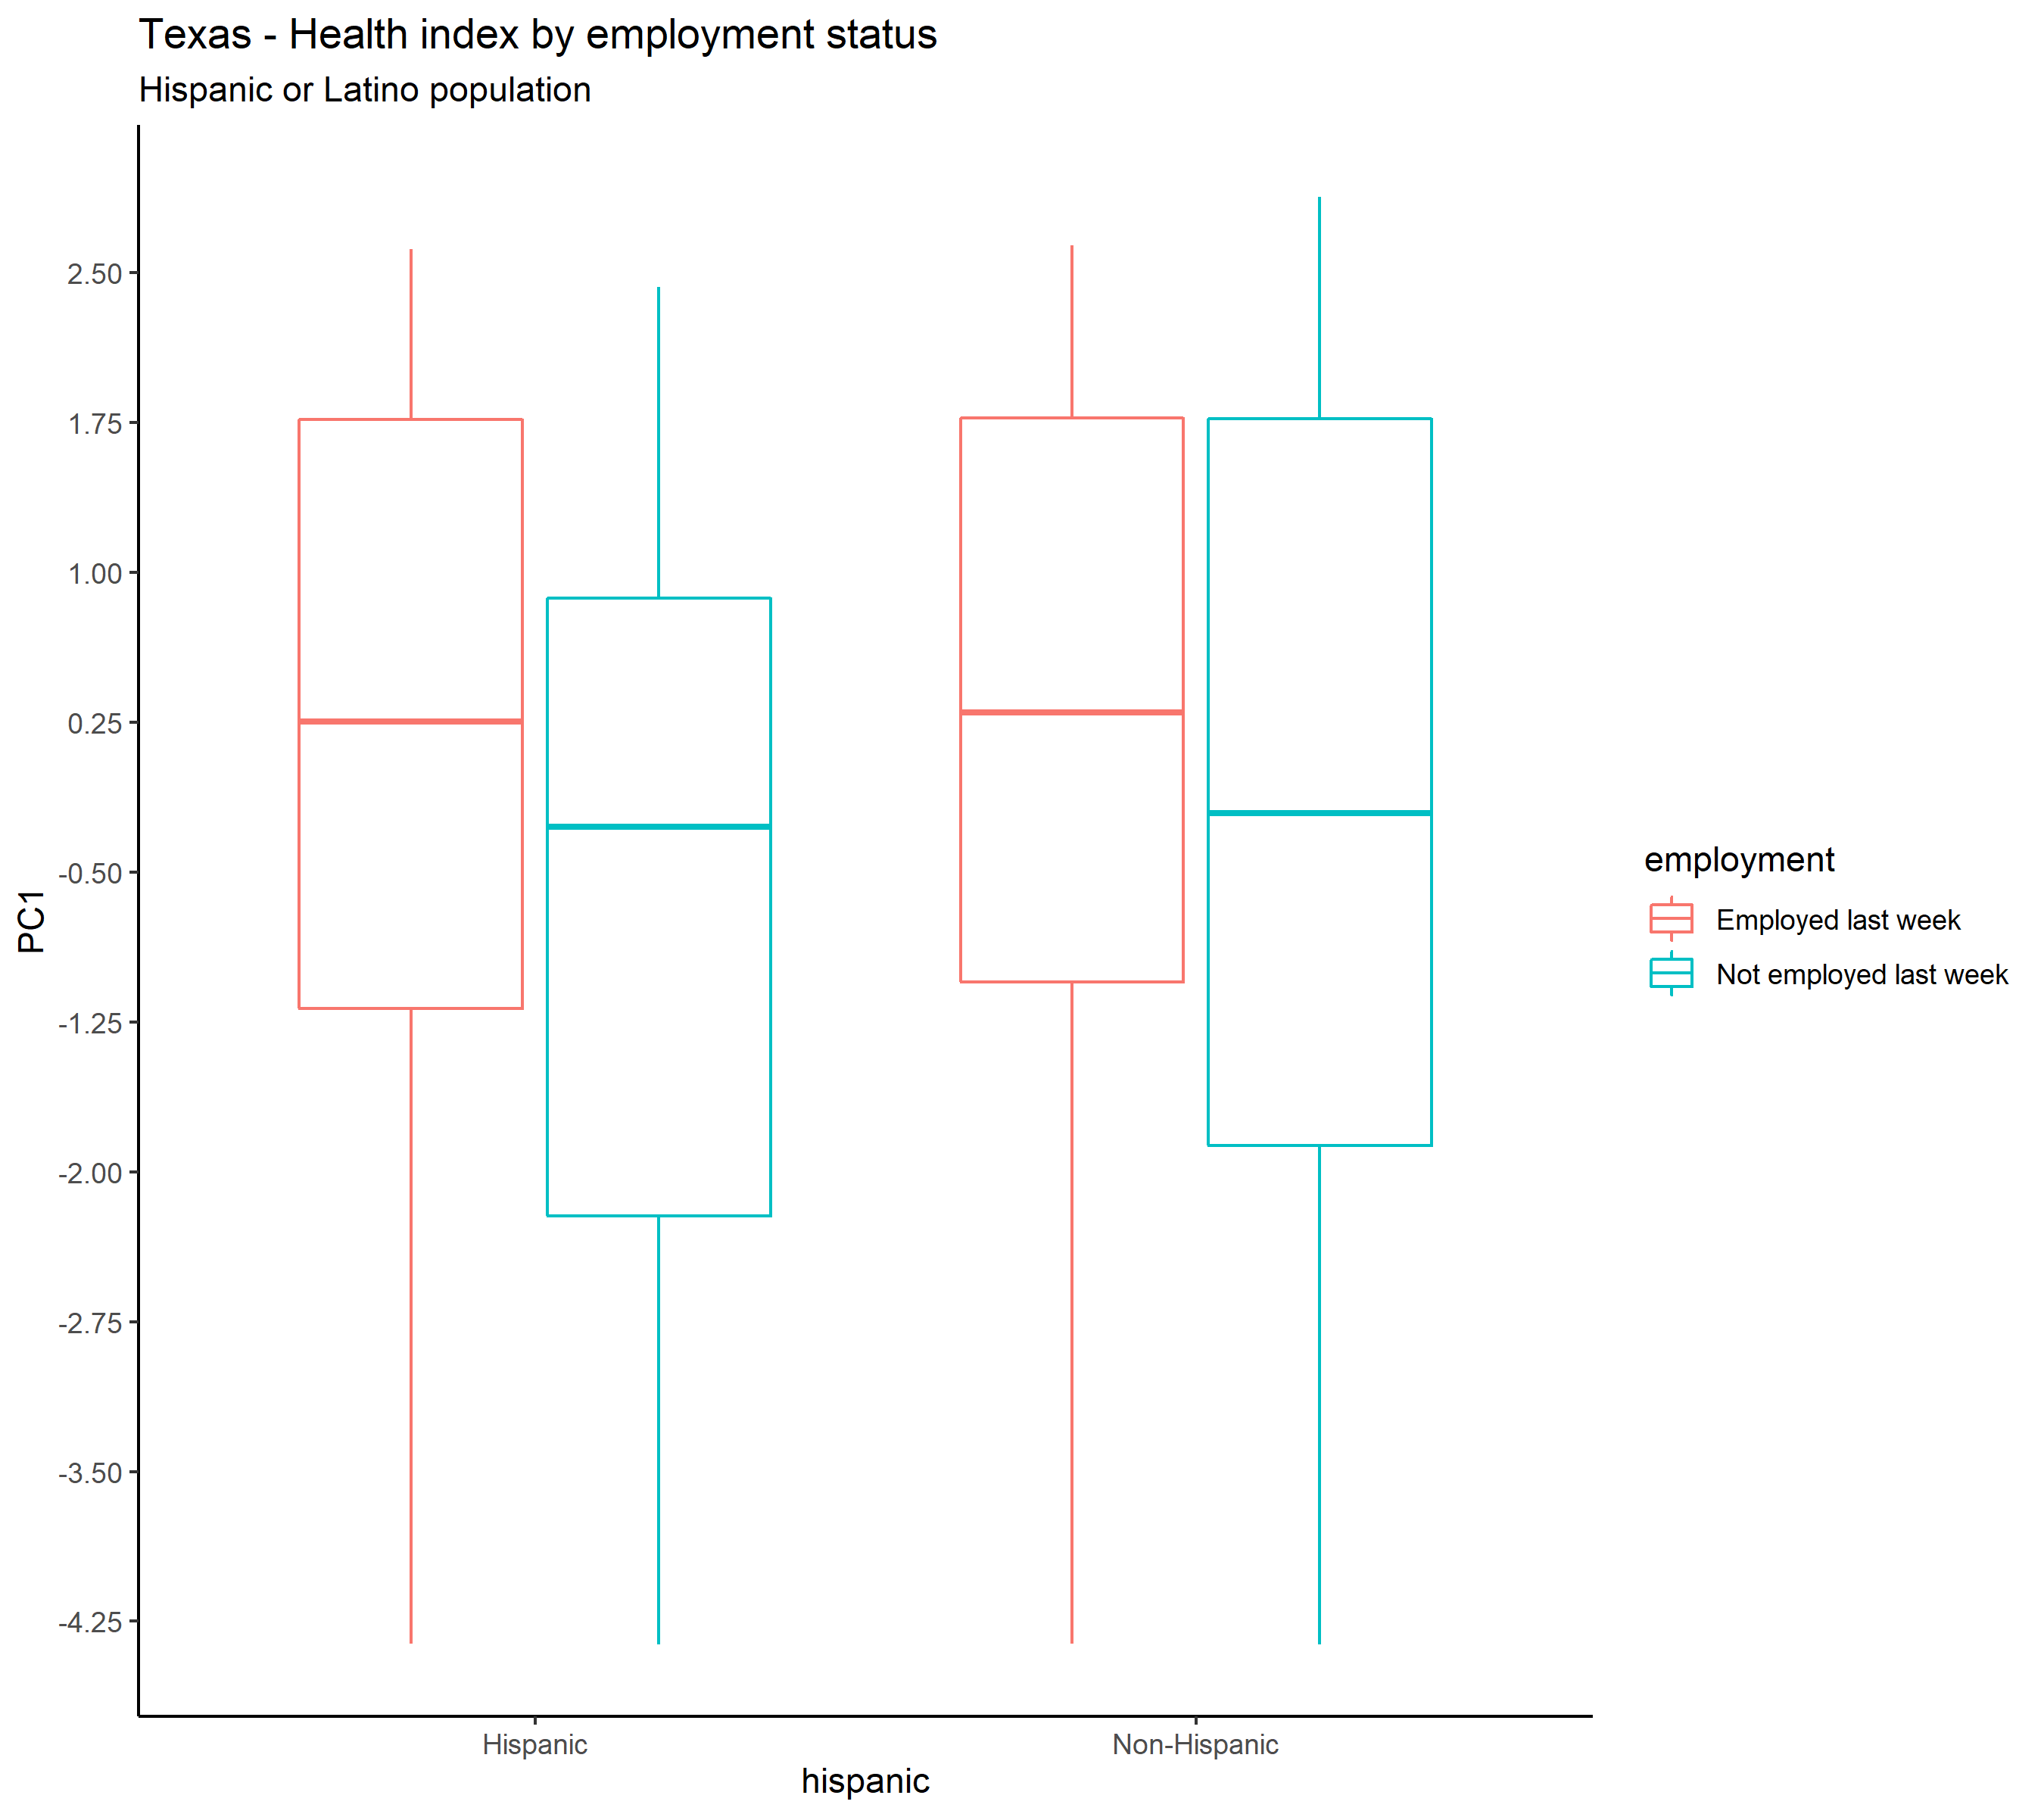

Slide 9
Final considerations
Studying how the covid-19 pandemic is impacting households in the US differently, from a social and economic perspective will help federal and state officials direct aid, assistance, and support
Providing timely data to help understand the experiences of Latino households during this pandemic is useful but there are gaps of information
Misrepresentation or underrepresentation in large data sets can amount to invisibility, perpetuating or even amplifying social, economic, and political disparities

Slide 10
¡Gracias!
uriel.lomeli@gmail.com
@ulomelic

