Slide 1
Latinx achievement and achievement growth during elementary and middle school in Texas from 2008 - 2015
Pat Rubio Goldsmith*, Peggy Carris, Emmber Garcia, and Mary Jalufka

Slide 2
Purpose
Identify
Determine
Prioritize
where Latinx students are high and low achieving
where resources and opportunities should be focused
the needs of Latinx students across Texas

Slide 3
Data
Stanford Education Data Archive
  Achievement scores and gaps 3rd – 8th grade
American Community Survey
  Population characteristics
Common Core of Data
  District characteristics
Department of Texas Health & Human Services
  COVID-19 case reporting

Slide 4
Findings

Slide 5
Latinx Achievement

Slide 6
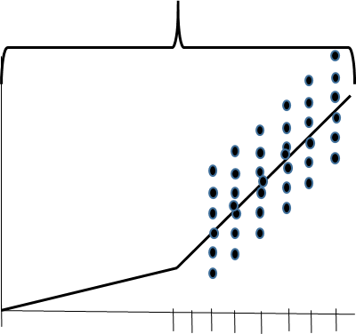
How Districts’ Achievement is measured
Covers Opportunities
to learn over ages birth through 8th grade
District’s average achievement over all grades and years
Average achievement in one grade in one year
Birth grade: 1 5 8

Slide 7
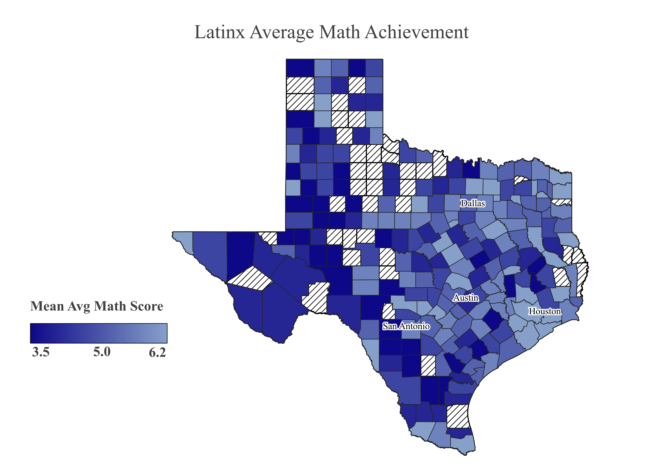

Slide 8
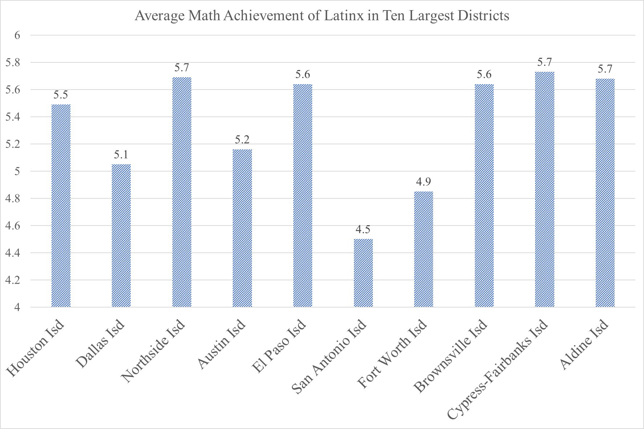
Slide Heading
Content Styling

Slide 9
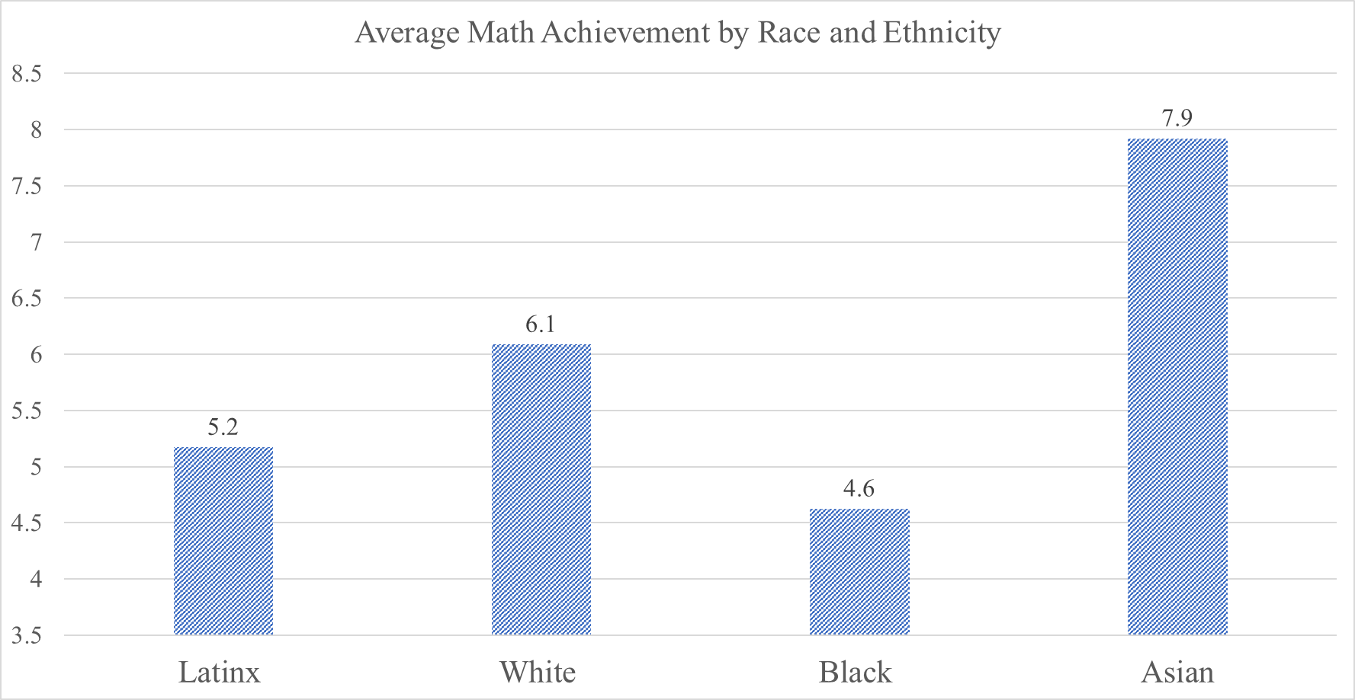
Slide Heading
Content Styling

Slide 10
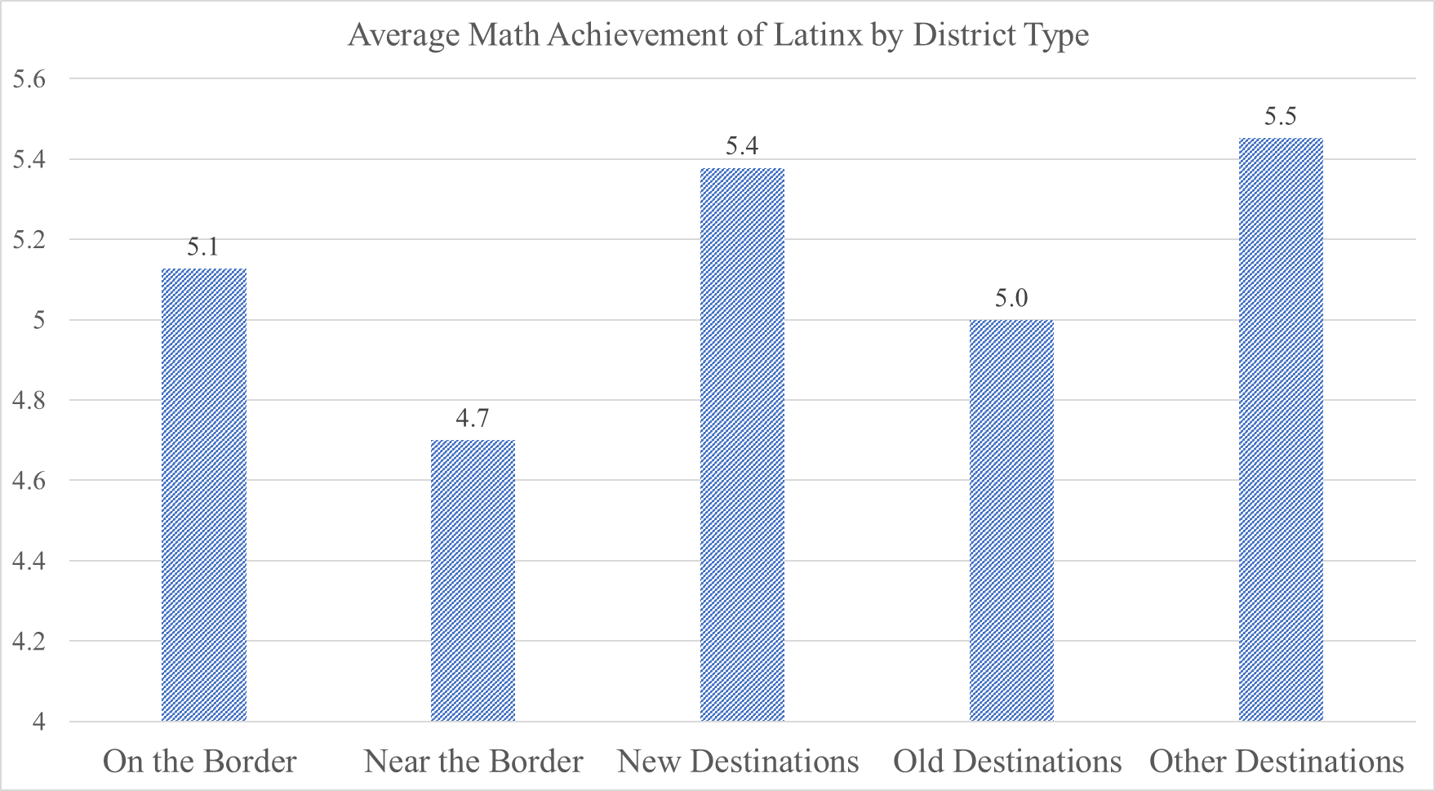
Slide Heading
Content Styling

Slide 11
Latinx Gains

Slide 12
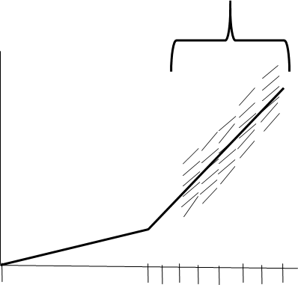
How Districts’ Annual Gains are measured
Covers ages 3rd through 8th grade
District’s average annual gain (slope) over all cohorts and years
Average gain (slope) for all cohorts in one year
Birth grade: 1 5 8

Slide 13
* Latinx Gains from Emmber
Content Styling

Slide 16
COVID-19

Slide 17
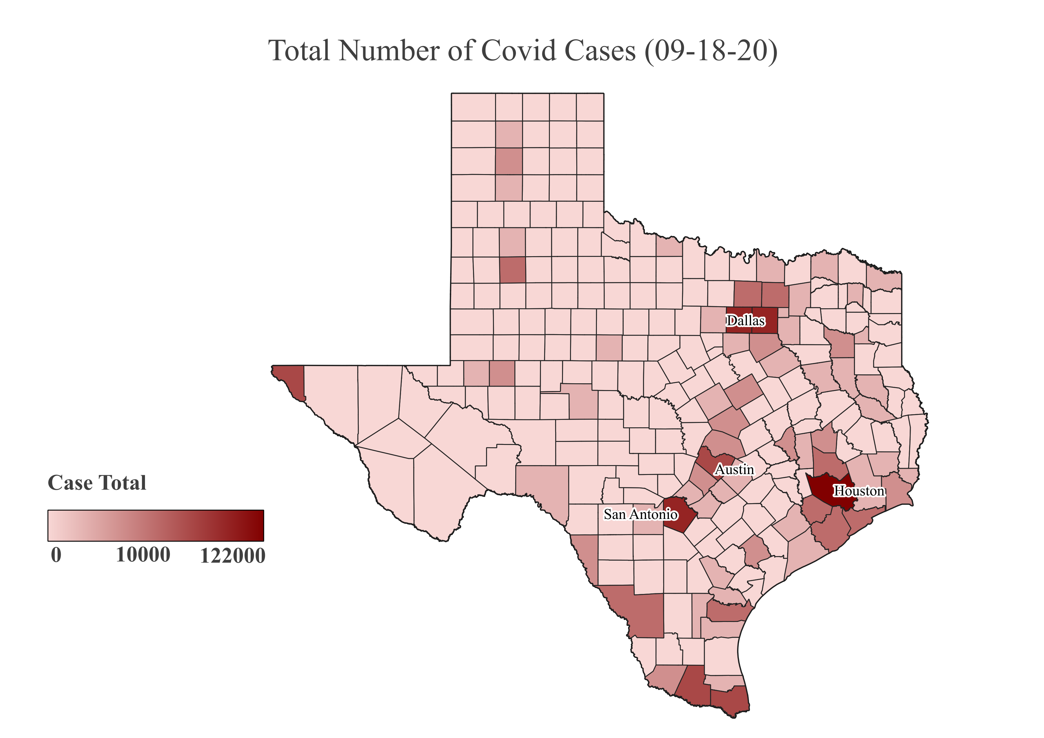

Slide 18
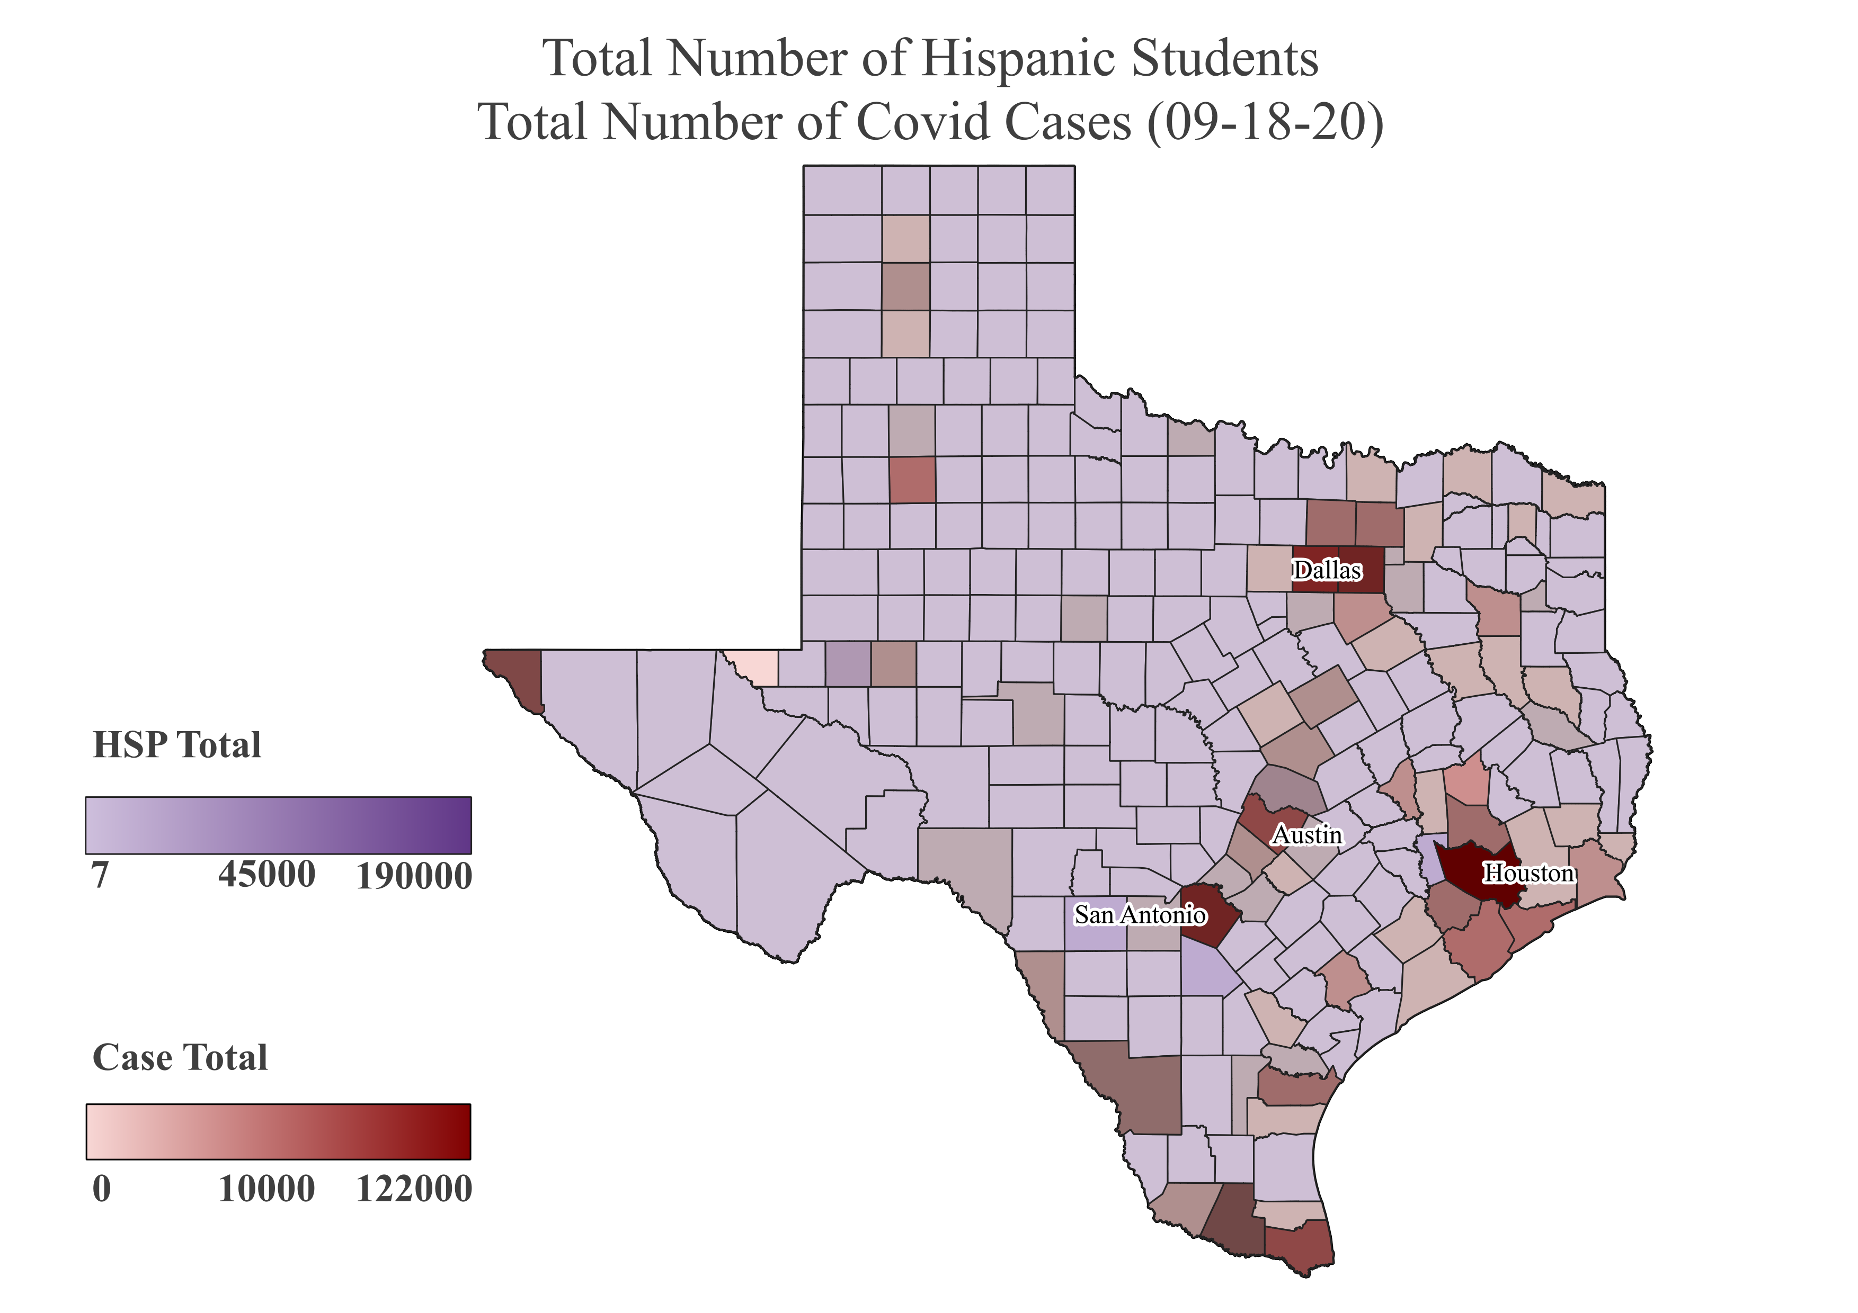

Slide 19
SAISD Pre-K During COVID Family Agreement, 2020
San Antonio ISD, Texas Education Agency
- Is this culturally relevant for Latinos?

Slide 20
Conclusions

Slide 21
Pre-K Policy Timeline
1985
Half-day Pre-K for eligible 4-year old’s
2015
Funds High-Quality Pre-K grants
2017
$15M cut from state Pre-K budget, end high-quality funding. Now, districts must use 15% of state Foundational School Program funds for high-quality.
2019
Full-day high-quality Pre-K for eligible 4-year old’s
Pre-school Development Grant program (PDG 0-5)

Slide 22
Who is eligible for free public prekindergarten in Texas?
The child must be three or four years old on or before Sep. 1st of the current school year and meet at least one of the following eligibility requirements:
Is unable to speak and comprehend English
Is educationally disadvantaged (meaning they are eligible for free or reduced lunch)
Is homeless
Is the child of a member of the armed forces of the United States who was injured or killed while serving on active duty
Is or has ever been in foster care
Is the child of a person eligible for the Star of Texas Award as a peace officer, firefighter, or emergency medical personnel

Slide 23

Pre-K quality standards checklist
Early learning and development standards that are comprehensive, aligned, and culturally sensitive
Curriculum supports with an approval process
Teacher minimum degree requirement
Teacher specialized training
Assistant teacher minimum degree requirement
Staff professional development
Maximum class size 20 or lower
Staff-child ratio 1:10 or better
Vision, hearing, and health screenings
Continuous quality improvement system

Slide 24
Percent of Texas Population enrolled in Public Pre-K
National Institute for Early Education Research, 2019

Slide 25
Texas Pre-K spending per child
National Institute for Early Education Research, 2019

Slide 26
Thank you!

Slide 27
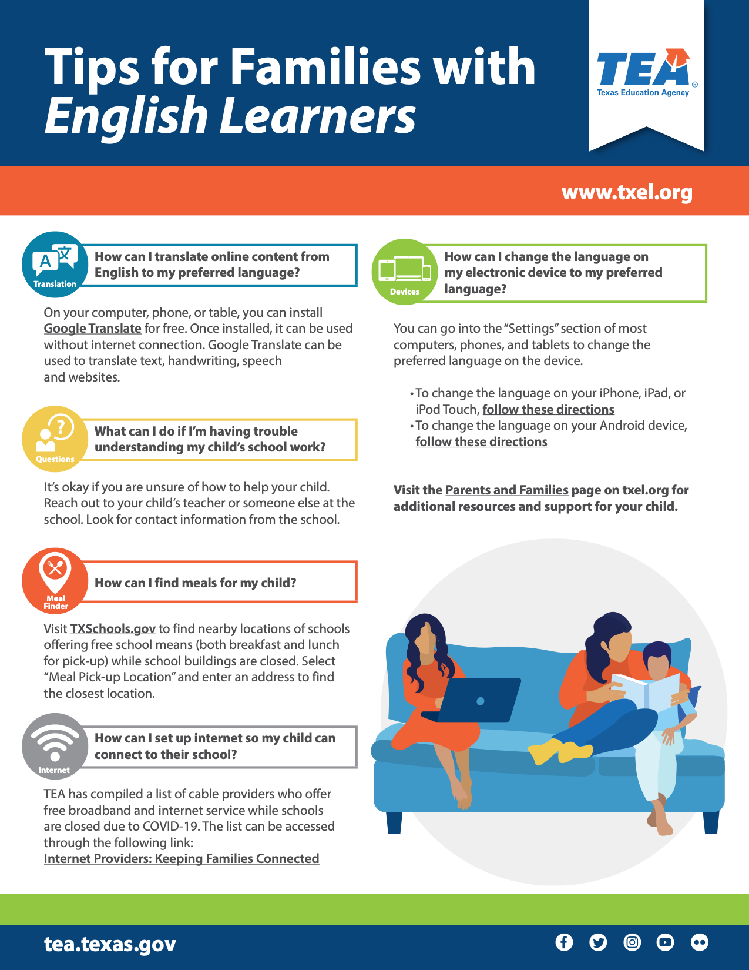
Tips for Families with English Learners, 2020
Texas Education Agency
- Is this culturally relevant for Latinos?

Slide 28
Tips for Parents of English Language Learners, 2020
TELPAS, Texas Education Agency
- Is this culturally relevant for Latinos?

Slide 29
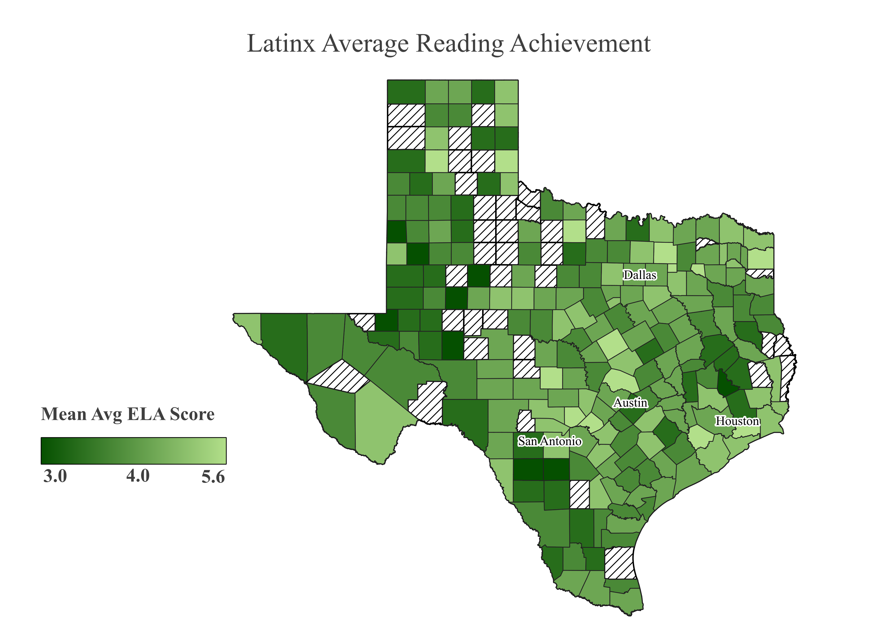

Slide 30
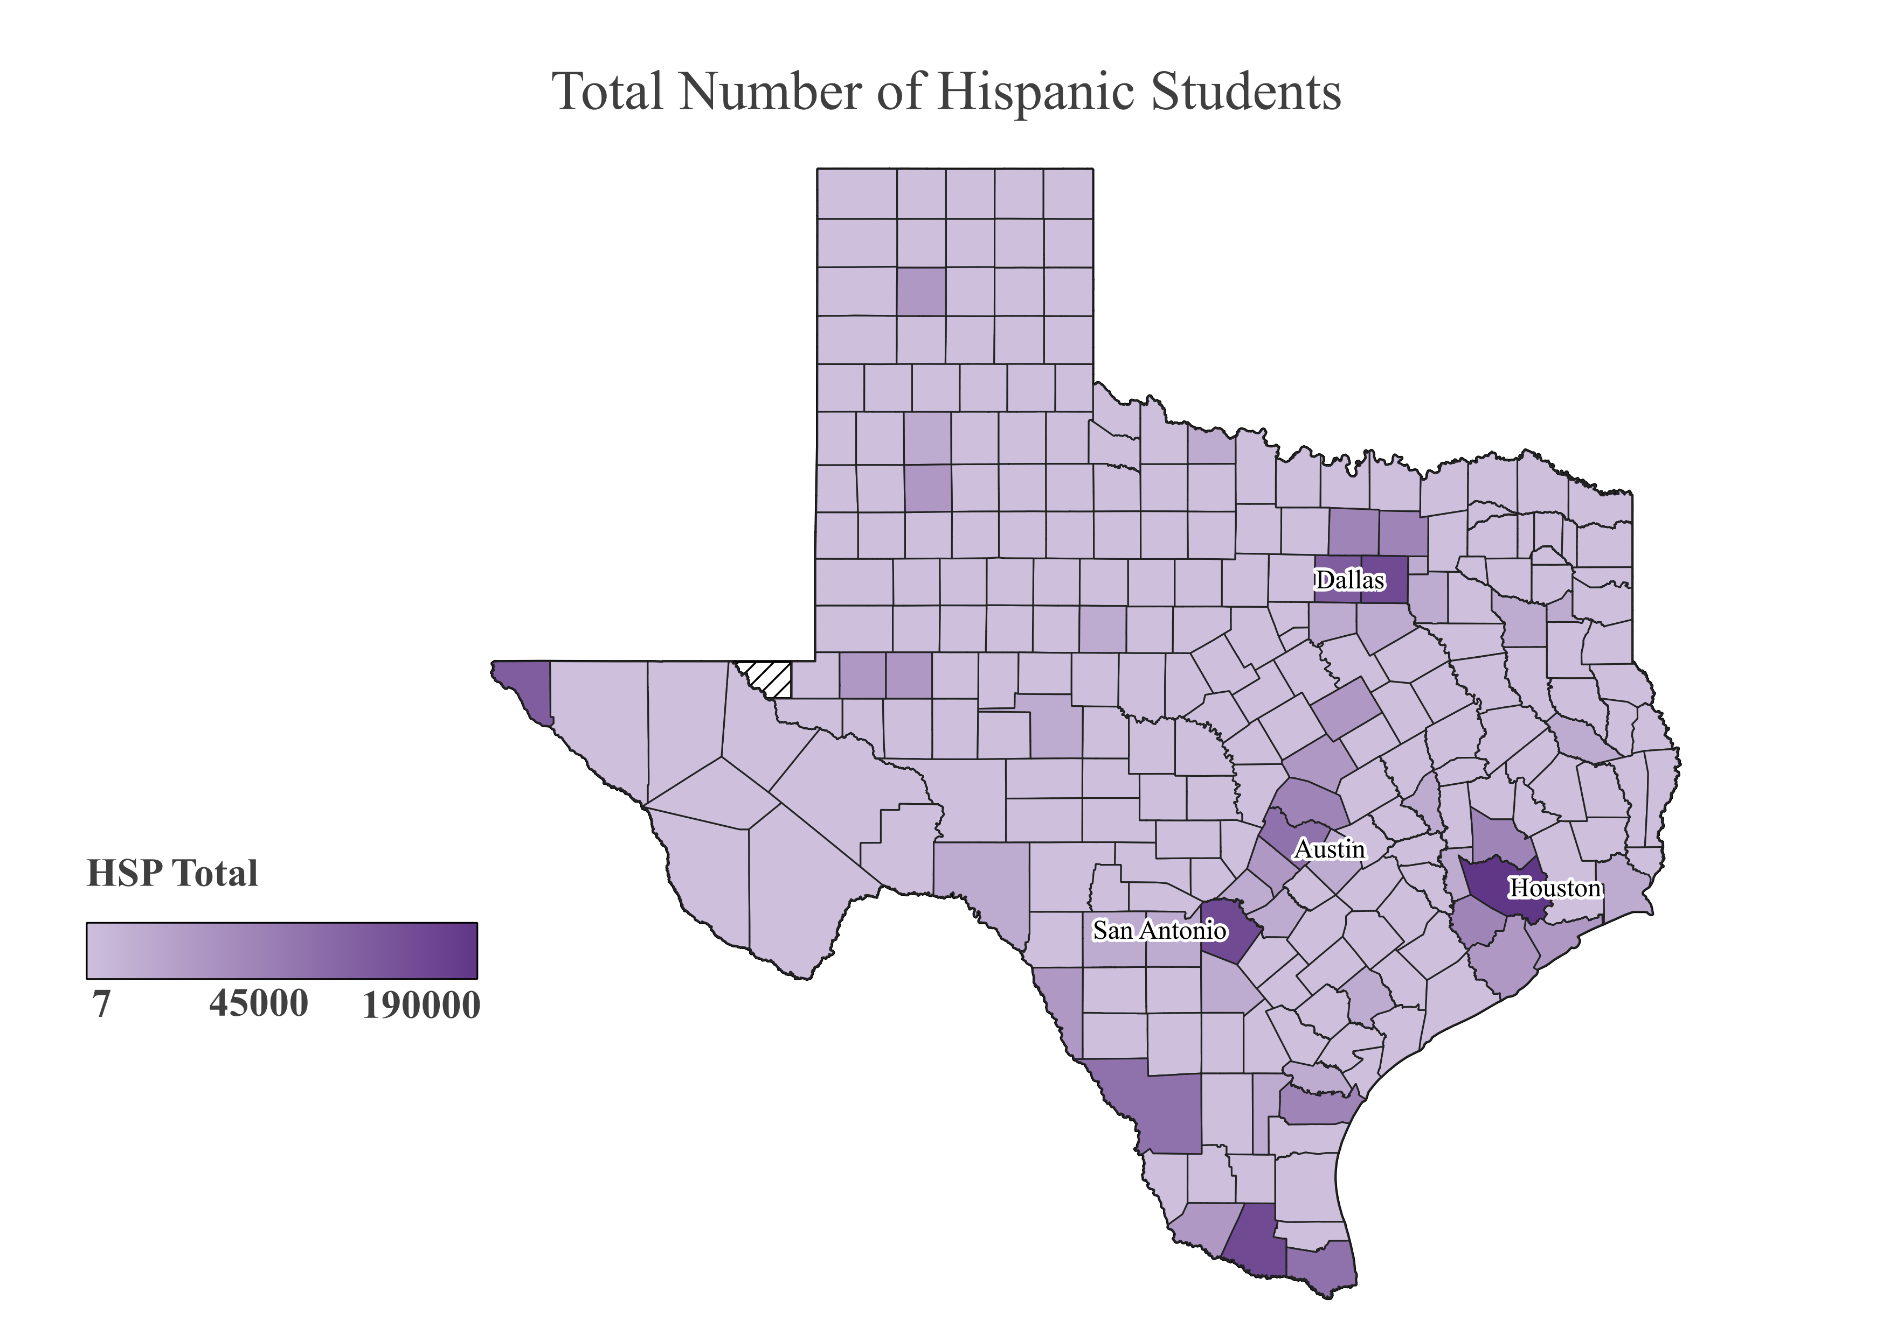

Slide 31
Average Reading Growth of Latinx in Texas Largest Districts
School District | Reading Growth
Houston ISD | 0.87
Dallas ISD | 0.91
Northside ISD | 1.02
Austin ISD | 0.93
El Paso ISD | 0.85
San Antonio ISD | 0.96
Fort Worth ISD | 0.98
Brownsville ISD | 0.90
Cypress-Fairbanks ISD | 1.12
Aldine ISD | 0.83

Slide 32
Reading Growth Based on Border Proximity and Latinx Population
Variable | Mean | Std. Dev.
On the Border | 0.94 | 0.13
Near the Border | 1.02 | 0.07
New Destinations | 1.02 | 0.11
Old Destinations | 0.99 | 0.12
Other Destinations | 1.02 | 0.11

Slide 33
Reading Growth by Race
Variables | Mean | Std. Dev.
Latinx | 1.00 | 0.12
White | 0.97 | 0.10
Black | 0.98 | 0.10
Asian | 1.07 | 0.14

