Slide 1
The State of Housing in Houston and Harris County & the Latinx population
Julia Orduña
Texas Housers

Slide 2
Wonderful publications used for this presentation

Slide 3
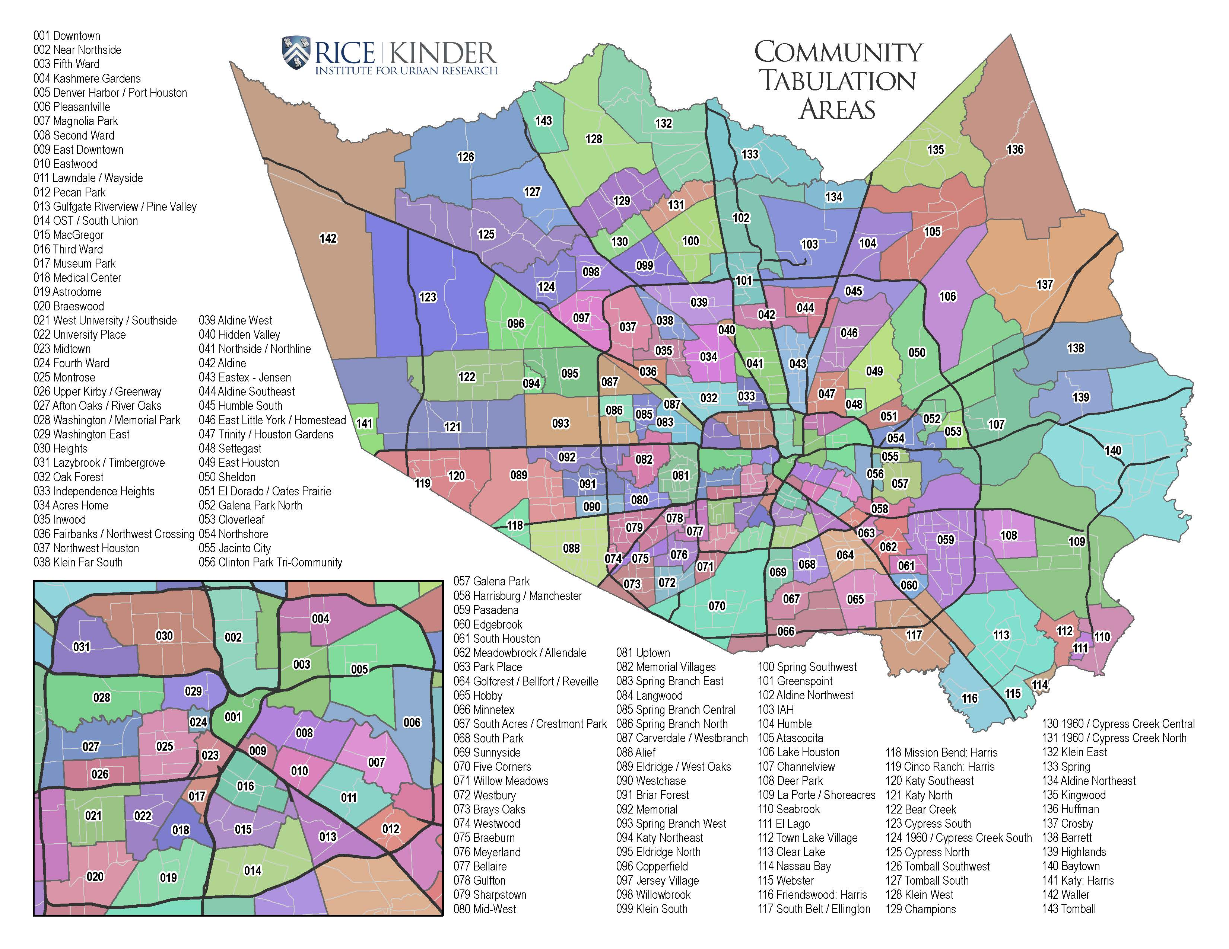
The State of Housing in Houston & Harris County
Harris County
3rd largest county in USA
1,777 sq miles / 4,600 km²
Census 2010: 4,092,459
Est Pop 2019: 4,713, 325
City of Houston
671 sq miles / 1,740 km²
Census 2010: 2,100,263
Est Pop 2019: 2,320,268

Slide 4
Population and Income

Slide 5
The Housing Market

Slide 6
What’s the big deal?
The elimination of lower valued homes and increase of more expensive housing widens the affordability gap.

Slide 7
Renters are affected too!

Slide 9
The Foreign-born Population

Slide 10
Immigration Status
Houston is not a sanctuary city.

Slide 11
Latinx Income & Unemployment

Slide 12
Affordability Housing

Slide 13
Gentrification in Low-income areas

Slide 14
Housing Choice Vouchers

Slide 15
Flooding & Other Environmental Hazards

Slide 16
COVID-19 Cases in Harris County
Causes of increased rate of infection:
Essential Worker Status
The need for income
Doubled up families
Dense neighborhoods
Lacking access to healthcare or insurance
Pre-existing conditions

Slide 17
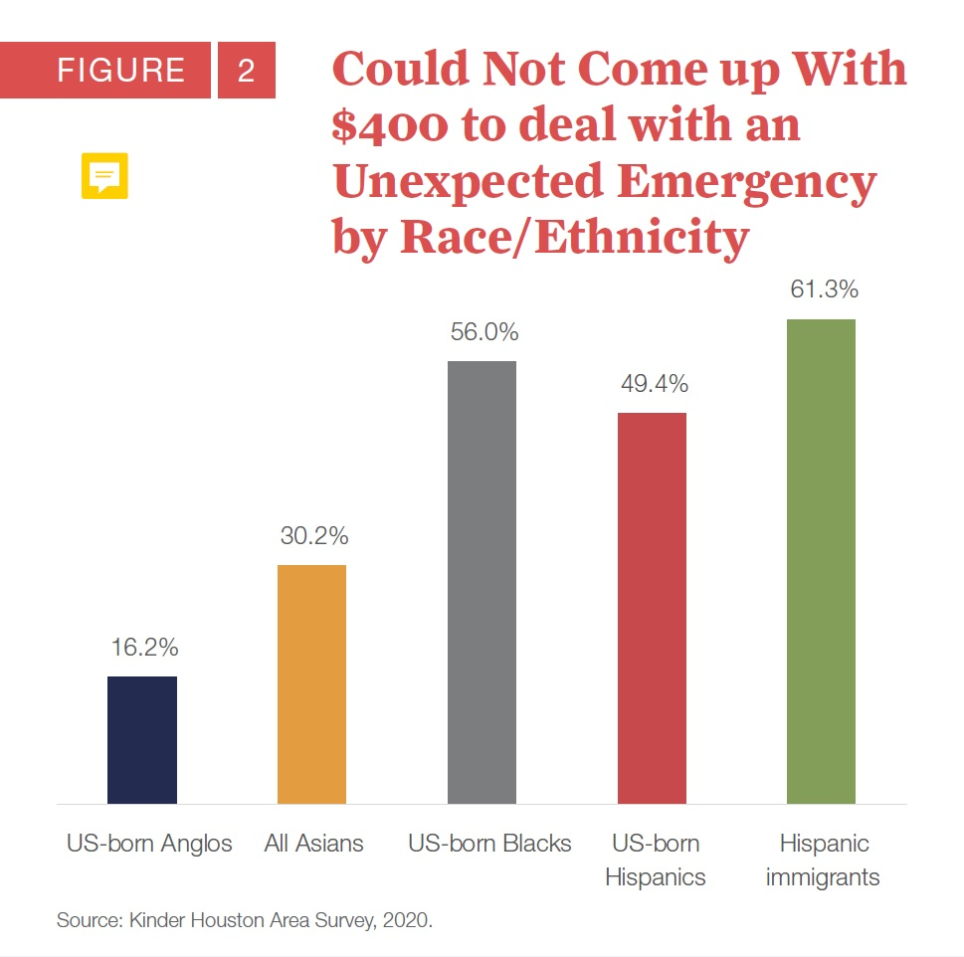
Eviction Filings in Harris County

Slide 18
What can we do?
Continue fighting for the four housing rights:
The Right to Choose
The Right to Stay
The Right to Equal Treatment
The Right to Have a Say

