Slide 1
Wage Equity for Latinos and the COVID Crunch
Lily Casura, MSW
Doctoral Student in Applied Demography,
University of Texas at San Antonio

Slide 2
Notes:
Source: (L) University of Wisconsin-Madison’s Institute for Research on Poverty, retrieved in May, 2018. https://www.irp.wisc.edu/resources/who-is-poor/; (R) Institute on Assets and Social Policy at Brandeis University, retrieved in 2018, Permission of Thomas Shapiro, Ph.D., Institute head.

Slide 3
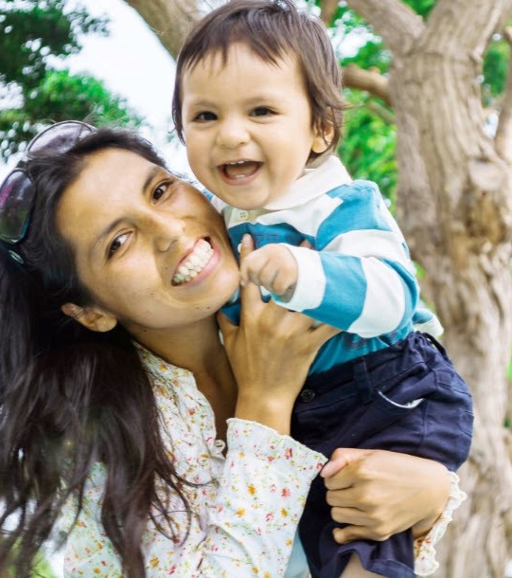
“Breadwinner Mothers”
“Breadwinner mothers” contribute 40% or more of the household income
Nationwide, a majority of Latinas (60.9%) are primary or co-breadwinners.
In Texas, almost half (46.1%) of Latina mothers are breadwinners or co-breadwinners in their households.
One quarter (25.8%) of Latina-headed households are led by single breadwinner mothers.
(The implications are numerous.)
Notes:
These stats are all from the Institute for Women’s Policy Research using 2018 ACS data. https://iwpr.org/wp-content/uploads/2020/07/Holding-Up-Half-the-Sky-Mothers-as-Breadwinners.pdf

Slide 4
The Wage Gap in Texas
Here in Texas, the #2 state in sheer numbers of Latinas in the workforce, Latinas earn approximately 44 cents on the dollar, compared to white, non-Hispanic men, according to Unidos US, using U.S. Census Bureau/American Community Survey data from 2012–2016.
That figure, while profoundly disturbing, is not even the lowest in the U.S. Latinas in California (43 cents) and New Jersey (42 cents) actually earn less.
Notes:
Source: “The Wage Gap is Shocking, and Latinas in Particular Suffer from It.” Medium. November 20, 2019. https://medium.com/@lilygc/the-wage-gap-is-shocking-and-latinas-in-particular-suffer-from-it-6b03ed200e39

Slide 5
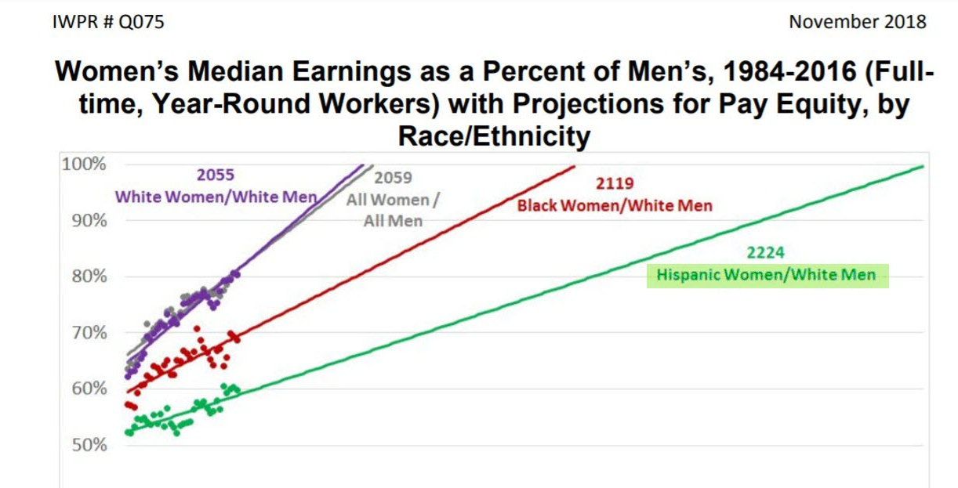
Notes:
Institute for Women’s Policy Research, November, 2018.

Slide 6
Annual and Lifetime Pay Gaps

Slide 7
And it might be worse than we realize…
In all likelihood, because women step in and out of the workforce more often than men, the ~“80%” figure is grossly exaggerated. If we look instead at 15 year “slices” of men’s and women’s earning lives, women earn substantially less. “Women today earn just 49 cents to the typical men’s dollar, much less than the 80 cents usually reported, according to a new study by economists Heidi I. Hartmann and Stephen J. Rose.”
Notes:
Source: Clark, J. (November 28, 2018). Women earn just half of what men earn over 15 years. Washington, DC: Institute for Women’s Policy Research.

Slide 8
Outright Discrimination
Far from being impossible to quantify, there are many reasons for the considerable wage gap, including:
Outright discrimination (as we’ll see on the next slide) and
Five specific types of discrimination women suffer in the workforce. Mass. Lt. Gov. Evelyn Murphy’s look at 200+ wage discrimination lawsuits identified 5 types of discrimination women suffer:
Blatant sex discrimination;
Sexual harassment;
Workplace sex segregation;
Everyday discrimination; and
Discrimination against mothers.
Notes:
Economist and former Massachusetts Lieutenant Governor Evelyn Murphy looked at hundreds of wage discrimination lawsuits and came up with five main types of discrimination that women experienced: Blatant sex discrimination; sexual harassment; workplace sex segregation; everyday discrimination; and discrimination against mothers. (From Publisher’s Weekly blurb about her book on Amazon: https://smile.amazon.com/Getting-Even-Women-Men-About-ebook/dp/B000FCKGWU/ref=sr_1_1?keywords=evelyn+murphy&qid=1578067281&sr=8-1)

Slide 9
Explaining the ~40 Cent Wage Gap
Item | Percent | Cost
Explained: | 45% | 18 cents out of 40 cent gap
Segregation of Hispanic women into lower-paying occupations | 45%
Segregation of Hispanic women into lower-paying industries | 17%
Disparity in access to education and skills training for many Hispanic women | 33%
Unexplained: | 55% | 22 cents out of 40 cent gap
Outright discrimination
Wage premium for white men | 45%
Wage penalty for Latinas (compared to white men) | 55%
Notes:
“The Intersectional Wage Gaps Faced by Latina Women in the United States,” The Washington Center for Equitable Growth, November, 2018. https://equitablegrowth.org/the-intersectional-wage-gaps-faced-by-latina-women-in-the-united-states/

Slide 10
Latinas and Occupational Segregation
Women tend to be clustered among low-paying occupations, especially women of color.
“Across the board, women of color are more likely than white women to be shunted into the lowest-earning occupations in the service sector and in sales and office jobs. This trend is particularly pronounced for Hispanic women. Among working women in 2014, 62% of Hispanics were clustered into just two job groups—service occupations and sales and office occupations. This is compared with 57% of Blacks, 51% of whites, and 44% of Asians in the same job categories.
“In 2014, . . . only 26% of Hispanic women were employed in higher-paying management, professional, and related jobs—compared with 48% of Asian women, 43% of white women, and 35% of Black women.”
Notes:
Source: Fisher, M. (2015). Women of color and the gender wage gap. Washington, DC: Center for American Progress.

Slide 11
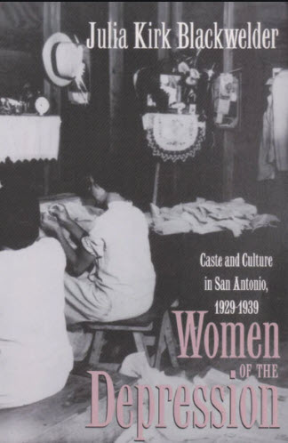
Historically, not that different
Julia Blackwelder’s observations about Anglo, Latina and Black women in the Depression focused on occupational segregation by race and ethnicity.
Women occupied lowest rungs of occupational structure
Latinas worked in low-wage occupations (e.g., manufacturing, food processing, garment making)
Few jobs lost by minority women were restored
Women were seen as lower-status than men: In emergency relief, “men were given jobs, women were given commodities.”
If it were different, if women were paid the same as comparable men, “nearly 60% of women would see a pay increase, including almost 2/3 of single mothers and women’s poverty would be halved.”
Notes:
Source on quote about “nearly 60% of women” is here: Source: The Gender Wage Gap 2018: Earnings Differences by Race and Ethnicity. (March, 2019.) Washington, DC: Institute for Women’s Policy Research.

Slide 12
Now we have COVID-19…and its impacts
Notes:
Source: “Hispanic unemployment rate has spiked during COVID-19, with women seeing a bigger increase than men.” Pew Research Center. August 3, 2020. https://www.pewresearch.org/hispanic/2020/08/04/coronavirus-economic-downturn-has-hit-latinos-especially-hard/ph_08-02-40_latino_economy-00-11/

Slide 13
Hispanic job losses have been steep
Notes:
Source: “The Covid-19 Recession is the Most Unequal in Modern U.S. History.” The Washington Post. September 30, 2020. https://www.washingtonpost.com/graphics/2020/business/coronavirus-recession-equality/?utm_campaign=wp_main&utm_medium=social&utm_source=facebook&fbclid=IwAR0tcul_eJhW35DSsd2TFvyaqHtfW9EBvB-cZLEvVTSeRGnB0wgZaEDhpTk

Slide 14
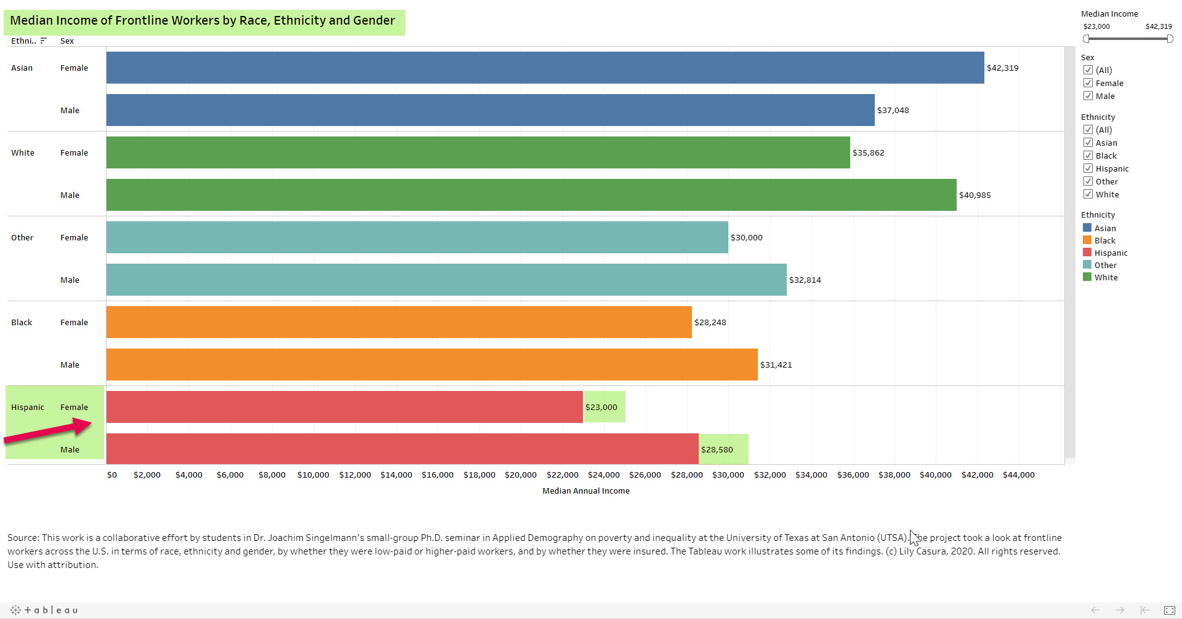
Notes:
OBSERVATIONS TO COME.
Frontline workers: What we found in our UTSA Applied Demography research, when we looked at 7 million frontline workers across the country, engaged in 71 different occupations, by race, ethnicity, gender, level of income, etc.

Slide 15
Frontline Workers Observations re: Latinos
Hispanic workers more likely to be concentrated in lower-paid frontline work. More than one-quarter (27%) of Hispanic workers are employed in lower-paid frontline work. Similarly, more than one-quarter (27%) of Latina workers are employed in lower-paid frontline occupations
Nearly 75% of Hispanic frontline workers earn less than $30,000 annually.
Among lower-paid frontline workers, Latinas earn the least ($19,900)
Among higher-paid frontline workers, Latinas earn the least ($43,505)
Among lower-paid frontline workers, Hispanics are more likely (37%) to be uninsured. Even among higher-paid frontline workers, Hispanics made up the highest percentage (15%) of uninsured.
Notes:
“Covid, Poverty Burden Frontline Workers.” The San Antonio Express-News. July 11, 2020. http://digital.olivesoftware.com/Olive/ODN/SanAntonioExpressNews/shared/ShowArticle.aspx?doc=SAEN%2F2020%2F07%2F11&entity=Ar01900&sk=8E6A98CC&mode=text

Slide 16
Policy Recommendations
Recovery and relief efforts should include ways to support single mothers, who have dual roles during the pandemic: as workers and primary caregivers.
Raise the minimum wage for all workers in the United States.
Work to close the gender wage gap.
Provide paid sick days and paid family and medical leave for all workers.
Address transportation issues so that low-wage earning workers can get to work and back safely and affordably
Ensure that all parents have access to affordable and quality child care.

Slide 17
Contact Info
Lily Casura, MSW
casura@gmail.com

