Slide 1
Challenges in Addressing Latino Concerns in Municipal Government and Related State Legislative Policies
Presented by Marissa Ximenez
Councilwoman Place 1, City of Floresville
President, Association of Hispanic Municipal Officials
TEXAS LATINO POLICY SYMPOSIUM 2021

Slide 2
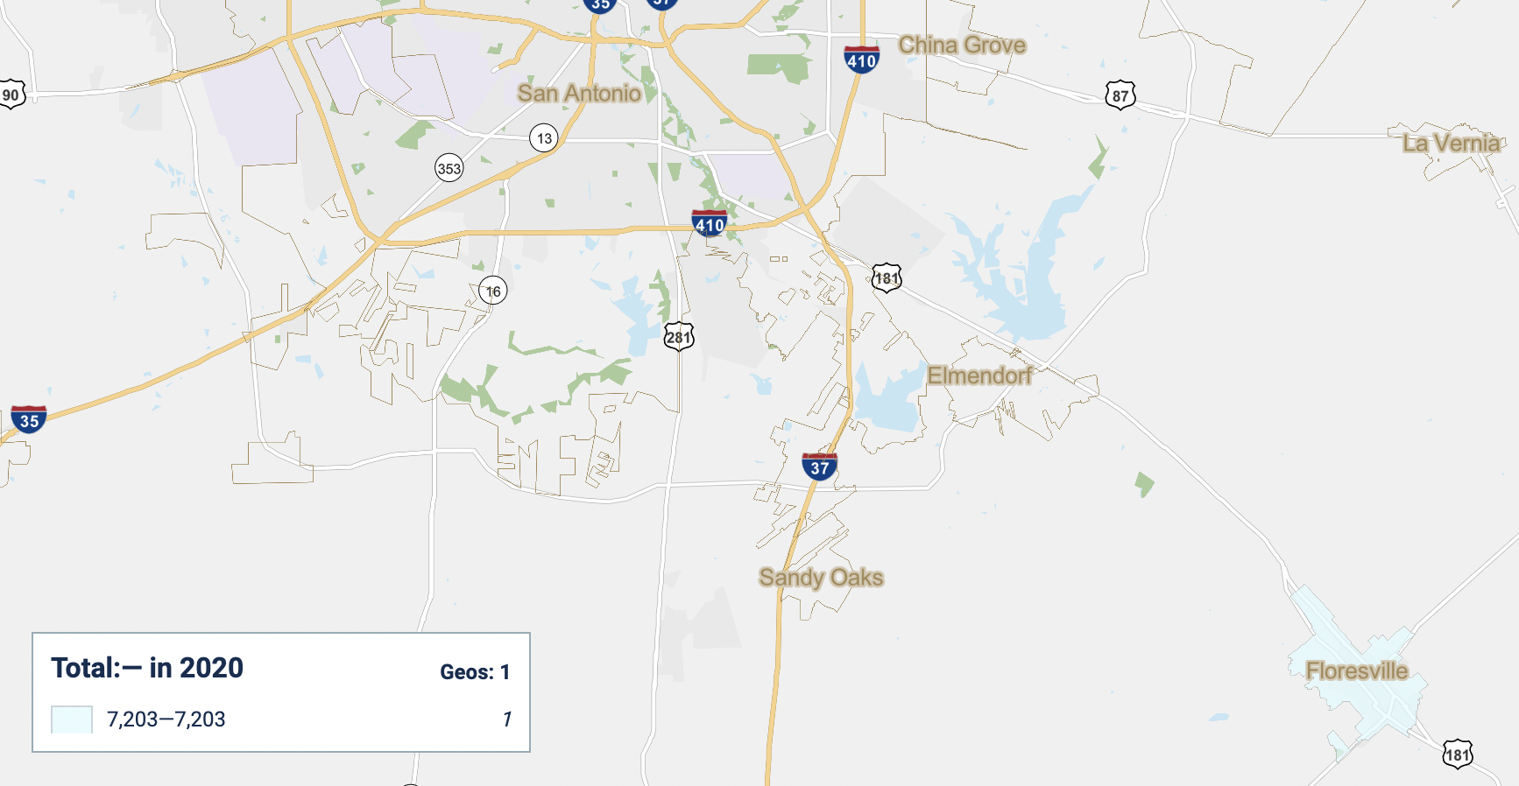
Where I come from
Floresville, Texas
Total Population: 7,203
Hispanic/Latino: 4,530
Non Hispanic: 2,673
Source: 2020 Decennial Census

Slide 3
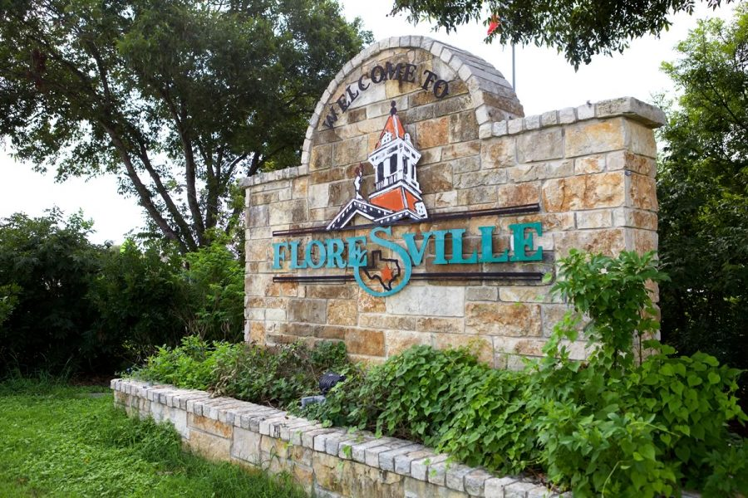
Municipal Government in Floresville
Home rule city
Council-Manager
5 At Large council seats, 2 yr term, 6 yr term limit
City council oversees the general administration, makes policy, sets budget
Council appoints a professional city manager to carry out day-to-day administrative operations
Where is the Latino population?
What is their involvement with the city?
Notes:
Council all hispanic
FEDC-3/7 Hispanic
Plan/Zone all anglo
Board of Adjustments all anglo
Describe the make up of the county seats
FISD Administration has 15 Directors of different departments, one Hispanic Director-director of maintenance
FISD school board has 1 hispanic board member out of 7
Total Population: 7,203
Hispanic/Latino: 4,530
Why is the Latino population not as involved?
So I asked different Latinos in my community.

Slide 4
Questions
How do we understand and publicly discuss the political lives of Latinos?
What can we expect to be revealed as we have discussions with Latino populations?
Notes:
I’m going to make reference to the voter. Latinos as voters or non voters. Those who vote become involved in their community more than those who do not.
People can’t always fully articulate why they don’t vote, but a more complete portrait comes into focus when we step back to explore their attitudes towards politics and representative government, and how these are shaped by their personal background and social and cultural experiences.
What emerges is a clearer picture that reveals the various gaps that keep Latinos from being better incorporated and served by the political system— as well as the areas of opportunity for building a more active and engaged electorate.

Slide 5
Asking the community
Examples of questions:
Do you vote?
What motivates you to vote? Or, what are some of the reasons you don’t vote?
Do you feel that your vote counts, that it makes a difference?
How do you identify yourself?
Have you ever been discriminated against?
How do you decide who to vote for? What informs and influences your choices?
Does your family vote?
Do you follow they latest policy issues?
How do you receive your information?
During this last local election, how did you decide who to vote for?
Do you feel represented?
Notes:
So I went into the community to ask questions. I did this by phone, door to door, while having cafecito and tacos or having a Dos XX at the local ice house. I made it a point to ask latino community members who voted or did not vote in the last local election which was held 11/20.
These are examples of questions I asked to initiate conversation and get to know my community more.
Do you vote?
What motivates you to vote? Or, what are some of the reasons you don’t vote?
Do you feel that your vote counts, that it makes a difference?
How do you identify yourself?
Have you ever been discriminated against?
How do you decide who to vote for? What informs and influences your choices?
Does your family vote?
Do you follow they latest policy issues?
How do you receive your information?
During this last local election, how did you decide who to vote for?
Do you feel represented?

Slide 6
What generates a Latino voter?
What convinces a Latino to vote?
How do they feel?
What are their beliefs?
Can they relate?
Are they accessible?
Notes:
Latinos who vote feel empowered and invested in the political system and have a firm sense of belonging on personal and social levels. They feel they have a right to be heard, they believe they can influence political outcomes, and they’re able to directly relate government policy to their lives. They often interact with other voters or politically engaged individuals.
Some voice opinions at council meetings, or reach out to councilmembers when they have questions/concerns.

Slide 7
What limits a Latino voter?
What discourages a Latino from voting?
How do they feel?
What are their beliefs?
Can they relate?
Are they accessible?
Notes:
Latino nonvoters believe their vote does not matter, they do not come from voting communities or backgrounds, and they do not feel that people in government or political candidates and parties truly care about their experiences or perspectives.
They tend to feel a lower sense of belonging in society and less agency over their lives. That does not mean Latinos are uninformed or apathetic about politics. Instead, the nonvoters I spoke with struggle to see a relationship between their political interests and the policies, campaigns, or behaviors of those in power.

Slide 8
Civic engagement and inclusion
Latino voters:
The decision to vote
Recognizing government impact
Voting matters/changes things
Political understanding
Responsibility for their community
Empower Latinos/Sense of Duty
Latino non-voters:
Access
My vote doesn’t make a difference
Not in my control
Informed but not engaged
No Political understanding
Rigged System
Racism/not inclusive
Notes:
The decision to vote seems to change over time, may only develop over the course of their life, as they establish stronger senses of empowerment and belonging. Some voters first learn this at home, from their family—tellingly, none of the nonvoters I spoke with grew up seeing their parents vote. Other people develop the tendency to vote in school, particularly in their college years. For them, political awareness comes from coursework, engagement with peers, and/or extracurricular and community involvement. Still others become voters when they begin to raise a family and make roots in their communities, developing a stronger sense of local ownership and belonging.
Recognizing government impact. Voting is important because they realize the impact that government policies have on them, their family, and their community. On a local level citizens become aware of what is specific to them and then ask the question, how can this change, where do I vote?
Voting matters./changes things Voters believe that a vote is a vote—one vote counts, and can, in certain elections, actually tip the scales and make the difference between a win or loss. They recognize a need for change to happen, and they believe that change is possible, particularly through voting
Political understanding. Regular voters are engaged in politics in a variety ways. They are typically surrounded in their lives by other voters and people who discuss politics. They feel like they have developed a solid, or solid enough understanding of politics and government to be informed to vote, even if they do not know all of the candidates running for office.
Responsibility for their community. They see voting not just as a personal responsibility, but as a broader responsibility to the people they share a physical and social environment with. Just as they don’t want to solely rely on government to make life better, they feel a need to assert themselves in the system for their own good and the greater good. And voting is one way they can do so.
Latino voters I spoke with talked about the historical struggle for the right to vote, or the sacrifices that others have made to allow them to vote.
Empowered Latinos, specifically, one voter talked about the need for Latinos to push back against discrimination and demand equity, and saw voting as the pathway: We discussed how Communities are stronger when they recognize and acknowledge the roles that racism and inequality play in the engagement experiences of community members.
_________________________________________________________________________________________________
When speaking to Latino non-voters:
Access. For some access to a location can be difficult but in discussion with some, its the long wait times, not having childcare so you can go vote, and not wanting to deal with onerous voting processes
Nonvoters fail to see how a collection of individuals could come together to create substantive change, “i’m just one vote, one vote(or my vote) won’t make a difference” This thought process was common amongst non-voters
They generally feel the election process is out of their individual control.
While nonvoters are largely informed through media/social media about the political state of affairs, they often lack information about how government works and how government policies impact their life and those around them. “Well I saw on Facebook,or someone posted on Facebook”, as if this FB is the only news source known to them. This suggests that political media is failing to adequately describe the actual workings of the government, instead tending to focus on more captivating storylines, especially political battles.
Some nonvoters struggle to believe that anyone is actually counting their votes that elections are rigged. This adds to their sense of disempowerment and reinforces their belief that their vote alone will not change outcomes.
Racism and discrimination also play a role in voter disempowerment and disengagement, racism divides people, and can damage a sense of belonging for Latinos.

Slide 9
Influence in Latino communities
People have power in their combined social capital.
Social capital that is built among diverse community members—has been shown to help create new connections between diverse community members
How do we create an engaging environment that links neighborhood concerns to larger regional or societal issues?
Notes:
According to the oxford dictionary social capital is the networks of relationships among people who live and work in a particular society, enabling that society to function effectively.
Through influence from family, peers, or other politicization processes, civically engaged Latinos develop a habit of voting regularly, becoming involved.
People have a wealth of power in their combined social capital—the networks, norms, and trust that enable participants to act together more effectively to pursue shared objectives.
Equitable civic engagement environment is built around gifts that community members contribute and their ability to capitalize on the benefits of creative gifts. The densely populated Latino community has not identified as a strong community base with a common bond of identity.
Maybe we catch their attention for a short span on a certain topic. But as soon as an issue is resolved, there is no need to stay current. The densely populated area where most of our Latinos live is close to the wastewater treatment plant. Prior to the city receiving funds (with the help of Congressman Cuellar) and updating the treatment plant, there were issues citizens who lived in the vicinity were dealing with. The then city council would argue about updating the plant. And yes, the Anglo councilman at the time were against spending money or having to “work” on this project. One of the Latino councilmen would hear from members of the community but as a solution was not quickly found, community members sunk into the belief that they did not matter. This was years ago and people still talk about it and feel their opinion does not matter. If I do not matter, then why should I become involved?
How do we create an engaging environment that links neighborhood concerns to larger regional or societal issues?

Slide 10
A Responsive Government That Represents Your Interests
A completely responsive government is an aspirational goal.
People want to belong. Unfortunately, there are people in many communities who are perceived as not being a full or deserving part of the community, and/or who are purposely excluded.
Municipal governments must be intentional about including the most vulnerable members of the community in a manner that is both inviting and empowering.
Notes:
Whether the connection is to family members, friends, or co-workers, people want to belong. Unfortunately, there are people in many communities—often people of color and those with lower incomes—who are perceived as not being a full or deserving part of the community, and/or who are purposely excluded.
the best engagement environments strive for a direct and meaningful impact on the concerns of residents from every walk of life, and are undertaken in a manner that is relevant and respectful of all community members.
For a community to be truly inclusive, community members must be intentional about including the most vulnerable members of the community in a manner that is both inviting and empowering.
Diverse groups of community members such as young people, new immigrants, returning citizens, and people of color can face tremendous resource barriers to engagement and as a result, many communities fail to incorporate their voices.
Through empowering citizens as information providers, verifiers, and consumers, government can be both more open and effective. Speaking of an open/effective government. Lets talk about how some of the latest legislative updates are impacting our Latino population.

Slide 11
Legislative Policies
S.B. 1 goes into effect 12/2/2021
The bill bans in-person drive-thru voting in the state of Texas. It’s important to note, this will not impact voters ability to access curbside voting.
The bill restricts early voting to a window of 6:00 a.m. to 10:00 p.m., which effectively bans 24-hour voting options.
The bill will make it illegal for the Elections Administrator to send mail ballot applications, including already eligible voters 65 and older, unless you reach out and specifically request an application be sent to you.
The bill establishes additional rules for identification requirements for voting by mail.
Enhanced poll watcher protections and mandatory training.
Creating new rules for voter assistants
Notes:
As recent Legislative policies have passed, our government is not presenting as being open and responsive.
I talk about SB1. This is legislation that further tightens state election laws and constraints local control of elections by limiting counties’ ability to expand voting options.
the bill bans in-person drive-thru voting in the state of Texas beginning December 2, 2021. It’s important to note, this will not impact voters ability to access curbside voting.
The bill restricts early voting to a window of 6:00 a.m. to 10:00 p.m., which effectively bans 24-hour voting options
The bill will make it illegal for the Elections Administrator to send mail ballot applications, including already eligible voters 65 and older, unless you reach out and specifically request an application be sent to you.
The bill establishes additional rules for identification requirements for voting by mail. Voters will be asked to provide their full driver’s license number or, if they don’t have one, their last four digits of your Social Security number directly on the applications for ballots. The same identification must also be provided on the envelope used to return their completed ballot.
This information must match what is already on file in the individual’s voter record.
The bill strengthens the autonomy of partisan poll watchers by allowing them “free movement” within a polling station with the exception of at a polling station while a voter is casting their ballot. It will be a criminal offense to block a poll watcher “in a manner that would make observation not reasonably effective.” The bill will also require training for poll watchers before they are eligible to serve.
If the onsite election judge witnesses a state Penal Code violation, the poll watcher may be removed from the polling place without warning. If other Election Code violations occur, the poll watcher can only be removed if the Election Judge witnesses the infraction, not if other Election clerks, voters, or bystanders witnessed or were subject to violation.
However, If a voter feels a poll watcher has broken any rules or laws, they should immediately notify the election judge at the polling place, or county attorney at so they can take steps to record and address the situation.
If you plan to assist, or get assistance, for in-person voting, the person providing assistance must fill out new paperwork disclosing their relationship to the voter. Additionally, the person providing assistance must recite an expanded oath, now under the penalty of perjury, stating they did not “pressure or coerce” the voter into choosing them for assistance.
Part of the pledge limits their assistance to “reading the ballot to the voter, directing the voter to read the ballot, marking the voter’s ballot, or directing the voter to mark the ballot.”

Slide 12
S.B. 1
LULAC filed suit to prevent new voting law
LULAC claims the new law violates the 1st and 14th Amendments of the U.S. Constitution and will “have a severe and disproportionate impact on Hispanics, blacks, and other communities of color.”
“LULAC strongly opposes this attack on our voting rights and freedoms because they have one and only one purpose; to dilute our voice at the ballot box and continue to stop electoral change in Texas,” said says Domingo Garcia, LULAC national president. “Texas voters deserve fair, open, and transparent elections, not a process rigged to deny our communities whose numbers are growing, the right to vote.”
Notes:
While SB 1 makes some changes that could expand access, namely increasing early voting hours in smaller, mostly Republican counties, the new law otherwise restricts how and when voters cast ballots.

Slide 13
S.B. 1111
LULAC also asked the court to block the enforcement of Senate Bill 1111, which the groups say violates the First, 14th, and 26th Amendments.
A person cannot "establish a residence at any place the person has not inhabited" and they cannot "designate a previous residence as a home and fixed place of habitation unless the person inhabits the place at the time of designation and intends to remain.”
The bill empowers voter registrars to send a confirmation notice letter to a registered voter
Notes:
LULAC also asked the court to block the enforcement of Senate Bill 1111, which the groups say violates the First, 14th, and 26th Amendments.
A person cannot "establish a residence at any place the person has not inhabited" and they cannot "designate a previous residence as a home and fixed place of habitation unless the person inhabits the place at the time of designation and intends to remain.” This means that the address a voter gives while registering to vote must be the address at which they currently reside.
the bill empowers voter registrars to send a confirmation notice letter to a registered voter requiring them to confirm their address. If a completed confirmation notice is not received within 30 days, that voter may become unregistered and be unable to vote.
To confirm the address of their current residence the voter must sign a sworn statement that their address is not a commercial location. They would also have to provide the same information required for one to register to vote, including some form of identification.

Slide 14
S.B. 1111
Potential to disenfranchise voters
Seen to intimidate people from minority communities who are already wary of interfering with the government.
“This type of legislation is as subtle as a jackhammer, they know who is not going to respond, people who can’t speak English, people who have problems dealing with bureaucracy, people who are just naturally scared of the government," Rudy Rosales LULAC director said.
Notes:
SB 1111 is seen as one of many examples of voter suppression pushed by Republicans this past legislative session.
The groups allege the law “burdens voters who rely on post office boxes” and unfairly targets people who may not reside in a single location for long periods of time. The population of people who may not have a primary location and rely on P.O. boxes include people who are experiencing homelessness and students who may live on a college campus.

Slide 15
Mexican American Legal Defense and Education Fund challenge Texas redistricting maps
According to the complaint, the new maps for Congress, the Texas House of Representatives, the state Senate, and State Board of Education do not reflect the growth of the Latino community.
In addition, the lawsuit alleges that the newly adopted redistricting plan for the State House of Representatives manipulates the district population to weaken Latino voting strength.
Notes:
https://www.maldef.org/2021/10/maldef-challenges-texas-redistricting-maps/
MALDEF (Mexican American Legal Defense and Educational Fund) filed suit in the U.S. District Court for the Western District of Texas, El Paso Division, on behalf of individual voters and a coalition of Latino organizations committed to securing fair redistricting plans in that state. The coalition is known as the Texas Latino Redistricting Task Force (Task Force).
According to the complaint, the new maps for Congress, the Texas House of Representatives, the state Senate, and State Board of Education do not reflect the growth of the Latino community.
In addition, the lawsuit alleges that the newly adopted redistricting plan for the State House of Representatives manipulates the district population to weaken Latino voting strength.
The organizational plaintiffs include the League of United Latin American Citizens (LULAC), Southwest Voter Registration Education Project, Mi Familia Vota, American GI Forum, La Union Del Pueblo Entero, Mexican American Bar Association of Texas, Texas Hispanics Organized For Political Education (HOPE), William C. Velasquez Institute, FIEL Houston Inc., and the Texas Association of Latino Administrators and Superintendents.
MALDEF has previously successfully challenged racially discriminatory redistricting plans. In 2018, the organization won a ruling from the U.S. Supreme Court that Texas unconstitutionally racially gerrymandered its State House plan (Abbott v. Perez). In a 2006 ruling in LULAC v. Perry, the U.S. Supreme Court ruled in favor of MALDEF’s claim that the Texas congressional redistricting plan diluted Latino voting strength in violation of the Voting Rights Act.

Slide 16
Mexican American Legislative Caucus filed the state case
MALC’s challenge centers on the reconfiguration of Cameron County in the Rio Grande Valley, which breaks the county line twice to create three district
Alleging the state’s new maps were drawn with discriminatory intent and violate the federal Voting Rights Act. Filed in Austin, MALC framed the suit as an effort to “redress once again Texas’s sordid pattern of racial discrimination.”
Notes:
In its federal lawsuit, MALC alleges the lines would also “severely dilute” the ability of Latinos and the Spanish-speaking community in the area to elect their preferred candidates.
Half of the state’s population gains in the last decade were among Hispanics. Yet the House map drops the number of districts in which Hispanics make up the majority of eligible voters from 33 to 30. The congressional map reduces the number of districts with a Hispanic voting majority from eight to seven.

Slide 17
In its federal lawsuit, MALC challenges the new maps for Congress, the Texas House and the State Board of Education, saying they are intentionally discriminatory and mired in illegal racial gerrymanders.
“The plans adopted by the State not only failed to increase Latino and minority opportunities for representation, they actually decreased them while increasing the number of districts in which Anglos form a majority of the eligible voter population,”
Notes:
Echoing the two federal lawsuits already in the pipeline, MALC is also challenging the Legislature’s refusal to create additional districts in which Hispanic voters would control elections. Republicans, who had complete control over the redistricting process this year, declined to create those districts even as they reconfigured the congressional map to include the two additional U.S. House seats the state gained, the most of any state in this year’s reapportionment, because of its explosive growth.
https://www.texastribune.org/2021/11/03/texas-redistricting-state-court/

Slide 18
Redistricting-What is the impact?
For Wilson county there is a new state representative and congressional representative
The new state rep switched parties, from Democratic to Republican
The new congressional rep is running in a different district
Who represents my views?
Notes:
Who will represent the Latinos?

Slide 19
The future of Texas is Latino
From 2010 to 2020, the Latino population in Texas grew by more than 20% and that growth contributed to nearly half of the state's population increase during the same period.
With the newly-approved redistricting maps in Texas organizations say it will dilute the vote of Latinos and other people of color.
Texas has a long history of using redistricting to limit Latino political power.
Historically, we have seen the way maps have been drawn in Texas for Congress and the state legislature, and it appears things have not changed.
According to the latest census data, nearly half of the entire Texas population under 18 is Latino, when you consider the future workforce of the state, the future leadership of the state, the future electorate of the state, it increasingly will be Latino.
Notes:
From 2010 to 2020, the Latino population in Texas grew by more than 20% and that growth contributed to nearly half of the state's population increase during the same period.
With the newly-approved redistricting maps in Texas organizations say it will dilute the vote of Latinos and other people of color.
Texas has a long history of using redistricting to limit Latino political power.
Historically, we have seen the way maps have been drawn in Texas for Congress and the state legislature, and it appears things have not changed.
I like to see more Latinos fully understand the redistricting process, because the way political maps are drawn affects our ability to elect who we want.
According to the latest census data, nearly half of the entire Texas population under 18 is Latino, when you consider the future workforce of the state, the future leadership of the state, the future electorate of the state, it increasingly will be Latino.

Slide 20
Implications
How do we convince Latinos?
Are Media/Social media narrative messages empowering?
Can we close the knowledge gap?
Are we responsive to meet the needs of the Latino community?
Do we have representation? How do we achieve this?
What we need:
Education and outreach
Provide opportunities for people—particularly at the crucial formative stages of civic engagement—to advance their skills, increase their knowledge, and engage in the difficult conversations of democracy.
Why:
To stimulate new thinking and new advances in promoting civic engagement.
Notes:
Latinos can be open to the idea and show the potential to be influenced. People still seemed to want to feel part of something bigger—something that could influence politics and the world for the better.
Reshaping political narratives, especially in the media, has potential value in transforming nonvoters. How can we show that their vote mattered? Are we showing politicians as policymakers seeking to change the shape of society? Fewer media outlets tell stories that inspire faith in civil society and the political process
Are we giving Latinos the tools to make informed decisions? Who are the candidates? What do they stand for? Even an informed voter needs more tools to become a full participant in civic life. To make communities better places to live, engaged citizens need to learn the skills of communication, networking, even running for public office.

Slide 21
Resources
https://www.tml.org/DocumentCenter/View/2703/LU2021-22
https://ahmo.org/
https://chc.house.gov/media-center
https://www.svrep.org/
Desipio, Louis, Latino Civic and Policy Participation, 2006 https://www.ncbi.nlm.nih.gov/books/NBK19906/
https://www.unidosus.org/facts/
https://www.nps.gov/articles/latinothemestruggles.htm
https://data.census.gov/cedsci/map?q=Floresville&tid=DECENNIALPL2020.P4&mode=customize&layer=VT_2020_160_00_PY_D1&cid=P4_002N
Pew Research Center, April, 2018, “The Public, the Political System and American Democracy, https://www.pewresearch.org/politics/2018/04/26/6-quality-and-responsiveness-of-elected-officials/
MALDEF statement on redistricting in Texas, https://www.maldef.org/2021/10/maldef-challenges-texas-redistricting-maps/

Slide 22
Jose Roberto Juarez, Jr., “Mexican American Voting Rights in Texas”. In Robert Brischetto and J. Richard Avena (Eds.), Mexican American Civil Rights in Texas, Michigan State University Press, 2021. https://secureservercdn.net/198.71.233.37/xpi.3b1.myftpupload.com/wp-content/uploads/2021/11/Latinos-Suing-Govenor-AGAIN.pdf
Juan Pablo Garnham, “Democrats Didn’t Get a Blue Wave, but Some of the Fastest-Growing Suburbs in Texas Are Still Moving to the Left,” Texas Tribune, November 11, 2020, https://www.texastribune.org/2020/11/11/texas-democrats-republicans-suburb/.
Mike Hixenbaugh and Antonia Hylton, “Inside Southlake: Texas Suburb at Center of a Critical Race Theory Battle Looks Forward,” CBS News, August 30, 2021, https://www.nbcnews.com/news/us-news/inside-southlake-texas-suburb-center-critical-race-theory-battle-looks-n1277748.
Matt Dulin, “In 2011, Houston created a district to boost Hispanic council representation. What happened?” November 1, 2021, https://kinder.rice.edu/urbanedge/2021/11/01/houston-redistricting-city-council
New Census Research Charts Latino Population Growth Across Texas and Within 10 Largest Cities, Press release, https://naleo.org/wp-content/uploads/2021/11/11_3_2021_-_NEF_Release_-_TX_Latino_Population_Growth_-_Final.pdf
Thank you to the various citizens of Floresville for answering interview questions

Slide 23
Marissa Ximenez
Councilwoman Place 1, City of Floresville
President, Association of Hispanic Municipal Officials
councilplace1@floresvilletx.gov
marissa.ximenez@gmail.com
210-749-5997
830-581-1589

