Slide 1
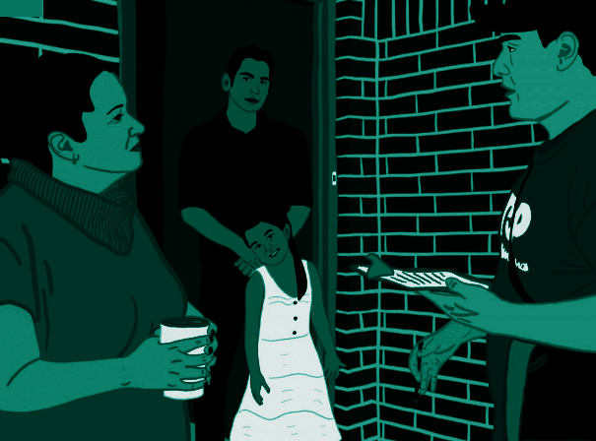
BUILDING
LATINX
ELECTORAL
POWER

Slide 2
LATINX STATS IN TX
4 million registered Latinx voters
Registered ↑⁺ 17% since ‘16
1.2 million newly registered
2.3 million Latinos voted in 2020
Notes:
2.3 million Latinos voted in Texas in 2020 - that’s more votes than the total turnout of 24 states in 2020

Slide 3
PRIORITIES FOR TX LATINX VOTERS
Economy
Immigration
Covid
Healthcare
More direct financial support from govt
Direct Financial Support was a top priority for Latinx Biden & Trump Supporters
Notes:
In the 2020 elections (post 2020 Equis & Avalanche surveys) - Economy, Immigration & Covid were important - Immigration was a key force for Latinx Trump supporters
Over 20% of Latinx Biden & Trump supporters both wanted more direct financial support when asked what is the one thing the government can deliver for you that would make a meaningful difference (it was the highest answer for both Biden & Trump Latinx voters)

Slide 4
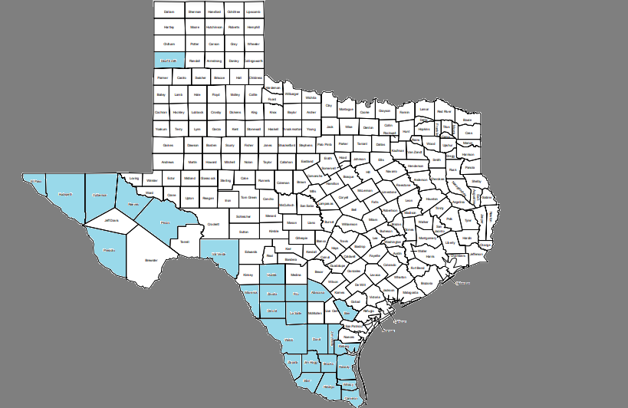
LATINX STATS IN TX
Latinx are the Registered Majority in
29
Counties
1.1 million Latinx Voters
Notes:
Most of the state’s 4 million registered Latinos are NOT in Latino-majority registered counties.
Latinx in Bexar & Nueces are 45% of registered

Slide 5
LATINX STATS IN TX
Counties with the largest Latinx Registration
​
County | Latinx Registered Voters
Harris | 591,876
Bexar | 532,383
El Paso | 354,886
Hidalgo | 329,709
Dallas | 282,990
Tarrant | 175,184
Cameron | 172,294
Travis | 138,395
Webb | 122,424
Nueces | 100,783
Fort Bend | 70,369
Notes:
Total of these 11 counties is 2.87 million

Slide 6
THE LATINX VOTE GAP
2 MILLION eligible unregistered voters
56% Turnout among Latinx makes it the worst performing demographic
The majority of non-voting Latinx live in Democratic Safe State Districts
Notes:
Most of this is because folks are not spending resources to get out the Latinx vote in TX -
It becomes a Self-fulfilling prophecy - if we don’t talk to Latinos, they won’t participate
In the RGV - Koch brothers have invested for 15+ years in a liberterian ideology

Slide 7
TOP ED FUND LATINO VOTER STUDY

Slide 8
THE LATINO VOTER STUDY

Slide 9
TWO FISTS STRATEGY
Multi issue:
jobs + workers’ rights
housing & neighborhoods
education justice
health care
immigrant rights
ending mass incarceration
Link issues to voting + policy change
Notes:
2 fists: community + electoral organizing/people power + political power: but we also know voting and winning elections is NOT enough.
We work in 3 largest counties, because 3 largest counties with largest numbers of non-voters of color.POC

Slide 10
FROM THE CITIES OUT...
PICK THE RIGHT FIGHTS:
Center LOCAL racial equality and economic security campaigns
STRATEGIC TARGETING:
Cities and Counties out where we can enact policy change
to impact millions
ELECT & ORGANIZE CHAMPIONS:
Mayors & County Judges as a local counterweight to the Governor
DEEP INVESTMENT IN LATINX ORGANIZING:
Race, Class, Narrative work, leadership
and organizational investment
QUANTUM LEAP ON VOTER REG:
Use every administrative approach to increase voter registration + traditional VOTER REGISTRATION
Notes:
RCN Description: https://www.wemakethefuture.us/history-of-the-race-class-narrative
RCN is founded in the belief that there is more that unites us than divides us. RCN leans in on issues of race and class instead of shying away from them and is meant as a counter-punch to the racist dog-whistle politics aimed at dividing working people and scapegoating communities of color. A critical component of the race class narrative is directly calling out that scapegoating and those responsible - self-interested politicians and corporate interests.

Slide 11
STRATEGIC ISSUE-BASED CAMPAIGNS
Build broad supporter base
Tackle root causes of poverty and inequality
Deliver meaningful change
Disrupt power structure
Engage ordinary people in the fight for our lives
Direct actions
Impact millions when we win
Build Black/Brown Power

Slide 12
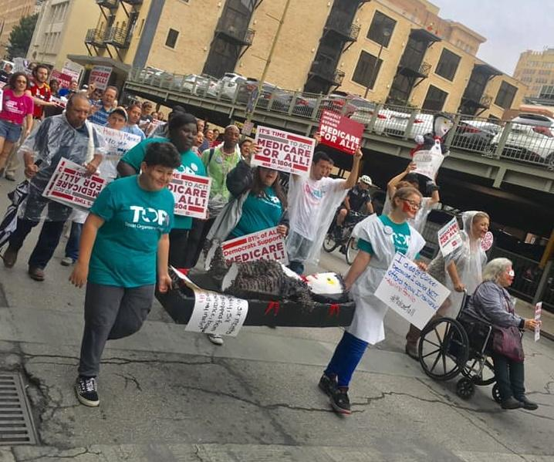
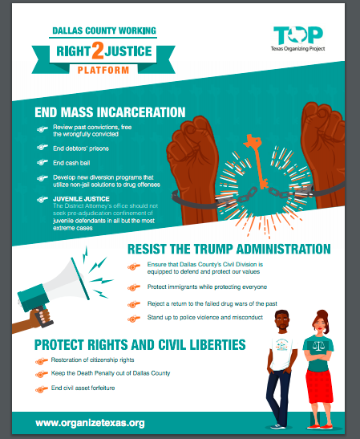
Q & A
Notes:
Add other images; Sick of It Coalition

Slide 13
KEEP IN TOUCH
Michelle Tremillo
mtremillo@organizetexas.org
210-393-7471
organizetexas.org
@OrganizeTexas FB, twitter & insta
TOPedfund.org/RealTalk

