Slide 1
“Covid-19: Mental Health Stressors, Coping Strategies, and Policies in Vulnerable Latino Communities” COVID-19: Mental Health and Policies Relevant to Vulnerable Latino Immigrants
Luz M. Garcini, PhD., MPH

Slide 2
Disclosures
Current Funding
NIH NHLBI (K01HL150247)
American Psychological Foundation
UTHSCSA Seed Grant Program
Editorial Boards
Cultural Diversity and Ethnic Minority Psychology
Other Board Membership
American Psychological Association
National Latinx Psychological Association
* Art work by Roberto Mamani Mamani

Slide 3
Goals and Objectives
1. Background and significance
2. Research findings: COVID-19
3. A call to action: Policy implications
5. Questions and remarks

Slide 4
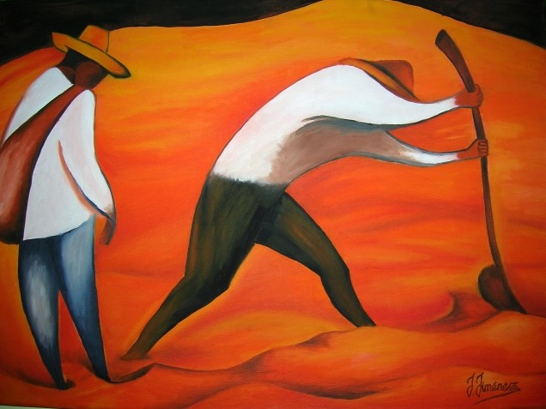
Background and Significance
“Learn to light a candle in the darkest moments of someone’s life. Be the light that helps others see; it is what gives life its deepest significance.” Roy T. Bennett

Slide 5
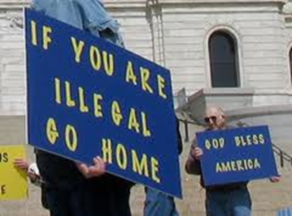
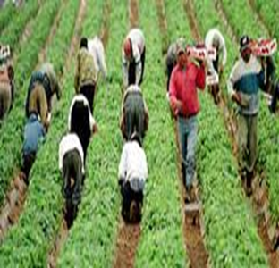
Undocumented Latino Immigrant Communities: A Vulnerable, Yet Resilient Population
Vulnerabilities
Population at the forefront of political controversy
High stigmatization
Socio-economic vulnerabilities
Longer time in U.S. associated with poor health
Limited access to services and resources
High amount of trauma
Highly heterogeneous
Limited information
Significantly affected by COVID-19
Resilience
Immigrant paradox

Slide 6
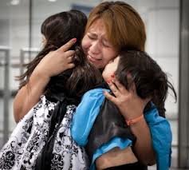
COVID-19 and Mental Health of Undocumented Latino Immigrants
Mental health crisis prior to COVID-19
Compounded stressors during COVID-19
Increased exposure due to front line jobs
Social distancing as a privilege
Limited access to services and information
Fear and mistrust
High amount of trauma (pre and during COVID)
High mental health stigma
Civil unrest, marginalization and stigmatization
Sociopolitical and anti-immigrant climate
Broken immigration system

Slide 7
The U.S. Immigration System: Current Context
Humanitarian and refugee crises; human rights violations
Legal immigration system is constrained
60% decline in visas issued in the U.S.
System is severe on penalties for violations
Priority of punishment over opportunity to correct violations
Focus on border control and early violations
Not addressing immigrants with longer time in the U.S.
Restricted paths to legalization
Immigration system is outdated and administration processes are slow
Massive backlog of cases and immigrants awaiting abroad
Cap for refugee program expanded to 62,000, but only admitted 12,000
Cap available for seasonal workers was not used either (65,000)
Notes:
We ARE THE Furthest we have EVER BEEN found the republican party to be (even in regards of DACA) FROM an immigration reform
Prevents people from correcting their mistakes - If you violate immigration law for more than one year, you are banned to obtained legal status for at least 10 years (separation from family). Punishment is too severe to wait that tenure restriction- This needs to change. – There needs to be a procedure to go back and apply for visas.
When a violation has occurred (even if you came decades ago), we need a statue of limitations (10 years) if you have been in country for 10 years you should be able to adjust your legal status. That needs to be revisited.
Immigration system is outdated and administration processes are slow and disorganized
System built in 1990 1986- fundamentals from the 1920s
Massive backlog of cases and immigrants abroad waiting to be processed. - Taking measures to streamline those applications (about half million people).
Overall, worst shape the system has been in the past 50 years!

Slide 8
Proyecto Voces (Voices) “If you have built castles in the air, your work need not be lost; that is where they should be. Now put the foundations under them.” Henry David Thoreau

Slide 9
Purpose
Identify stressors and coping strategies to the health of Latino immigrants during COVID-19
Develop clinical strategies to address the health needs of Latino immigrant communities
Methods
Participants were 43 CHWs and Promotor/as
Mixed methods (surveys and focus groups)

Slide 10
Stressors

Slide 11
Effects on Mental Health
Depression, loneliness
Anxiety, despair
Hostility, irritability
Obsessions, compulsions
Somatization
Agoraphobia
Diminished sleep
Changes in eating patterns
Diminished self-care
Diminish sense of self-efficacy
Diminish view of self
Diminished sense of control
Loss of meaning, purpose
Guilt and shame
Interpersonal violence
Substance use

Slide 12
Coping Strategies
Behavioral strategies
Cognitive strategies
Social support
Spirituality and religiosity

Slide 13
Research, Clinical, & Ethical Considerations: Lessons Learned
"The future depends on what you do today."
Mahatma Gandhi

Slide 14
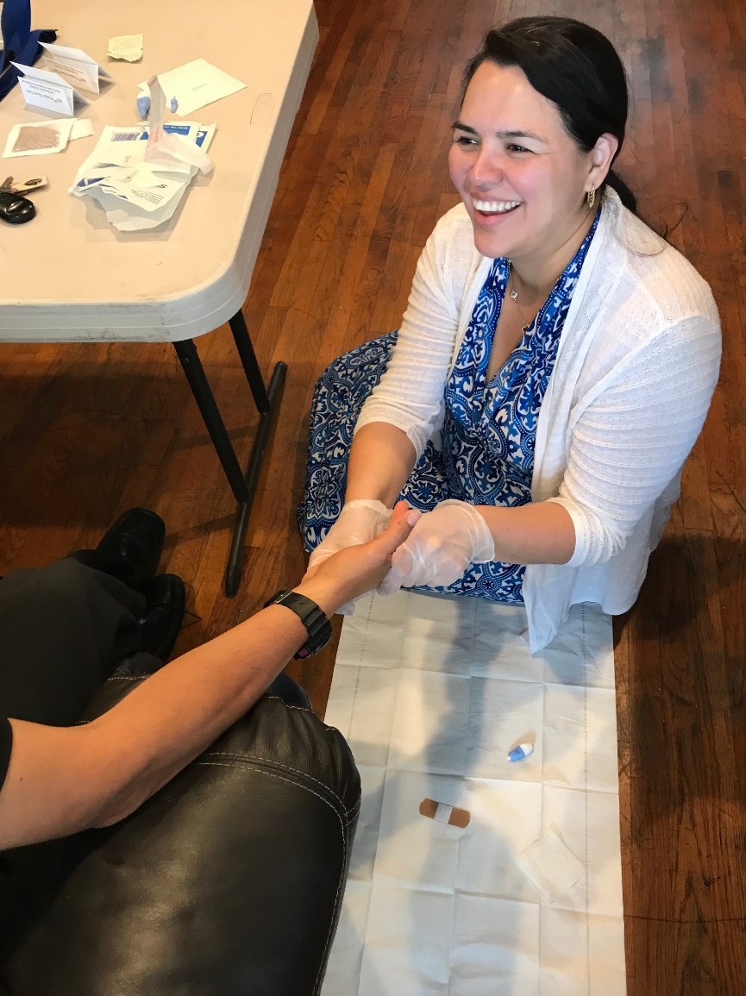
Research Considerations: Building Knowledge
Research
Refine methods and measures
Identify mechanisms Identify protective factors Effects over time Effect of policy and context
Interventions Development, implementation, dissemination, sustainability
Expand interdisciplinary collaboration to develop appropriate methodology
Build research infrastructure and workforce
Funding to build a knowledge base

Slide 15
Clinical Considerations: Addressing Need
Clinical Needs Evaluation and Intervention
Build clinical infrastructure and workforce
Training and best practices
Emergency response systems
Trauma informed systems
Disseminate evidence-based interventions and information using non-traditional sources
Addressing intersectional identities and trauma
Funding to address clinical needs
Notes:
Immigration Evaluation Guidelines

Slide 16
Ethical Considerations: Protecting Human Rights and Promoting Social Justice
Advocacy and Policy
Eradicate systems of oppression: Brutality of law enforcement and border patrol
Funding to build knowledge base and to address clinical needs
Prompt resolution and dialogue
De-stigmatization
Create safe environments: Ensuring safety, protections, and fair treatment
Facilitating access to services and resources: Accessibility & Quality

Slide 17
A Call to Action
“Throughout history it has been the inaction of those who could have acted, the indifference of those who should have known better, the silence of the voice of justice when it mattered most, that have made it possible for [harm] to triumph.”
Haile Selassie

Slide 18
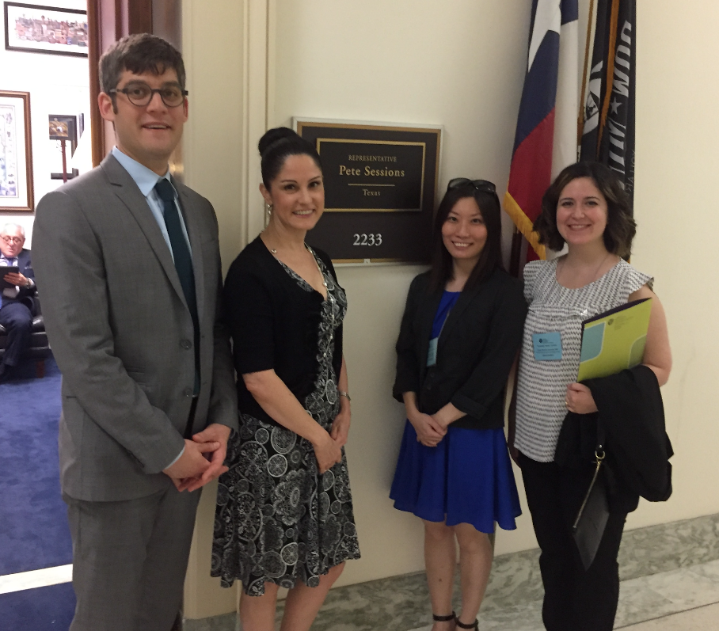
Interdisciplinary Collaboration and Binational Efforts

Slide 19
Policy Statements

Slide 20
The Media as Gate

Slide 21
Closing Remarks
Current context is putting Latino immigrants at risk
Research, clinical and advocacy efforts are needed
Our Latino immigrant communities need us and we need them!
“Make a difference today for someone who is fighting for their tomorrow”
Jim Kelly

Slide 22
Questions or Comments
Luz M. Garcini, PhD., MPH
Garcini@uthscsa.edu

