Slide 1
The Fight for Representation Continues: Texas Redistricting
Southwest Voter Registration Education Project
Texas Latino Redistricting and Voting Rights Summit
NINA PERALES
MALDEF

Slide 2
2011 Redistricting Cycle LITIGATION BY THE TEXAS LATINO REDISTRICTING TASK FORCE
State House Plan
Congressional Plan
House districts intentionally discriminated on the basis of race
El Paso County (HD78)
Bexar County (HD117)
Nueces County (elimination of HD33)
Texas racially gerrymandered HD117 in Bexar County (Task Force only claim)
Texas racially gerrymandered HD90 in Tarrant County (Task Force only claim)
CD23 discriminated against Latinos intentionally and in effect
CD23 was a racial gerrymander (Task Force only claim)
Districts in the DFW Metroplex intentionally discriminated based on race
CD26 in DFW Metroplex was a racial gerrymander (Task Force only claim)

Slide 3
2021 Redistricting
Texas Again Enacts Discriminatory Redistricting Plans

Slide 4
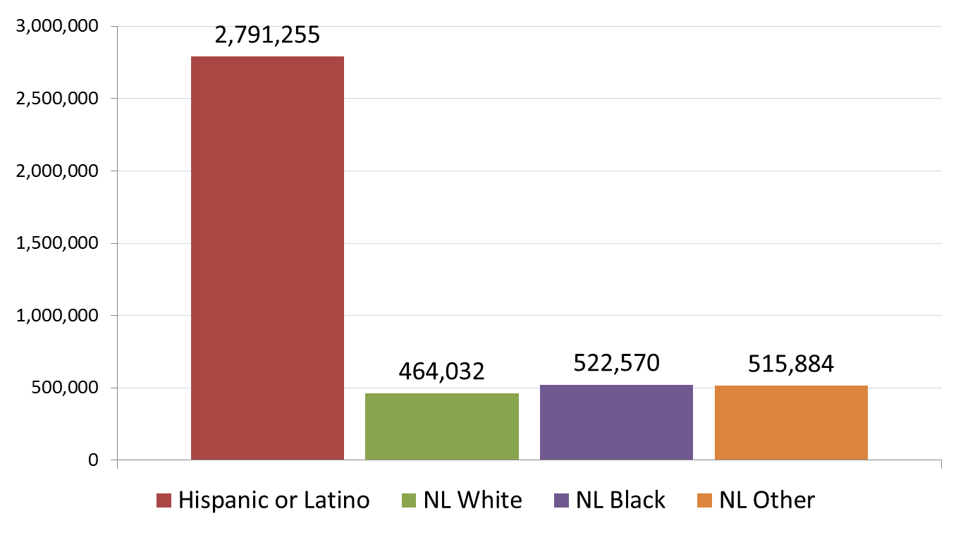
TEXAS POPULATION CHANGE 2000-2010

Slide 5
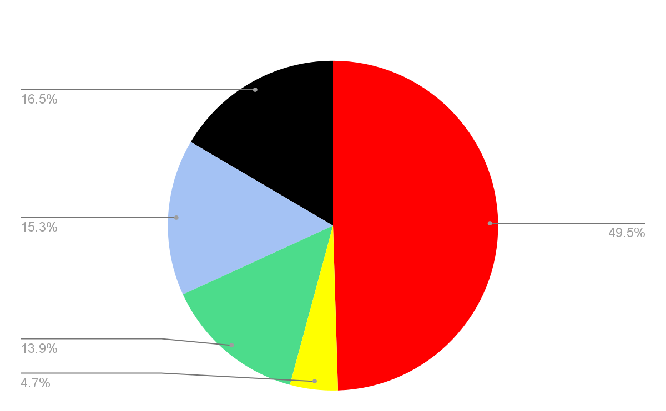
TEXAS POPULATION CHANGE OVER DECADE
Total Texas Population Change: +3,999,944
MALDEF

Slide 6
Failure to Create New Latino Districts
Harris County
DFW Metroplex
More
Failure to create a new Latino majority congressional district
Failure to create a new Latino majority state house district
Failure to create a new Latino majority SBOE district
Failure to create a new Latino majority congressional district
Failure to create a new Latino majority senate district in South/Central Texas
Failure to create a new Latino majority state house district in West Texas
Failure to create a new Latino majority state house district in South/Central Texas

Slide 7
Texas Weakened Existing Opportunity Districts
State House Plan
SBOE Plan
Congressional Plan
HD31 in South Texas (Starr/Zapata)
HD37 in South Texas (Cameron/Willacy)
HD118 in Bexar County
SBOE District 3 in South Texas (Starr/Bexar)
CD23 in West Texas
CD15 in South Texas (Hidalgo/Guadalupe)

Slide 8
THANK YOU
Nina Perales
Vice President of Litigation
MALDEF
nperales@maldef.org

