Slide 1
Hispanic Serving Institutions as Business Serving Institutions: A Look at Outcomes and Policy Implications
Vanessa Quetzeri
Rick Sperling, PhD
2021 Texas Latino Policy Symposium

Slide 2
Land Acknowledgement
As we have gathered here at St. Mary’s University, I want take the time to acknowledge that the campus of St. Mary’s University stands on Indigenous land the belongs to the Jumanos, Tonkawa, Lipan Apache, and Coahuiltecan peoples, many of whom live and work here today. In our commitment to social justice, we are called to acknowledge our participation in systems of oppression, we are called to acknowledge the forceful removal and genocide of Native Americans, and we are called to acknowledge the past, present, and future impacts of this history on these communities.
Notes:
Jumanos
Tong-Kuh-Wah
Ly-Pan Apache
Coahuil[te]can

Slide 3
Hispanic Serving Institutions (HSIs)
Enroll at least 25%, full-time Hispanic/Latinx students
Eligible to compete for federally funds under Title V
HSIs enroll 66.8% of all college eligible Hispanic students
Receive 68 cents for every dollar distributed to all other institutions of higher education (HACU, 2019-20; HACU, 2021)
Notes:
Hispanic serving institutions (HSIs) are federally recognized as institutions of higher education that enroll at least 25%, full-time Hispanic/Latinx students that are eligible to compete for federal funds under Title V (Galdeon, 2012). HSIs enroll 66.8% of all college eligible Hispanic students; however, HSIs receive 68 cents for every dollar distributed to all other institutions of higher education (HACU, 2019-20; HACU, 2021).

Slide 4
Return on Investment (ROI)
Performance Measure
"Cost-effective"
Inequitable
Developed in the business sector by Donaldson Brown
Adopted for policymaking
Distribution of State funds
Economic benefits acquired - tangible forms of investment
Adjustment of a standardized measure
Multifaceted educational experience is simplified
Students are seen as a commodity
Notes:
Gasman et al. (2017) have suggested that minority-serving institutions, such as HSIs, are often “overlooked” because of their lack of ROI research. Return on investment (ROI) is an institutional performance measure developed in the business sector by Donaldson Brown that was later adopted into higher education (Bo, 2020). ROI has been increasingly used in higher education through policymaking, to address and determine where and how state funds should be distributed (Blagg & Blom, 2018). This “cost-effective” measure is traditionally calculated by subtracting tangible forms of investment from economic benefits acquired (Bo, 2020; Blagg & Blom, 2018). However, performance measures have a long history of inequity in primary, secondary, and higher education (Knoester & Au, 2017). ROI could certainly be another means of distributing inequity under the guise of institutional improvement, and therefore, student improvement. When institutions of education adjust a standardized business measure to determine the allocation of funds, a students’ multifaceted educational experience is simplified, and students are seen as a commodity that is translated into economic, political, and social capital (Krawczyk, 2013; Epstein & Mckinnon-Crowley, 2020).

Slide 5
Hispanic Association of Colleges and Universities (HACU)
Educational association that nationally represents HSIs
Seeks to increase educational degree attainment
Mission statement reflects the interests of the political, social, & economic sectors
"[m]eeting the needs of business, industry, and government ... " (HACU, 2021, see section HACU’s Mission: To Champion Hispanic Success in Higher Education)
Notes:
The Hispanic Association for Colleges and Universities (HACU) is an educational association that nationally represents HSIs (HACU, 2021). HACU advocated for the federal recognition of HSIs, and succeeded, with the passage of the Higher Education Act of 1992 (Galdeon, 2012). Although HACU seeks to increase educational degree attainment among Hispanic students, their mission statement reflects the interests of the political, social, and economic sectors. According to HACU’s mission statement, the association is “meeting the needs of business, industry, and government through the development and sharing of resources, information, and expertise” (HACU, 2021, see section HACU’s Mission: To Champion Hispanic Success in Higher Education).

Slide 6
HSIs as Business Serving Institutions
HSIs meet the needs of racially & economically stratified systems
Students invest their history, culture, language, & dignity
Outcome measures lack the ability to encompass oppression, stratification, & unequal power dynamics
Neo-liberalistic approaches: profitability & efficacy
De-center minority voices from higher education & educational policy
Notes:
Therefore, there is reason to believe that the purpose of HSIs is not to meet student needs, but instead, to meet the needs of racially and economically stratified systems. At HSIs, Latinx students run the risk of investing their history, culture, language, and dignity to assimilate into the ideals that are replicated in the political, social, and economic sectors (Apple, 2019). Thus, using outcome measures that respond to binary inputs, lack the ability to encompass systemic issues of oppression, stratification, and unequal power dynamics, and achieves further hegemony over Latinx students. In addition, these neo-liberalistic approaches that favor profitability and efficacy over cultural capital and equity, have de-centered minority voices from higher education and educational policy, through the exclusion of intangible student investments and the failure to build on students' cultural wealth (Krawczyk, 2013; Yosso, 2005).

Slide 7
Developing Hispanic Serving Institutions Program
DHSI
Federal allocation of funds by grant submission
Awarded funds to: “38 high-quality applications that were underfunded in FY [fiscal year] 2020”
Notes:
The federal allocation of funds is determined under the Developing Hispanic-Serving Institutions (DHSI) Program. In 2021, the DHSI Program did not take new grant submissions, but they ranked and awarded funds to “38 high-quality applications that were underfunded in FY [fiscal year] 2020” (U.S. Department of Education, 2021, p. 1). However, the criteria did not include a culturally sensitive framework or directly address Latinx student needs.

Slide 8
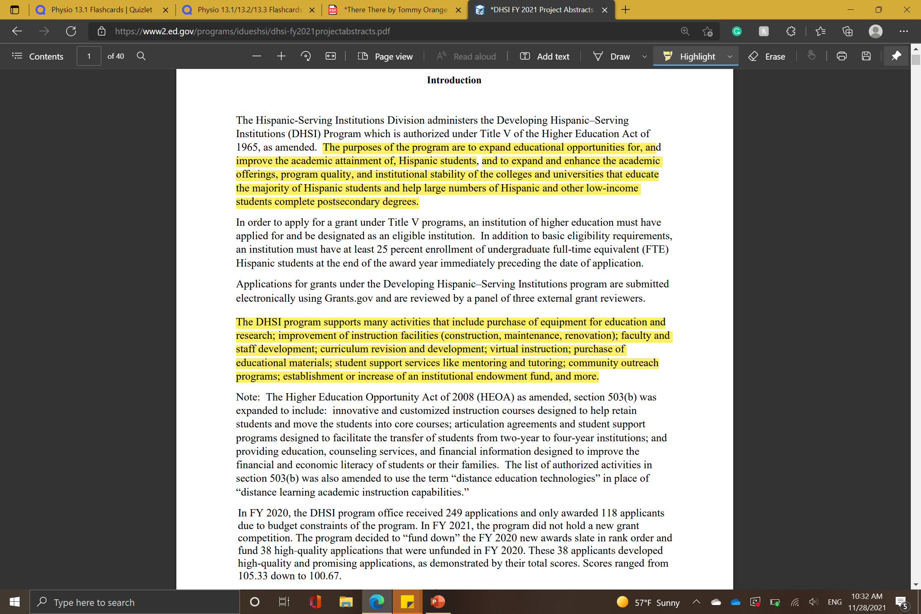
Notes:
The top mentions expanded educational opportunities and academic attainment for Hispanic students, but the DHSI lists general criteria of what the funding can be used for:

Slide 9
Notes:
Equipment for educational research
Improvement of instruction facilities (construction, maintenance, repair)
Faculty and staff development
Curriculum revision and development
Student support services
Community outreach
The grant tackles the institutions as a whole; instead of the population that should be directly addressed. So, as long as the proposal includes how this funding will trickle down to Latinx students, it will be approved.

Slide 10
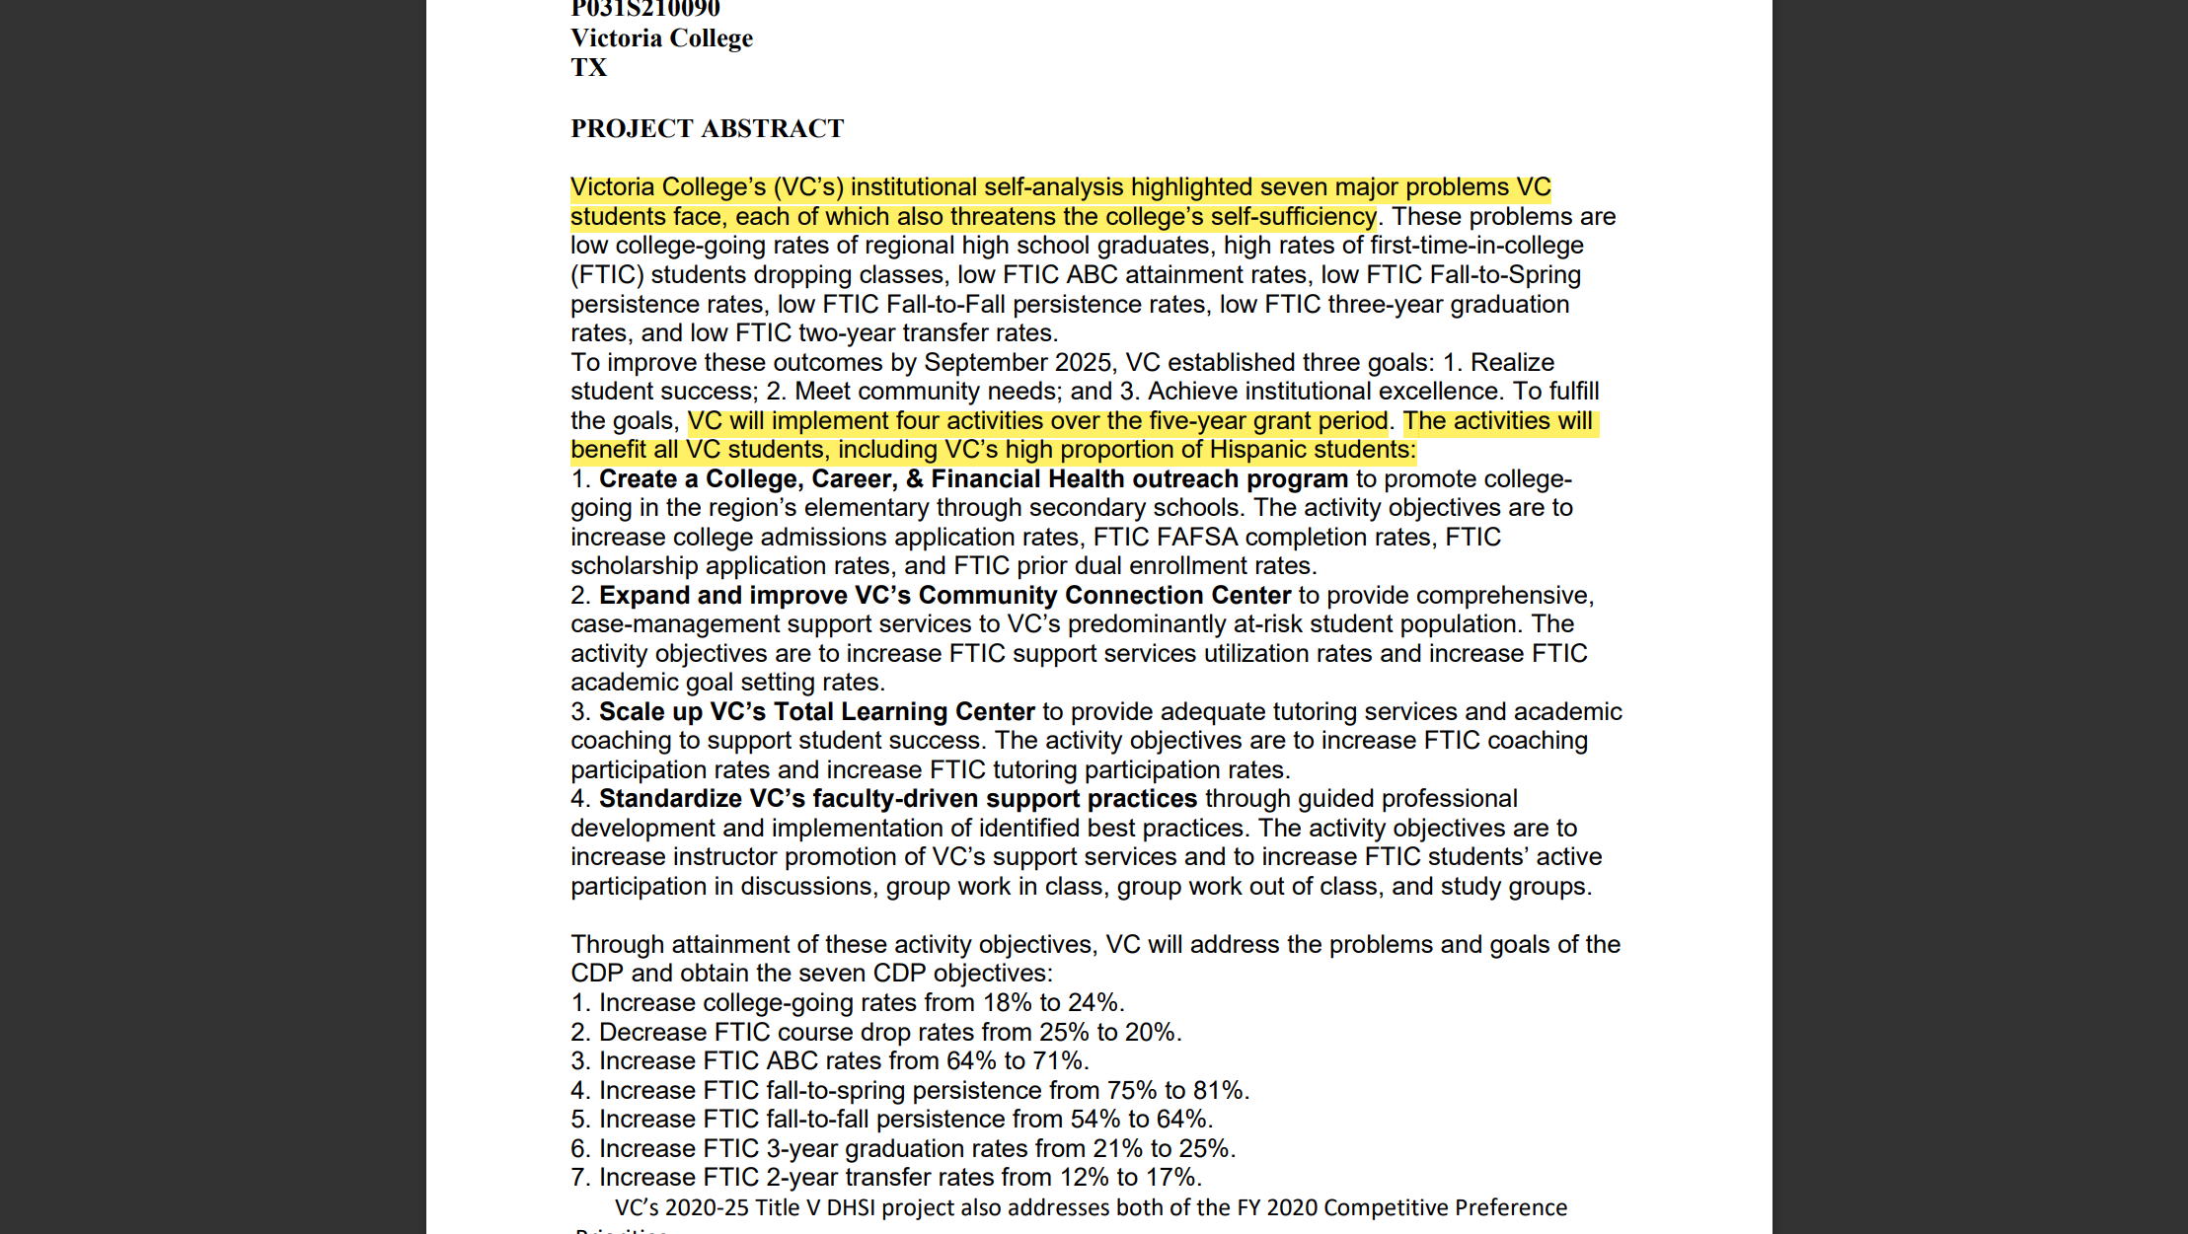
Notes:
This was shown in Victoria College in Texas grant

Slide 11
Notes:
[Where] the activities proposed were described as benefiting “all VC students, including VC’s high proportion of Hispanic students,” framing the general population of VC students as the primary beneficiaries of the grant over the Latinx population (U.S. Department of Education, 2021, p. 4).

Slide 12
Victoria College in Texas (VC)
Ranked 2nd for proposal
Students’ low performance outcomes were a threat to the “colleges self-sufficiency”
Framed beneficiaries of the funds to general VC population
Notes:
Victoria College was ranked second and awarded Title V funds for a proposal that mentioned Latinx student low performance outcomes as a threat to the “colleges self-sufficiency.”

Slide 13
Notes:
Therefore, the importance of HSI funding is focused more on the lack of institutional productivity, and the overall status of an institution, rather than the Latinx students that make this funding possible.

Slide 14
Deficit-Based Perspectives
Hold “[s]tudents from historically oppressed populations responsible for the challenges and inequalities that they face” (Davis & Museus, 2019, p. 119)
Alternative: strength-based perspectives
strengths/weaknesses
talents/deficits
multicultural/monocultural
Notes:
The grant proposed by Victoria College displayed deficit-based perspectives. It focused on the students’ weakness over their strengths, deficits over their talents, and represents a monocultural framework over a multicultural one.

Slide 15
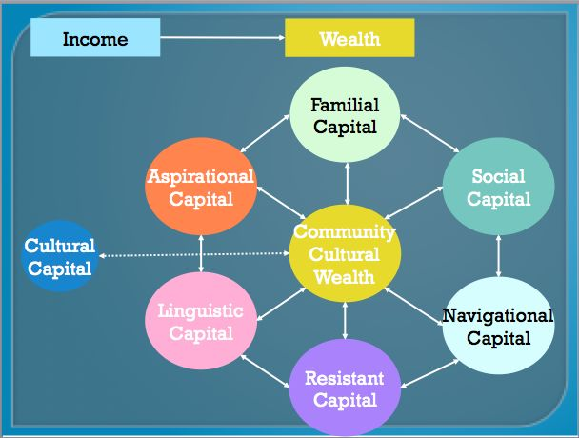
Notes:
Yoso’s Model of Cultural Wealth
Yosso’s model uses a strength-based perspective that understands the lived experiences and capital that students bring into their colleges, degree programs, and classes.
Aspirational Capital: “hopes and dreams” students have
Linguistic Capital: language, communication skills, and storytelling
Familial Capital: pre-college experiences within their community
Social Capital: friends and other social contacts
Navigational Capital: students' ability to navigate social institutions, like educational spaces
Resistance Capital: a historic legacy of engaging in social justice

Slide 16
HSIs in Texas
Home to 100/569 HSIs (Excelencia in Education, 2021)
The second highest geographical location
Texas HSIs must: increase their critical understanding of HSIs & the Latinx students that enroll in them & add state funds that would fill the gaps created by federal funds
Notes:
In 2021, Excelencia in Education reported that HSIs are housed in 30 states, the District of Columbia, and Puerto Rico. Texas is home to 100 of 569 HSIs, the second highest geographical concentration of these institutions (Excelencia in Education, 2021). Therefore, Texas must recognize and address the increasing number of HSIs in the state, and the Latinx students that enroll in them. This includes a critical understanding of how a culture of power (Delpit, 1995) contributes to the assimilation and stratification of Latinx students in higher education, and the addition of state funds that would fill the gaps created by federal funds at HSIs.

Slide 17
Texas State Funds
Culturally responsive curriculum & pedagogy
Programming that centers language, culture, & diverse perspectives
Hiring practices that diversify faculty, staff, & administration
Resourcing that responds directly to Latinx student enrollment, retention, & graduation
Notes:
State funds would be allocated using criteria that promote culturally responsive curriculum and pedagogy, hiring practices that diversify faculty, staff, and administration, programming that center the language, culture, and diverse perspectives of minority students, and resourcing that directly respond to Latinx student enrollment, retention, and graduation.

Slide 18
Proposal
San Antonio HACU Office + the State of Texas
Grant
U.S Department of Education Funds -> Texas HSIs
Counter neo-liberalistic approaches
Build on Latinx students' cultural wealth
Notes:
A collaboration between the San Antonio, TX HACU office and the State of Texas, could lead to a grant that supplements U.S. Department of Education Funds to Texas HSIs with state funds intended to build on Latinx students’ cultural wealth and counter neo-liberalistic approaches that dehumanize and exploit minority students (Roman, 2020).

Slide 19
Acknowledgments
Notes:
Texas Latino Policy Symposium
Dr. Rick Sperling
St. Mary’s University

Slide 20
Preguntas?

Slide 21
References
Apple, W. M. (2019). Ideology and curriculum. Taylor & Francis. (Original work published 1979)
Blagg, K., & Blom, E. (2018). Evaluating the return on investment in higher education: An assessment of individual- and state-level returns. Urban Institute. Evaluating the Return on Investment in Higher Education (urban.org)
Bo, Y. (2020). Issues around using academic return on investment (A-ROI) for informing and improving decisions. Jefferson County Public Schools (Kentucky). ERIC - ED603587 - Issues around Using Academic Return on Investment (A-ROI) for Informing and Improving Decisions. Part I: Validity, Online Submission, 2020
Delpit, L. (2006). Other people’s children: Cultural conflict in the classroom. The New Press. (Original work published 1995)
Epstein, M. E., & Mckinnon-Crowley, S. (2020). (D)riven by neoliberalism: Exploring alternative purposes for higher education, Texas Education Review, 8(2), 6-17. http://dx.doi.org/10.26153/tsw/9206
Excelencia in Education. (2019-20). Hispanic-serving institutions (HSIs) 2019-20: Fast facts. Hispanic-Serving Institutions (HSIs) 2019-2020 (FINAL FULL) (edexcelencia.org)
Galdeano, E. C., Flores A. R., & Moder J. (2012). The Hispanic association of colleges and universities and Hispanic-Serving institutions: Partners in the advancement of Hispanic higher education. Journal of Latinos and Education, 11, 157-162. https://doi.org/10.1080/15348431.2012.686352
Gasman, M., Samayoa, C. A., & Nettles, M. (2017). Investing in student success: Examining the return on investment for minority-serving institutions (Policy Information Report and ETS Research Report Series No. RR-17-57). Educational Testing Service. ERIC - EJ1168872 - Investing in Student Success: Examining the Return on Investment for Minority-Serving Institutions. Policy Information Report and ETS Research Report Series No. RR-17-57, ETS Research Report Series, 2017 (ed.gov)

Slide 22
References
Hispanic Association of Colleges and Universities. (2019-20). HSI quick facts. Quick_Facts.pdf (hacu.net)
Hispanic Association of Colleges and Universities. (2021). 2021 fact sheet: Hispanic higher education and Hispanic-serving institutions (HSIs). 2021_HSI_FactSheet.pdf (hacu.net)
Knoester, M., & Au, W. (2017). Standardized testing and school segregation: Like tinder for fire?, Race Ethnicity and Education, 20(1), 1-14. https://doi.org/10.1080/13613324.2015.1121474
Krawczyk, J. (2013). Conflicting purposes of higher education in federal language: Defining a liminal discourse [Doctorate dissertation, Oklahoma State University]. ProQuest Dissertations and Theses.
Roman, B. (2021). Latino Bienestar During and Post Covid-19 [Policy brief]. Texas Latino Policy Symposium. Latino Bienestar During and Post Covid-19 Policy Brief Book (secureservercdn.net)
U.S. Department of Education. (2021). Project abstracts for Title V HSI. DHSI FY 2021 Project Abstracts (PDF) (ed.gov)
Yosso, J. T. (2005). Whose culture has capital? A critical race theory discussion of community cultural wealth, Race Ethnicity and Education, 8(1), 89-91. https://doi.org/:10.1080/1361332052000341006

