Slide 1
Latino Affordable Housing Concerns: Responsive Policy Priorities
Mia Loseff - Texas Housers

Slide 2

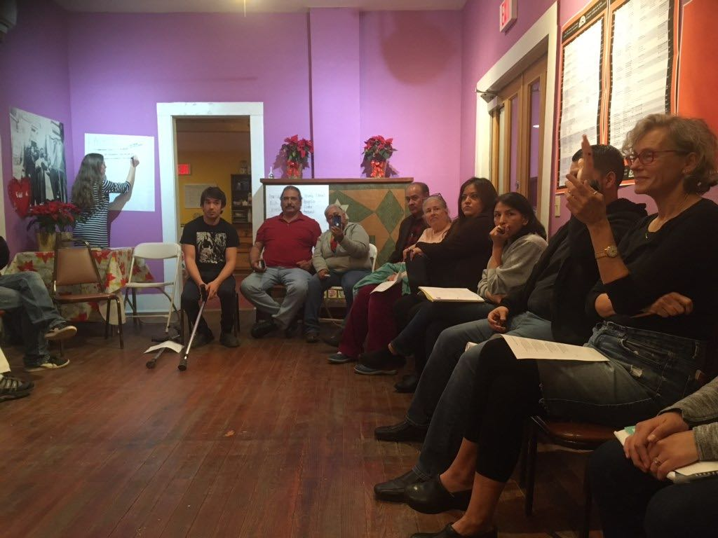
Our perspective - rooted in Community
Notes:
Rooted in westside organizng, Talk about housers as a whole and the goal. All about combining lived experience with what we see in data and historical trends of issues impacting latinos
My experience is in the westide and what we see in san anotnio. The issues covered in this presentation are disproportionately impacting latinos!
In this presentation im going to go through renters and homeowners, some main issues impacting them and solutions

Slide 3
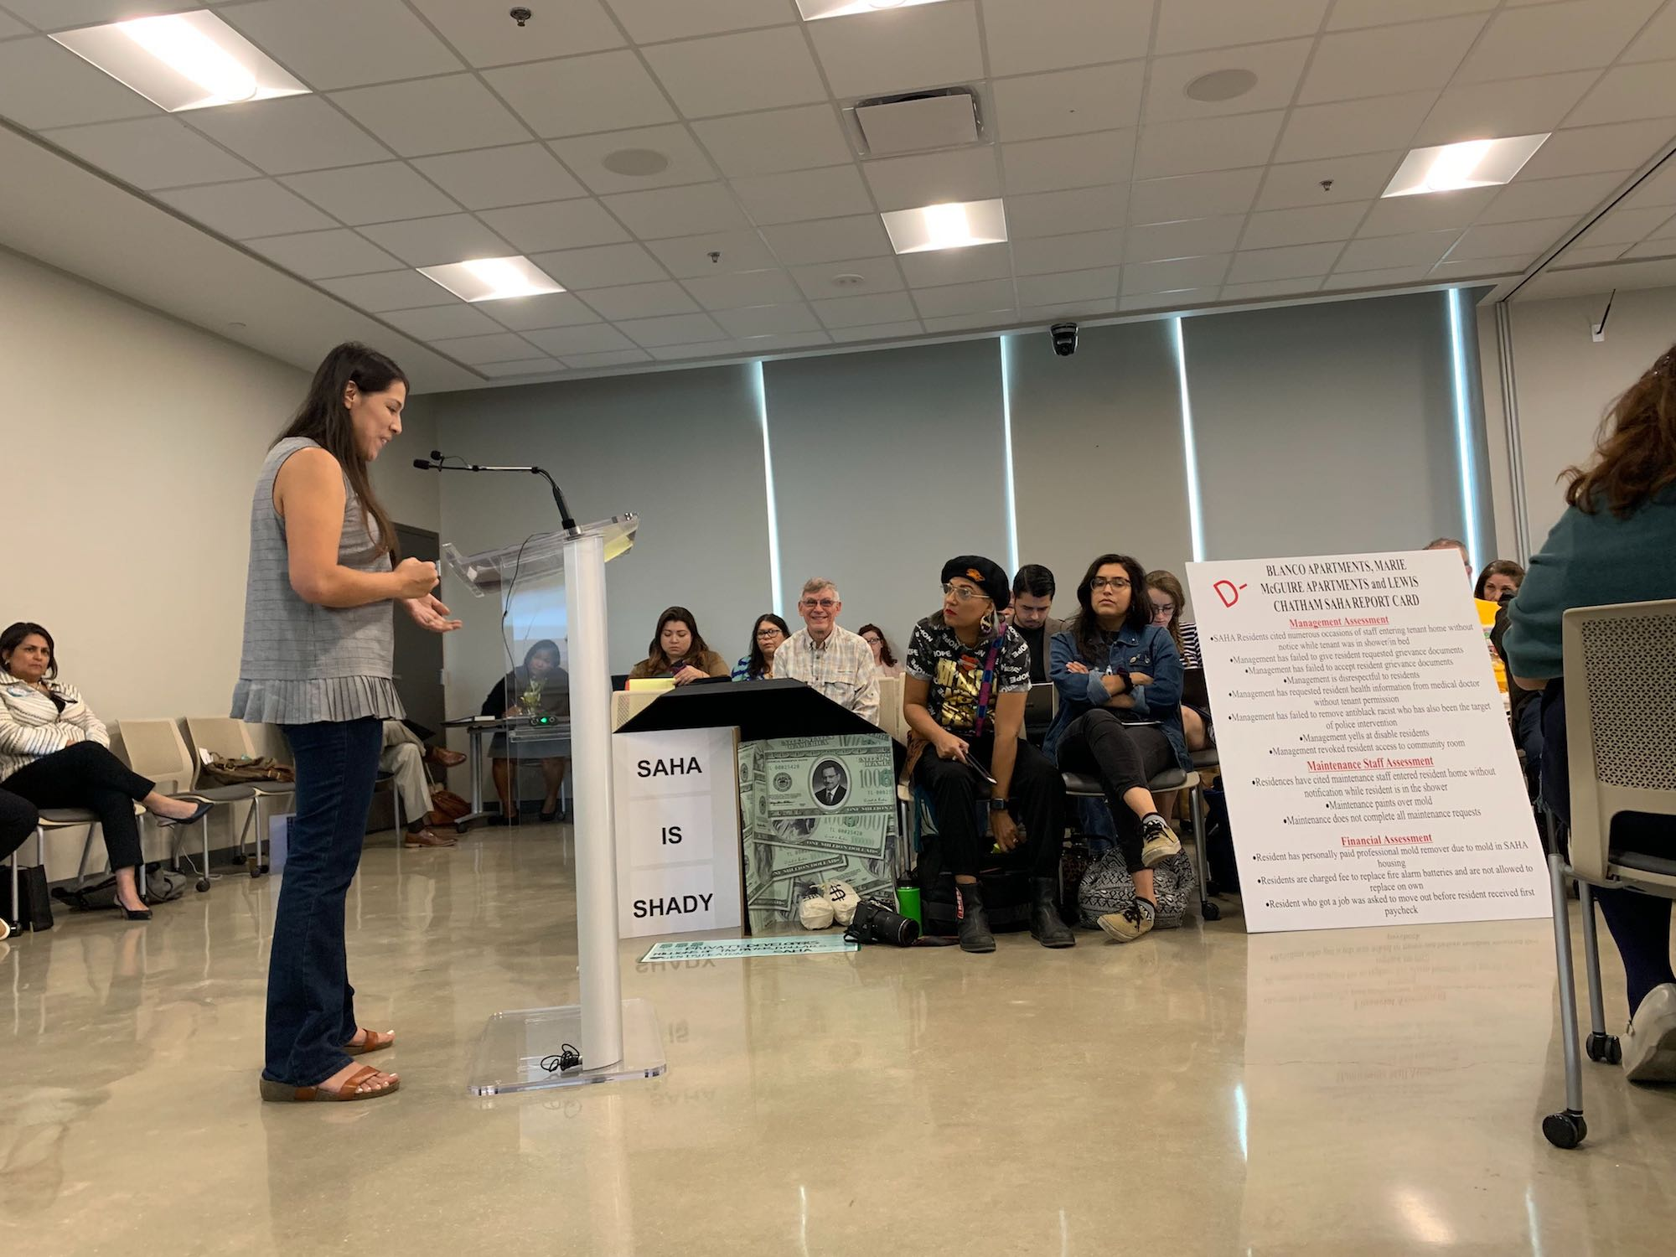
The Four Rights
The Right to Choose
The Right to Stay
The Right to Equal Treatment
The Right to Have a Say
Notes:
What to consider when we discuss policy (the four rights, then Talking about needs, concerns and policy actions for renters Homewoenrs and finally )Where we go from here / next steps / what you can do
Affordable housing is broken down in these two
Jump right into this.
Hope is to give a sampling of some of the big issues facing latinos in the realm of affordable housing

Slide 4
Central issues facing SA Renters
The housing gap - not enough units at low income levels
30% AMI [$22,000] - 30 units for every 100 households who need one 50% AMI [$37,000] - 47 units for every 100 households who need one
100% AMI [$74,000] - 107 units for every 100 households who need one
Neglected maintenance repairs + absent management
Notes:
Renters in san antonio are disproportionately latino and Black so as we talk about these numbers it is important to keep that in mind

Slide 5
Policy Solutions for SA Renters
Fund public housing, fund new MF housing at the lowest income levels
Incentivize deep affordability
  If CoSA dollars are involved, project must include units for 30% AMI
Rental registry
Repeat offender policy
Notes:
Might need to take out rental policy sidewalk policy all these things

Slide 6
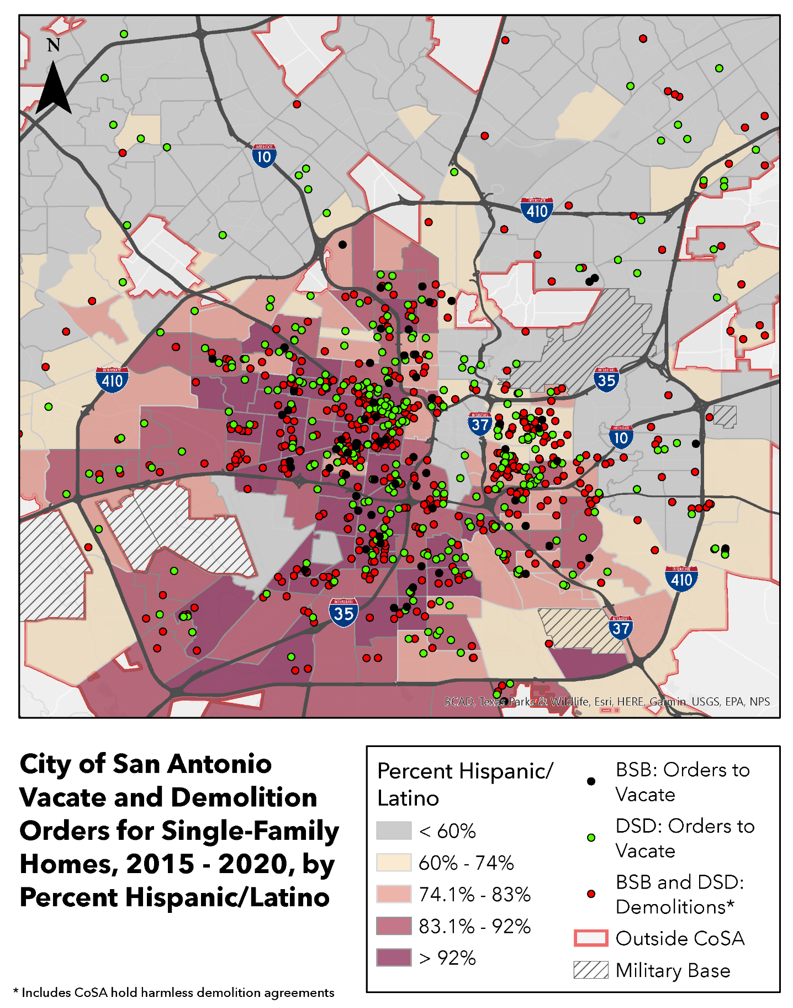
Central Issues facing SA Homeowners
Targeted code violations
Often leading to demolitions
Rapidly increasing property taxes
Notes:
These are tied together, when u get repairs ur taxes can shoot up. Key issue here is DISPLACEMENT
Big theme with latino homeowners and low income around the city is we dont want to displace.

Slide 7
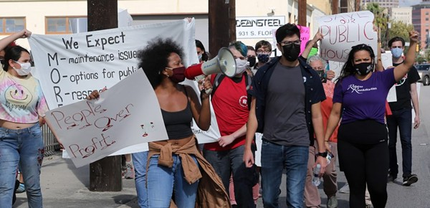
Policy Solutions for SA Homeowners
Fund preservation + rehabilitation efforts
Non-emergency code violations are not fined
Property tax freezes
  Homestead Exemption, Legacy homeowner freeze, etc
Notes:
Rehab efforts, the most affdble housing we have is the one that already exists

Slide 8
Considerations to influence SA affordable housing policy
Unified Development Code - green building, less parking spaces, density bonuses
Lived Experiences at the Forefront
Eye for Displacement - cater towards existing residents before making space for new ones
Notes:
Policy is a chance to have a large impact. So where do we go from here?
We continue to push
We base our policy in lived experinces of latino commuinties who are in these neighborhoods
We maintain the four rights throughout all policy ideas we consider
And we DONT STOP. la lucha sigue!! Gracias por oir mi presentacion :)

