Slide 1
Latino Bienestar (Well-Being) among Texas’ 12 Economic Regions
Rogelio Sáenz and Albert Assogba
University of Texas at San Antonio
rogelio.saenz@utsa.edu
Presented at the Fourth Texas Latino Policy Symposium. December 2, 2021. San Antonio.

Slide 2
Outline
Opening remarks
The big picture
Demographic trends
Socioeconomic trends
The COVID challenges
Variations in Latinos in the 12 Economic Regions
Demographic structure
Political possibilities
Socioeconomic and health patterns
Concluding remarks

Slide 3
Opening Remarks
We have been waiting for this time—when Latinos would outnumber whites as the largest group in Texas
Periodically there have been efforts to try to identify the key issues and strategies that we need to undertake in order to maximize this opportunity
Kudos to Juan Flores for his visionary outlook and uncompromising commitment to get people together to discuss what is needed and to plan accordingly
The big challenges that confronted us 3-4-5 decades are still with us
Republicans have used all means at their dispersal to minimize the political power of Latinos and other people of color and have continued their minimalist policies re: human development in favor of cultural wars

Slide 4
The Big Picture

Slide 5
Demographic Trends
What did the 2020 census tell us?
The Texas population experienced the largest gain and one of the fastest rates of growth between 2010 and 2020
Growth due of 4 million Texans due to primarily to Latinos (49.5% of the growth), other persons of color (45.8%), and very little due to whites (4.7%)
With an aging population, whites experienced very little population growth [added 187,252 people ~ Brownsville (186,738)]
People of color added 3,812,692 ~ Houston (2,304,580) + San Antonio (1,434,625)
While Texas population grew at a rapid pace relatively speaking, the population growth slower than in the past
Undercount in Texas

Slide 6
Socioeconomic Trends: A Half Century of Inequality

Slide 7
Median Family Income in 2018 Dollars: Panel A (Latino, White, and Black Families); Panel B (Native-Born and Foreign-Born Latinos), 1960-2018

Slide 8
Ratio of Black/Latino Median Family Income to White Median Family Income: Panel A (Latino, White, and Black Families); Panel B (Native-Born and Foreign-Born Latinos), 1960-2018

Slide 9
COVID-19 CHALLENGES

Slide 10
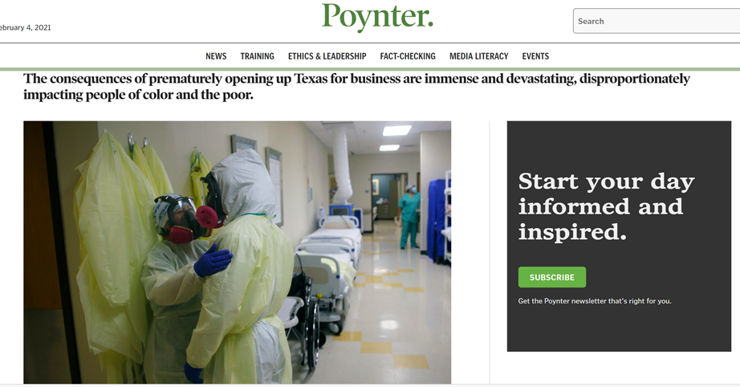
COVID-19 Devastation on Latinos in Texas

Slide 11
Ratio of Texas Latino-White and Black-White COVID-19 Age-Adjusted Death Rates, Selected Periods

Slide 12
Variations of Latinos Across the 12 Economic Regions

Slide 13
Data
2019 American Community Survey 5-Year Estimates (2015-2019)
Counties aggregated into 12 Economic Regions

Slide 14
Texas 12 Economic Regions

Slide 15
Profiles
DEMOGRAPHIC | POLITICAL | SOCIOECONOMIC | HEALTH
Latino population Pct. of region population Latino | Pct. of region Citizen Voting-Age Population Latino | Pct. of Latinos 25+ college graduates | Latino Age-Adjusted Death Rate
Pct. of Latinos foreign-born |  | Pct. of Latino workers in top occupations | Total Population COVID-19 Death Rate
Pct. of Latinos 0-17 |  | Latino STEM majors per 1,000 workers
Pct. of Latinos 65+ |  | Pct. Latinos 16-64 working
 |  | Median family income
 |  | Pct. Latino families in poverty
 |  | Pct. Latino housing units owner-occupied
 |  | Pct. Latinos without insurance

Slide 16
DEMOGRAPHIC PROFILE, 2015-2019
ECONOMIC REGION | Latino pop. | % Latino pop. | % Latino FB | % Latino <18 | % Latino 65+
Alamo | 1,494,249 | 53.8 | 15.3 | 29.4 | 9.4
Capital | 709,600 | 31.7 | 25.6 | 31.1 | 5.3
Central Texas | 286,327 | 23.7 | 22.2 | 33.8 | 5.4
Gulf Coast | 2,618,890 | 37.1 | 37.7 | 33.2 | 5.4
High Plains | 329,514 | 37.9 | 18.2 | 33.4 | 6.6
Metroplex | 2,182,635 | 28.3 | 36.3 | 35.1 | 4.6
NW Texas | 122,762 | 22.3 | 15.7 | 32.3 | 7.6
South Texas | 2,050,578 | 84.6 | 23.1 | 32.3 | 10.1
SE Texas | 119,842 | 15.4 | 33.7 | 35.0 | 5.3
Upper East TX | 175,244 | 15.4 | 33.9 | 38.0 | 4.3
Upper Rio Grande | 706,148 | 82.0 | 27.3 | 28.7 | 11.4
West Texas | 321,092 | 49.8 | 20.0 | 32.7 | 7.2

Slide 18
POLITICAL PROFILE, 2015-2019
ECONOMIC REGION | PCT. CITIZEN VOTING-AGE POPULATION LATINO
Alamo | 48.1
Capital | 23.9
Central Texas | 17.3
Gulf Coast | 25.8
High Plains | 30.3
Metroplex | 17.6
NW Texas | 18.1
South Texas | 78.6
SE Texas | 9.0
Upper East TX | 8.6
Upper Rio Grande | 77.6
West Texas | 41.8

Slide 19
SOCIOECONOMIC PROFILE

Slide 20
Percent of Persons 25 and Older with a Bachelor’s Degree or Higher by Economic Region, 2015-2019

Slide 21
Percent of Latino Workers in Management, Business, Science, and Arts Occupations by Economic Region, 2015-2019

Slide 22
Latino STEM Majors Per 1,000 Workers by Economic Region, 2015-2019

Slide 23
Percent of Persons 16-64 Employed by Economic Region, 2015-2019

Slide 24
Median Latino Family Income by Economic Region, 2015-2019

Slide 25
Percent of Latino Families in Poverty by Economic Region, 2015-2019

Slide 26
Percent of Latino Housing Units Owner-Occupied by Economic Region, 2015-2019

Slide 27
Percent of Latinos Without Health Insurance by Economic Region

Slide 28
HEALTH PROFILE

Slide 29
Latino Age-Adjusted Death Rates by Economic Region, 2015-2019

Slide 30
Total Population COVID-19 Death Rates by Economic Region, 2015-2019

Slide 31
OVERALL RANKING OF ECONOMIC REGIONS ON LATINO BIENESTAR
RANKING | ECONOMIC REGION | POINTS
1 | Capital | 27
2 | Alamo | 42
3 | Gulf Coast | 52
4 | Upper Rio Grande | 53
5 | Metroplex | 58
6 | Central Texas | 63
7 | West Texas | 63
8 | South Texas | 77
9 | High Plains | 81
10 | Southeast Texas | 86
11 | Northwest Texas | 89
12 | Upper East Texas | 89

Slide 32
Closing Remarks
Simply put: lots of work to be done, much more than before the pandemic
Great diversity in Latino population
Political messaging
Political engagement
203,000 Latinos turn 18 every year

