Slide 1
Residential Displacement & Assistance
Matt Garcia
Staff Attorney

Slide 2
The TRLA
Service Area

Slide 3
EMAIL: RighttoCounsel@trla.org
RIGHT TO COUNSEL
CALL/TEXT: (210) 212-3703

Slide 4
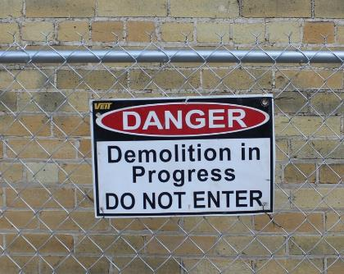
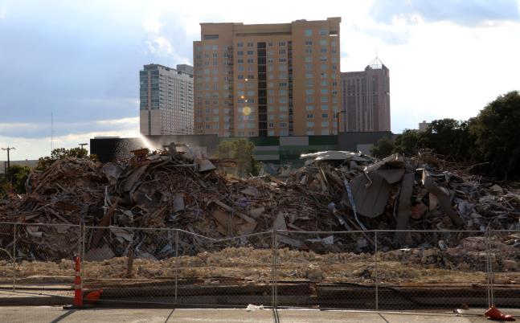
The Many Forms of Displacement

Slide 5
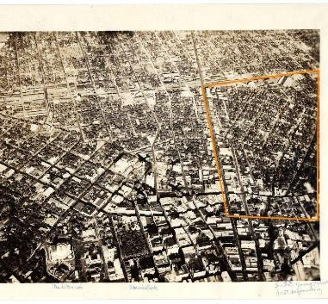
Urban Renewal and the Uniform Relocation Act

Slide 6
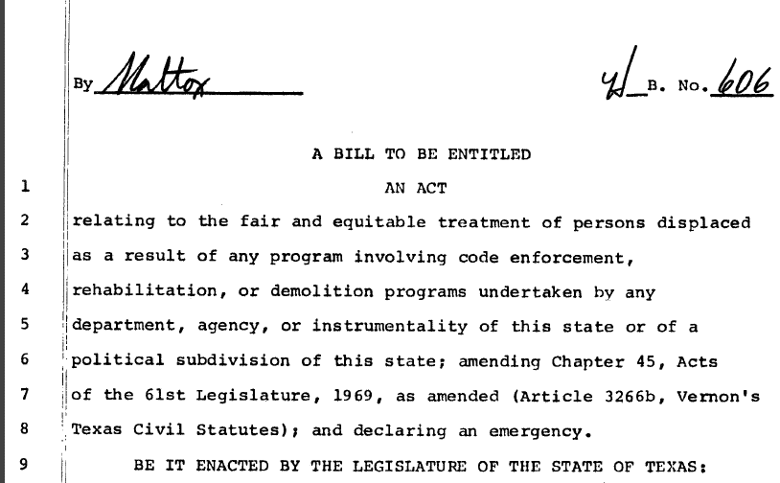

Slide 7
§ 21.046. Relocation Assistance Program
(a) A department, agency, instrumentality, or political subdivision of this state shall provide a relocation advisory service for an individual, a family, a business concern, a farming or ranching operation, or a nonprofit organization that is compatible with the Federal Uniform Relocation Assistance and Real Property Acquisition Policies Act of 1970, 42 U.S.C.A. 4601, et seq.
(b) This state or a political subdivision of this state shall, as a cost of acquiring real property, pay moving expenses and rental supplements, make relocation payments, provide financial assistance to acquire replacement housing, and compensate for expenses incidental to the transfer of the property if an individual, a family, the personal property of a business, a farming or ranching operation, or a nonprofit organization is displaced in connection with the acquisition.
(c) A department, agency, instrumentality, or political subdivision of this state that initiates a program under Subsection (b) shall adopt rules relating to the administration of the program.
(d) Neither this state nor a political subdivision of this state may authorize expenditures under Subsection (b) that exceed payments authorized under the Federal Uniform Relocation Assistance and Real Property Acquisition Policies Act of 1970, 42 U.S.C.A. 4601, et seq.
(e) If a person moves or discontinues the person's business, moves personal property, or moves from the person's dwelling as a direct result of code enforcement, rehabilitation, or a demolition program, the person is considered to be displaced because of the acquisition of real property.

Slide 8
Jones v. Alamo Heights ISD

Slide 9
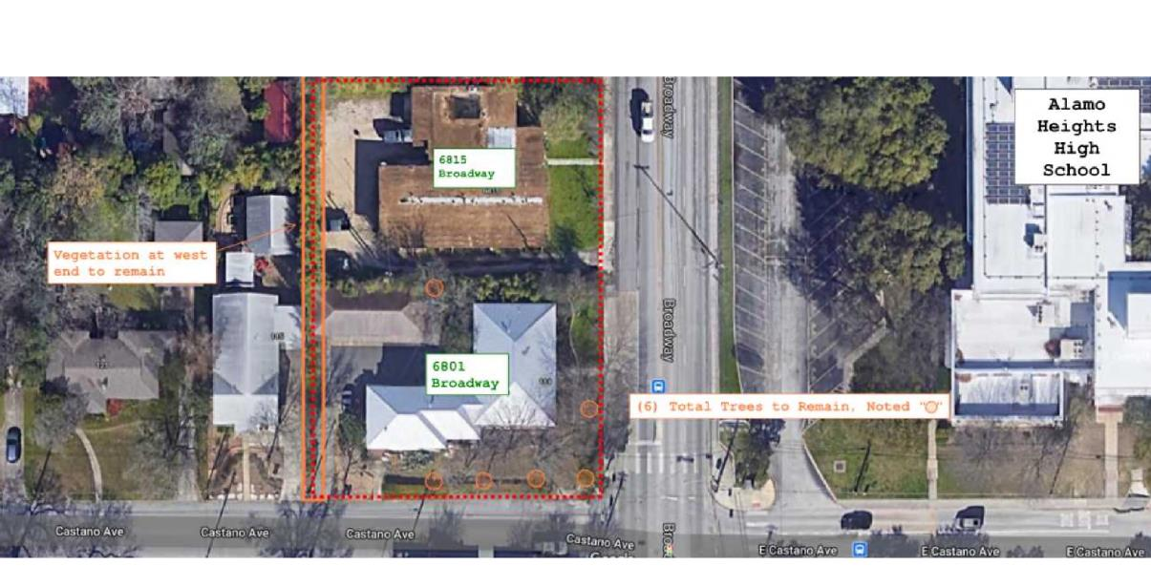

Slide 10
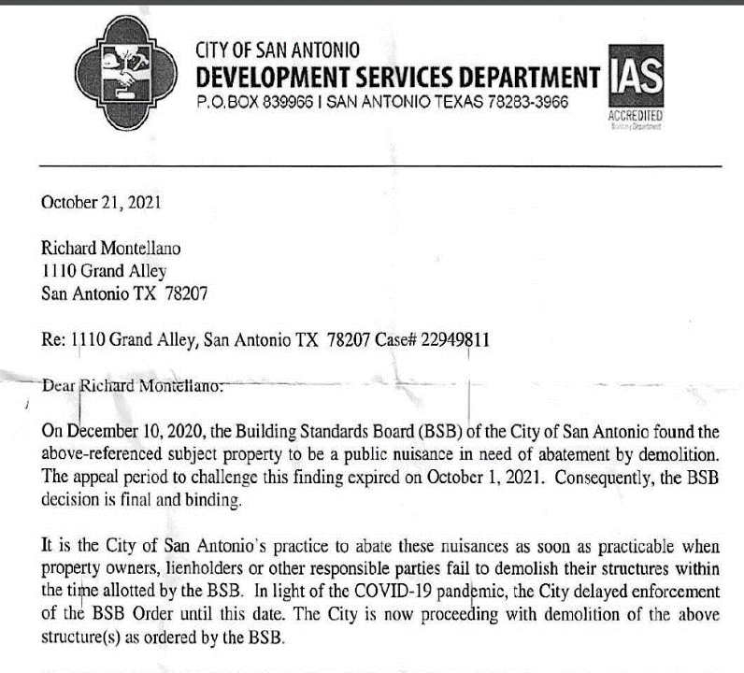
Montellano v. Nirenberg, et al.

Slide 11
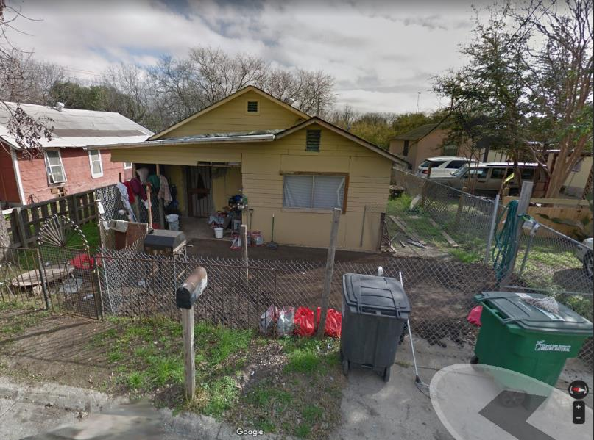

Slide 12
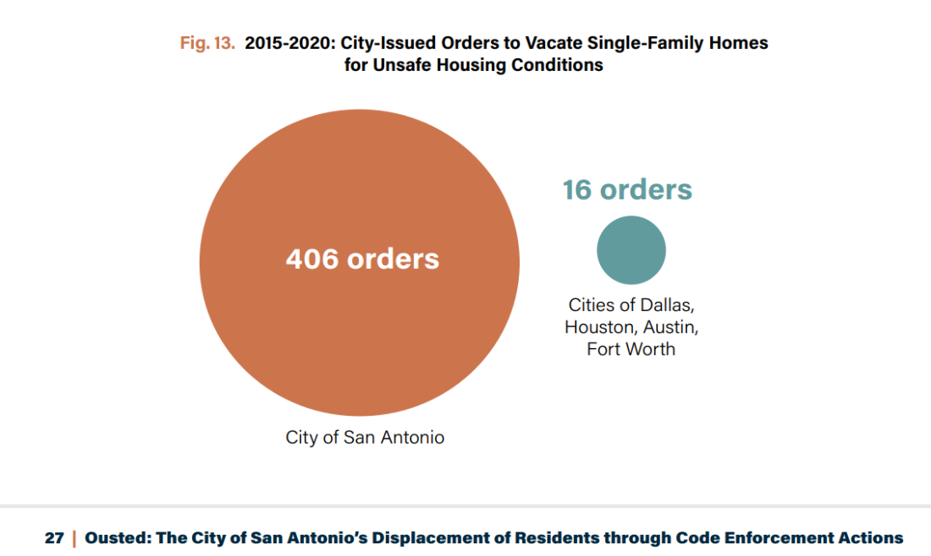

Slide 13
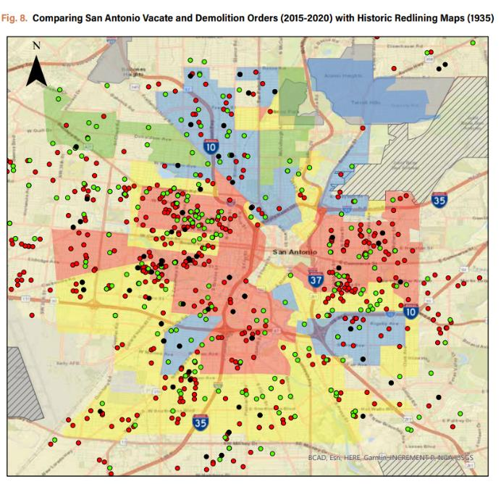
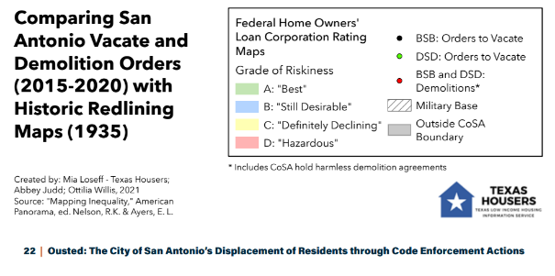

Slide 14
Residential Displacement & Assistance
Matt Garcia
Staff Attorney
@mattsgarcia

