Slide 1
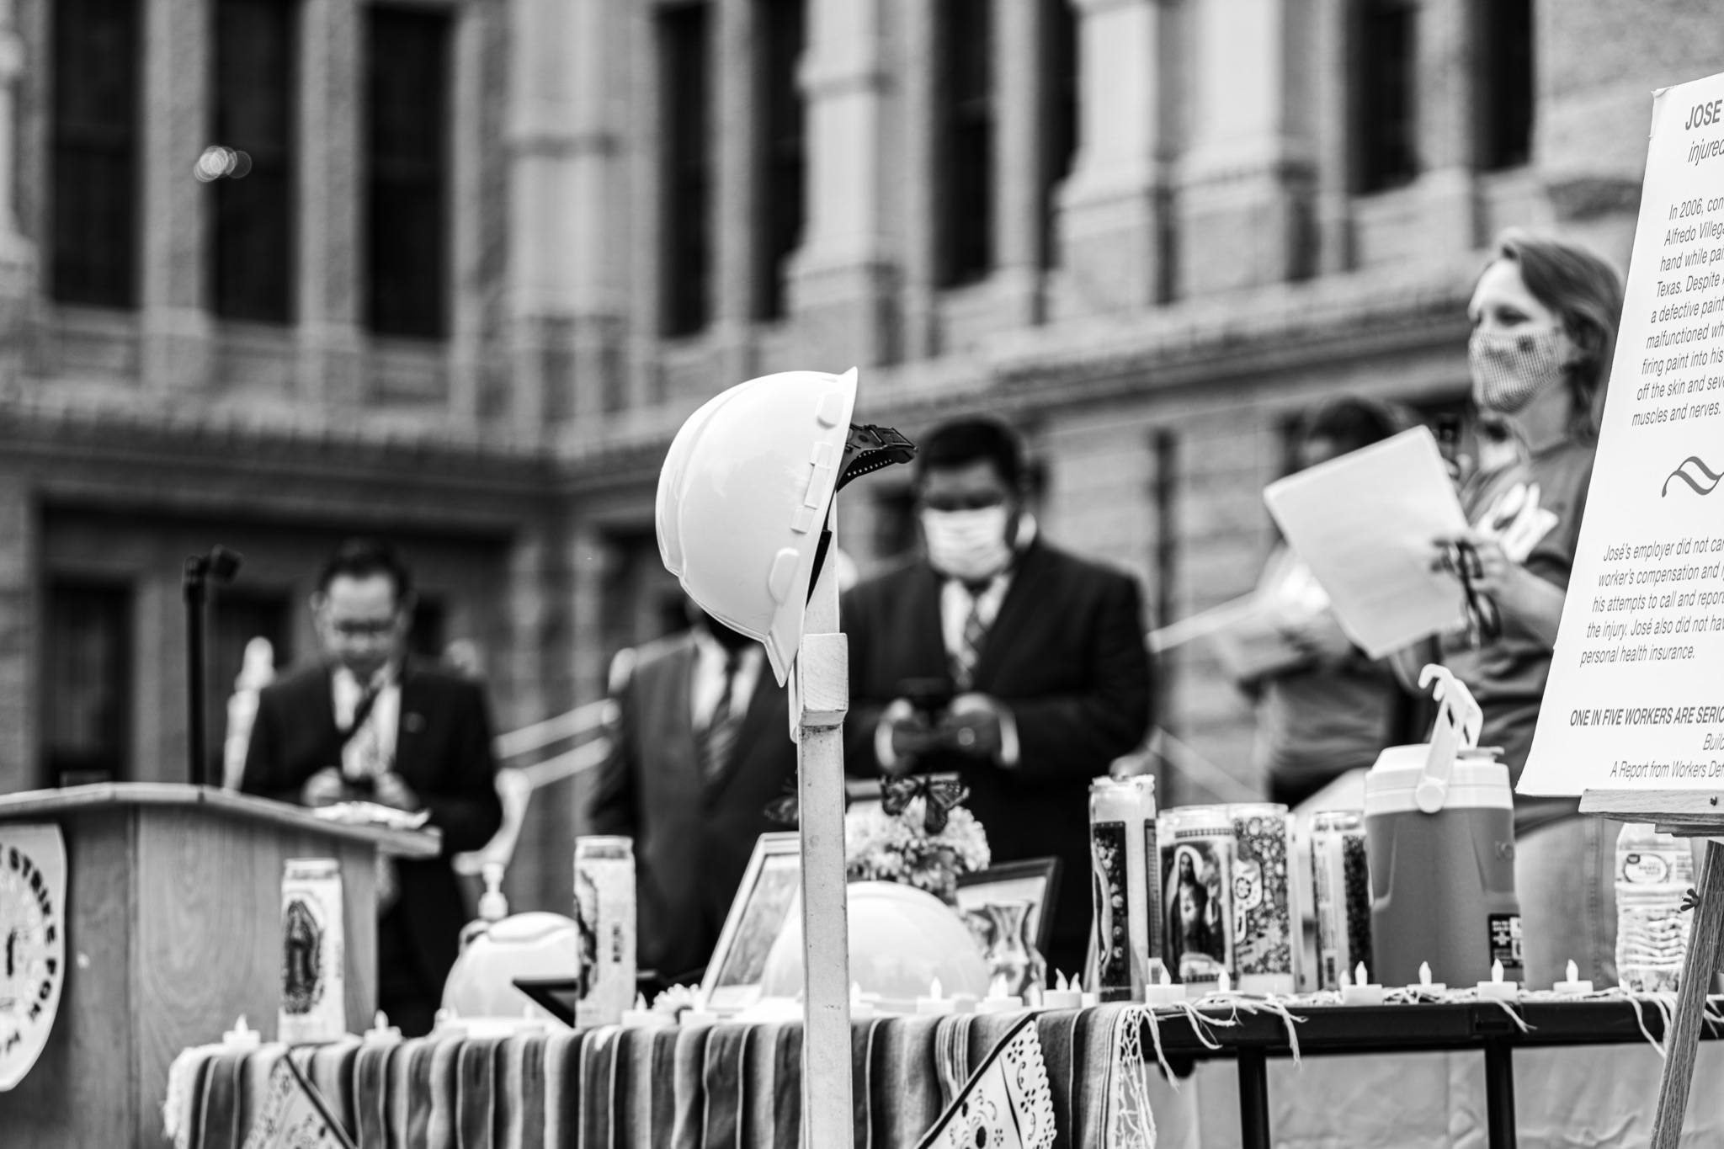
Worker Power in Texas: Local & State Organizing
Juan Benitez, Director of Communications

Slide 2
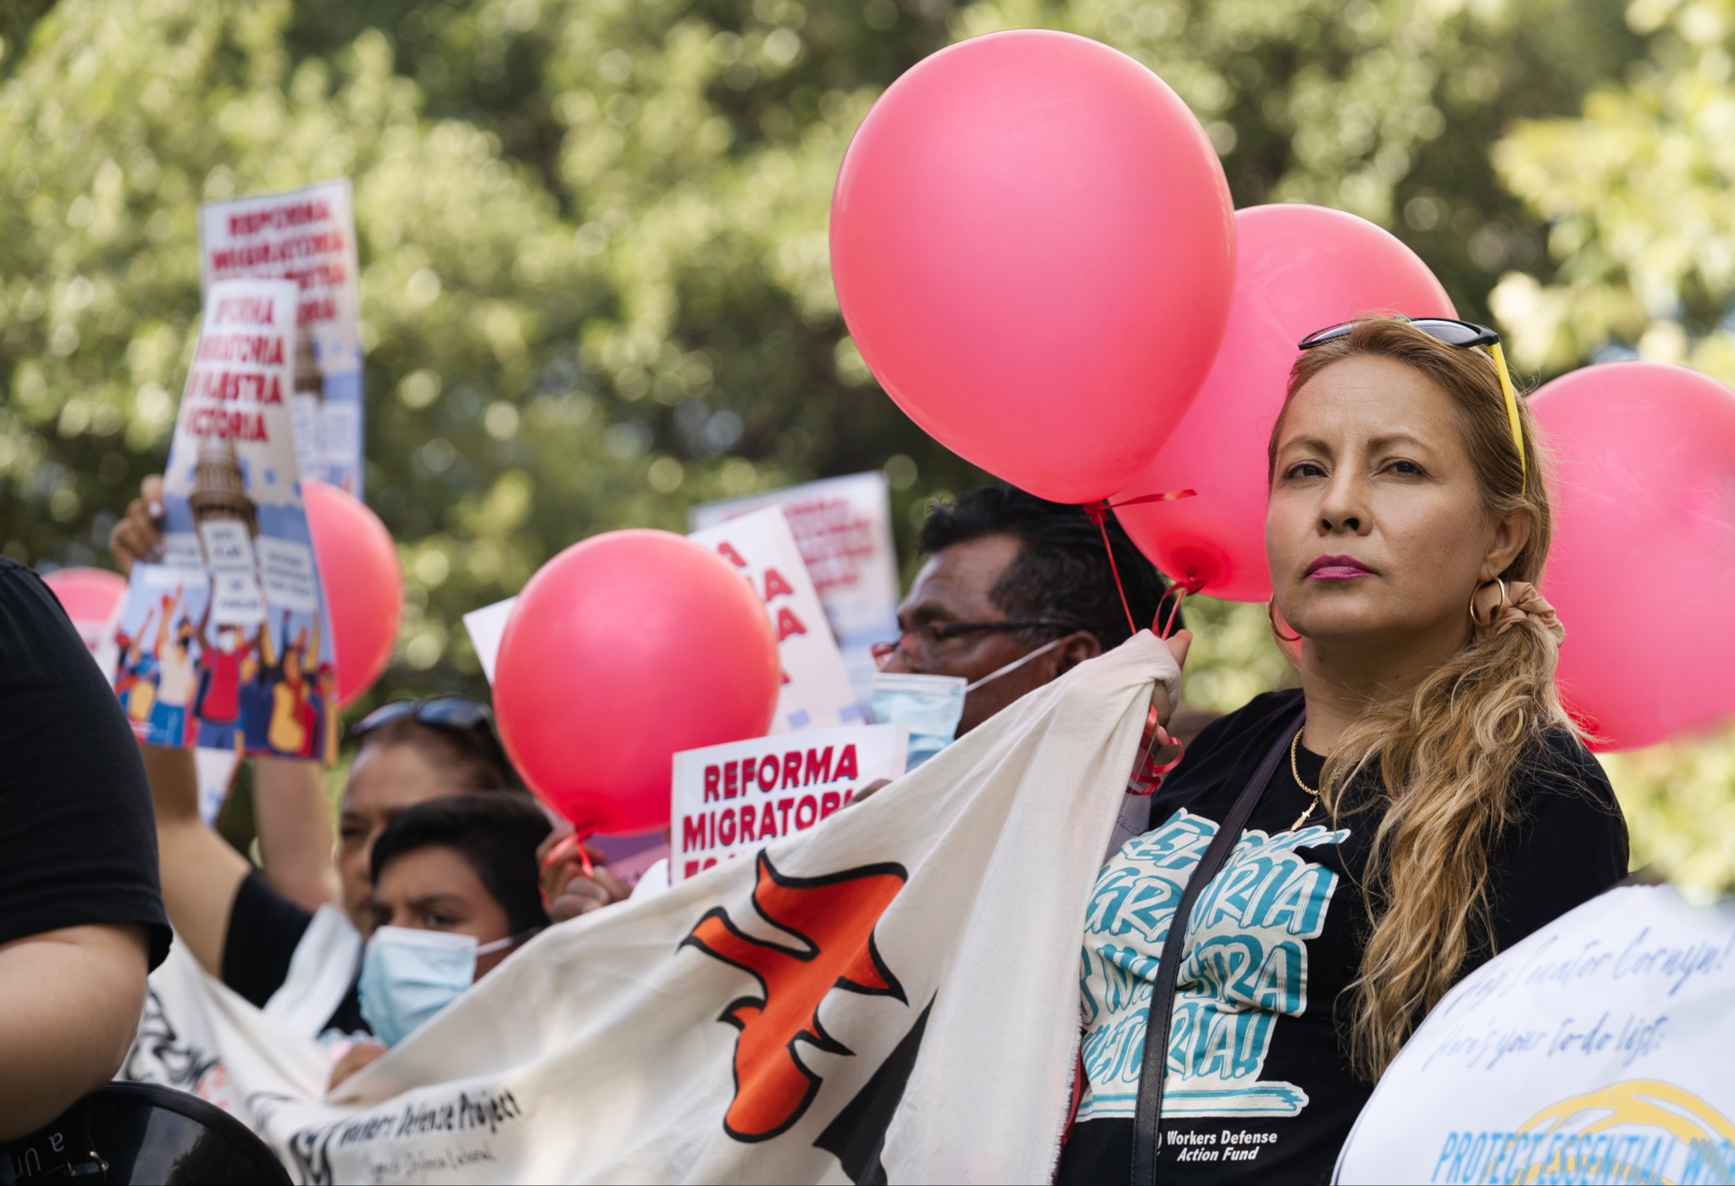
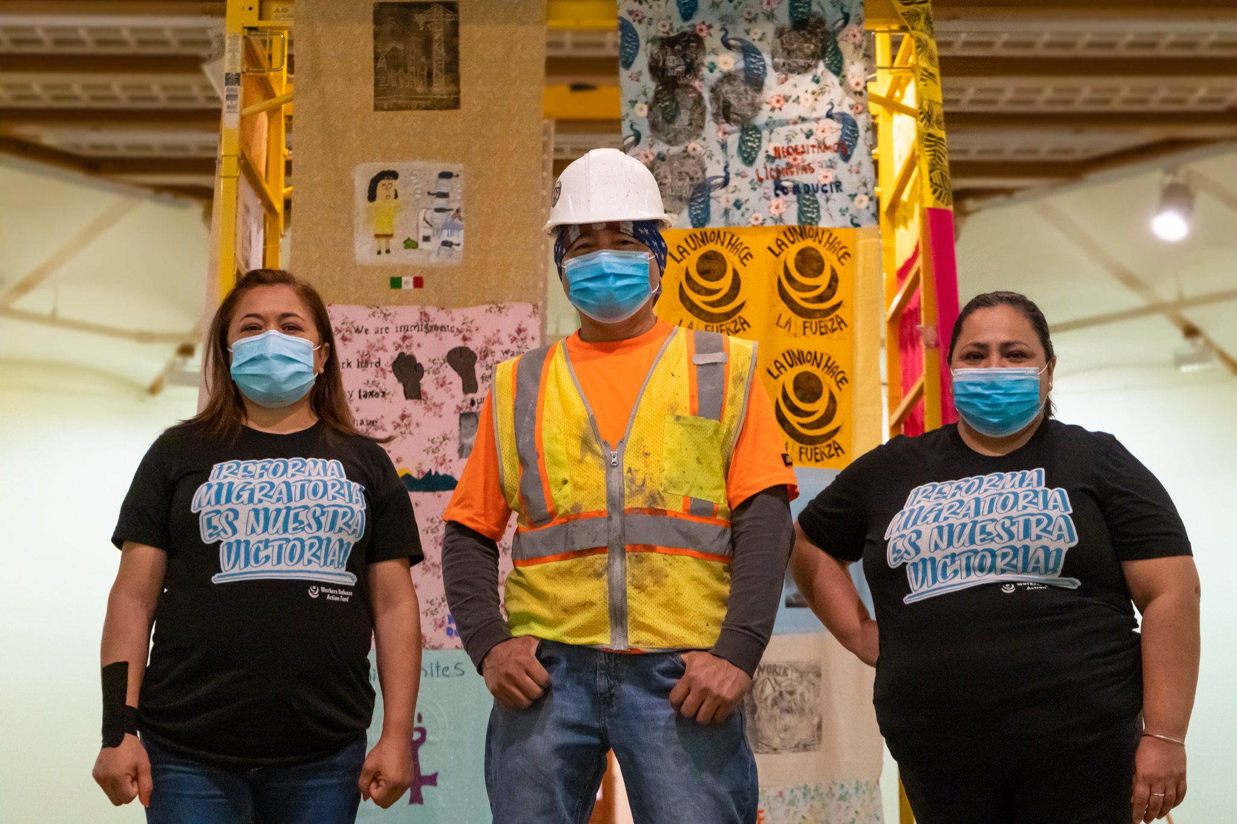
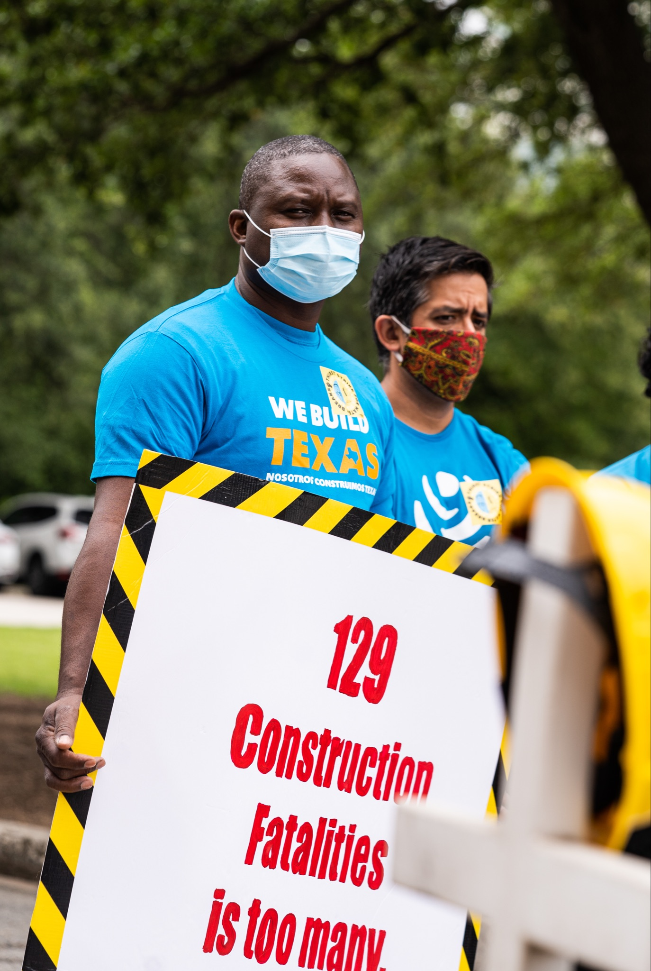
Workers Defense Project is a statewide member-based organization building power for low-wage, immigrant workers across Texas. Through education, organizing and direct services, we empower workers to win fair, safe jobs and become effective advocates for themselves and their communities.
Notes:
Strategic focus on the construction industry - the deadliest construction industry in the country where a construction worker dies every three days.

Slide 3
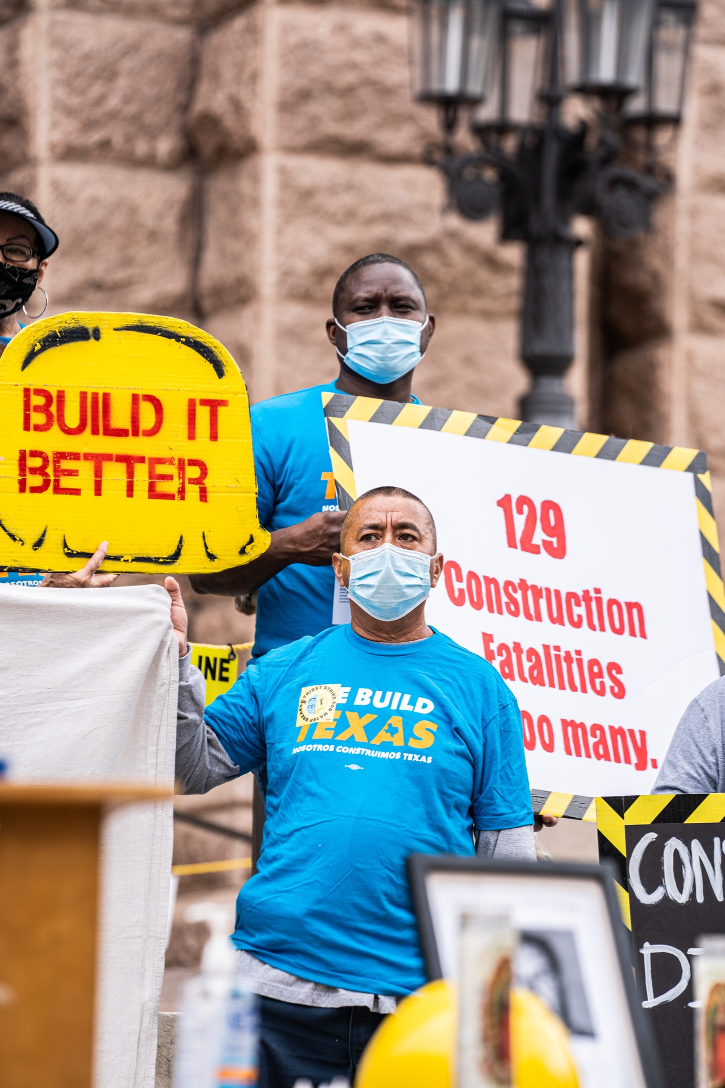
THE TEXAS CONSTRUCTION INDUSTRY
Deadliest construction industry in the country
Construction worker dies every three days
70% immigrant workforce, 50% undocumented
Some issues on construction sites:
Wage theft
Relation
No workers’ compensation
No water breaks
Lack of safety training
Notes:
Construction workers in Texas build our state but face deadly working conditions, wage theft, discrimination and are denied the basic protections all workers deserve.
Dangerous and deadly working conditions.
Texas is the deadliest state for construction workers in the country. A construction worker in Texas dies from a workplace injury every three days, making it the country’s deadliest state for construction workers.
Basic safety protections like rest breaks, protective equipment, clean drinking water, and emergency first aid are critical to ensure safe workplaces. For a significant portion
Wage Theft and Retaliation
What is the problem?
One in every five construction workers in Texas is denied pay by their employer.
Additionally 1 out of 3 of workers who try to recover wages are retaliated against by their employer
Workers Compensation
What is the problem?
Construction is dangerous and many workers don’t have any insurance: Death and Injury on the job are rampant in the Texas construction industry
One in five workers gets seriously injured on the job, requiring medical attention.
More workers die in Texas and at a higher rate than in any other state.
Yet, only 40% of workers report that they have workers compensation.

Slide 4
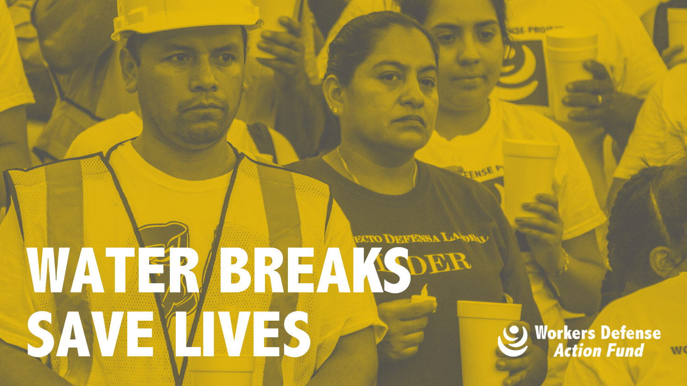
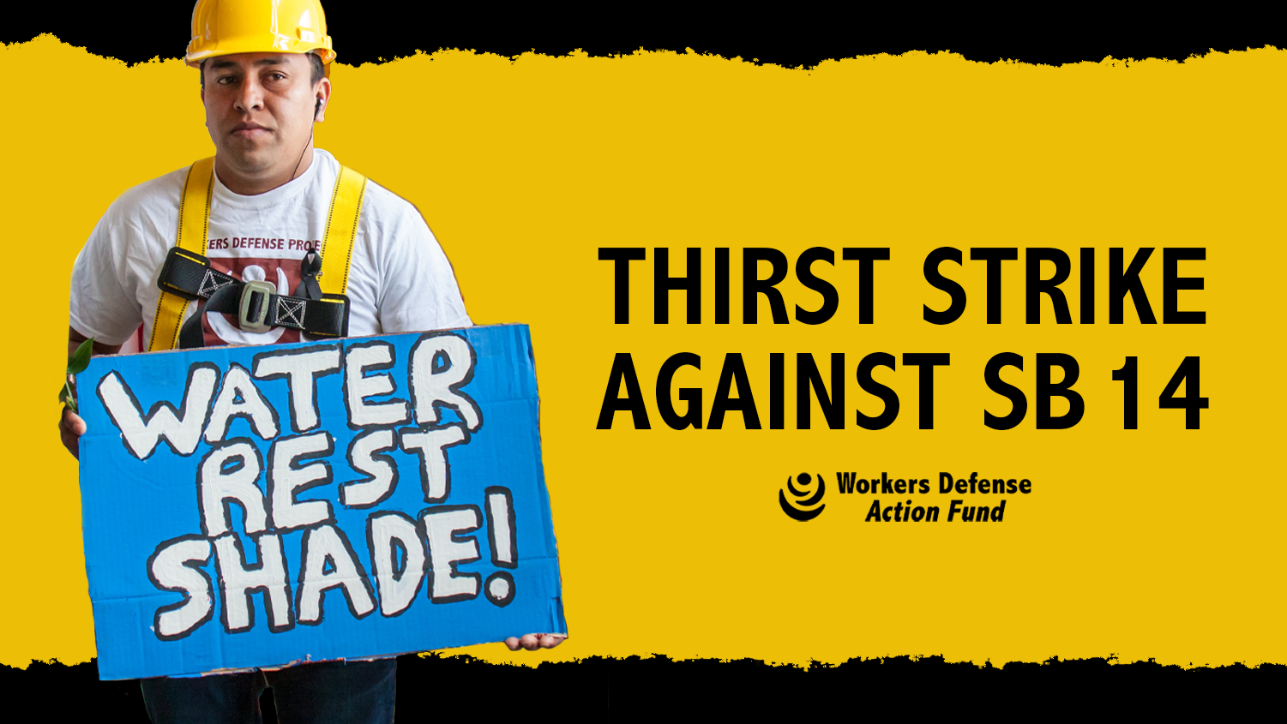
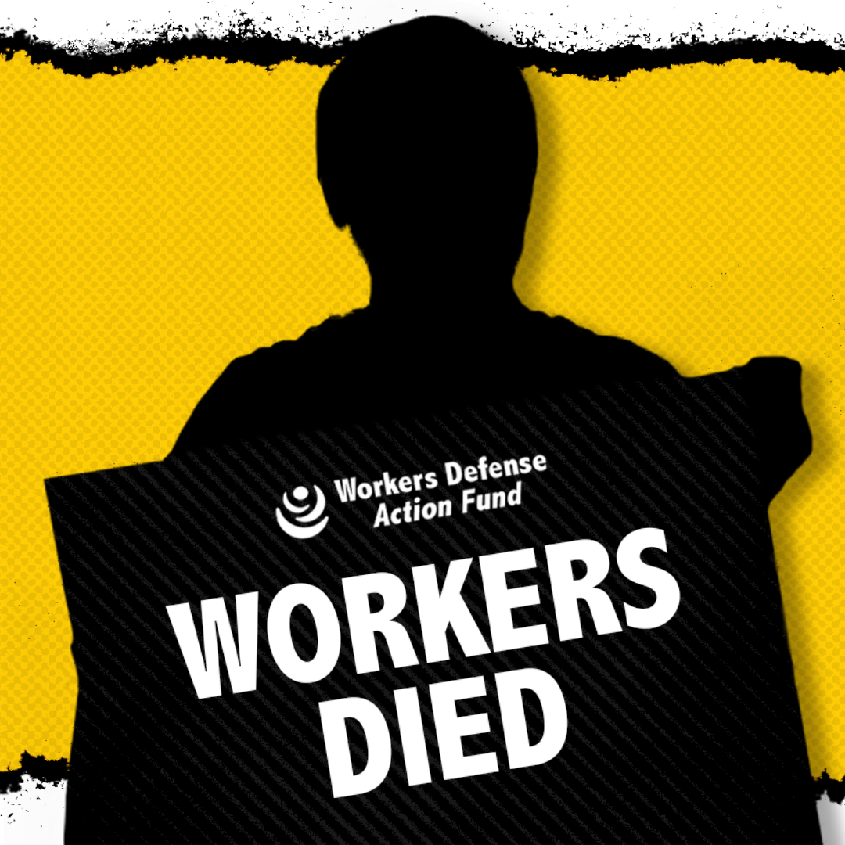
TEXAS LEGE ORGANIZING:
Some context:
Austin rest break ordinance (2010)
Dallas rest break ordinance (2015)
Senate Bill 14 - Labor preemption bill
Bridging policy with comms
Fight to protect water breaks for construction worker
Notes:
No state or federal law that guarantees construction workers are given a water break. Workers Defense led the fight for rest break ordinances in Austin and Dallas for construction workers that guarantee at least 10 minutes for every 4 hours of work.
SB 14 would have undone all local worker protections and prevented cities and counties from passing protections that exceed those at the state level.
Fight against SB 14 turned into the fight to protect water breaks for construction workers. This was a joint policy and comms decision for how we wanted this fight to play out locally, statewide and nationally.

Slide 5
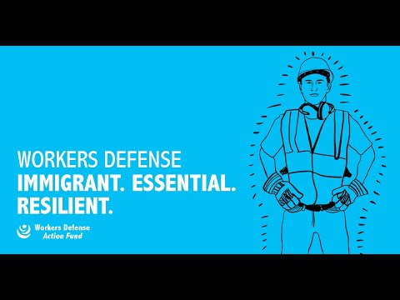

Slide 6
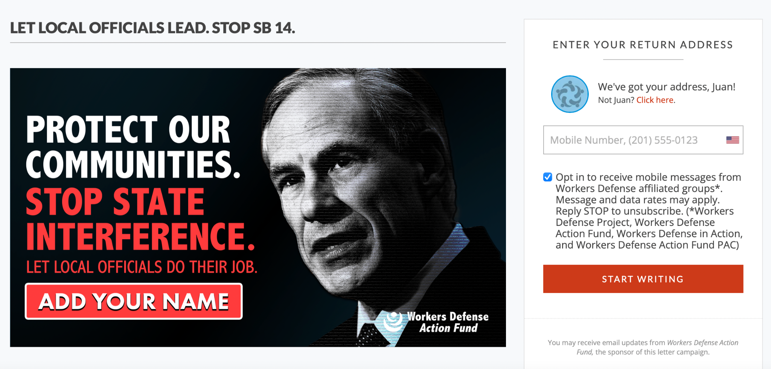
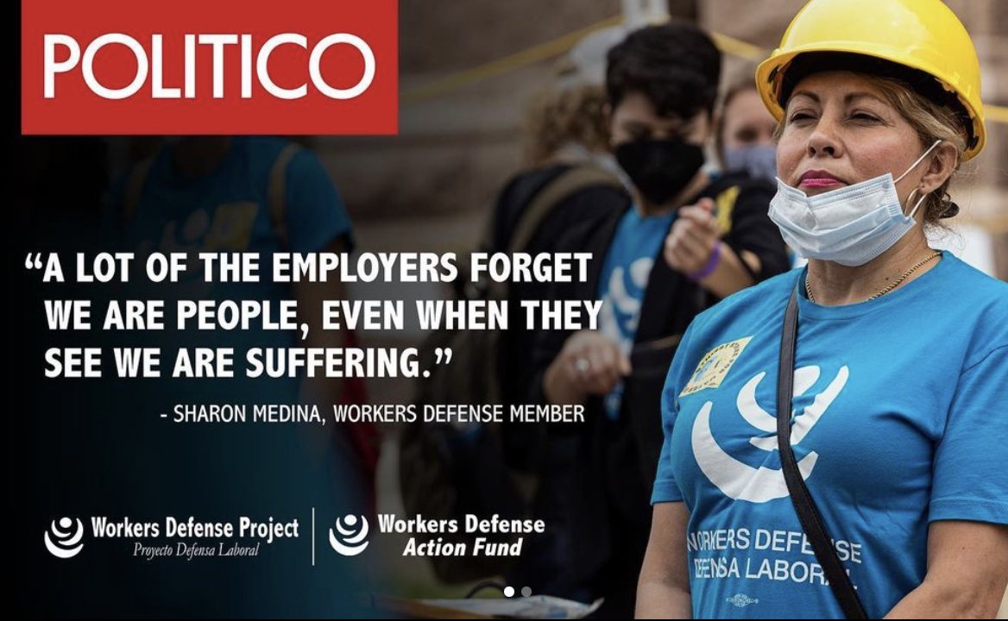
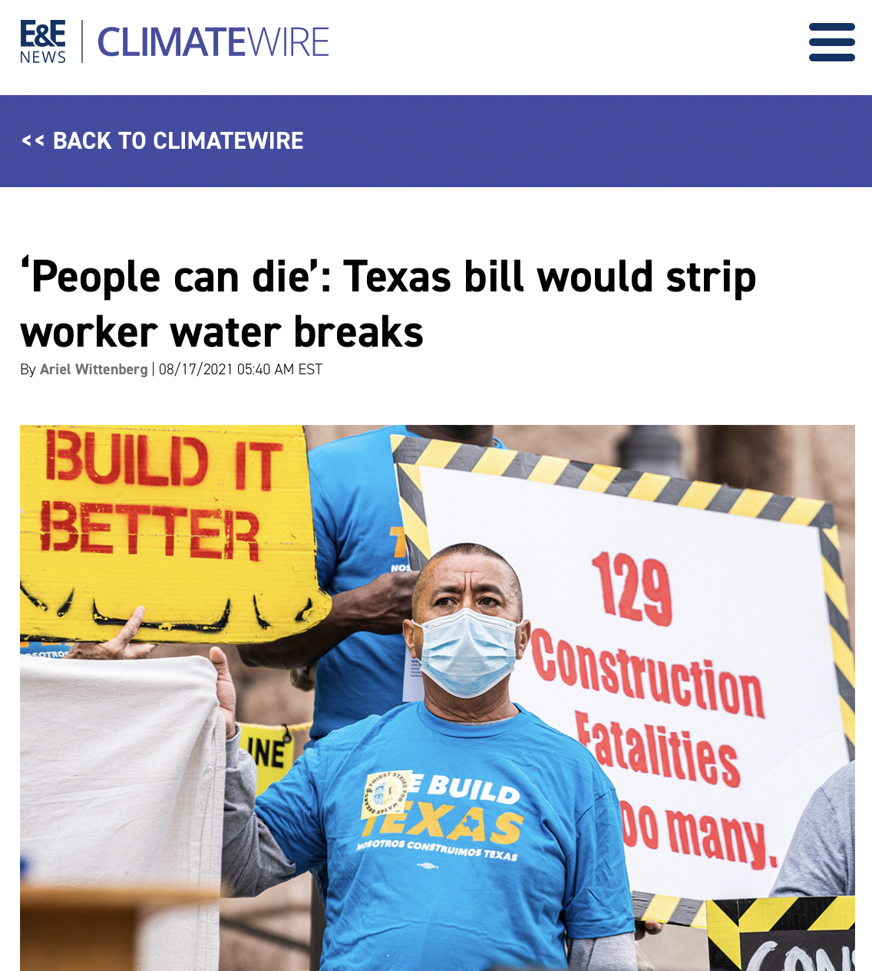
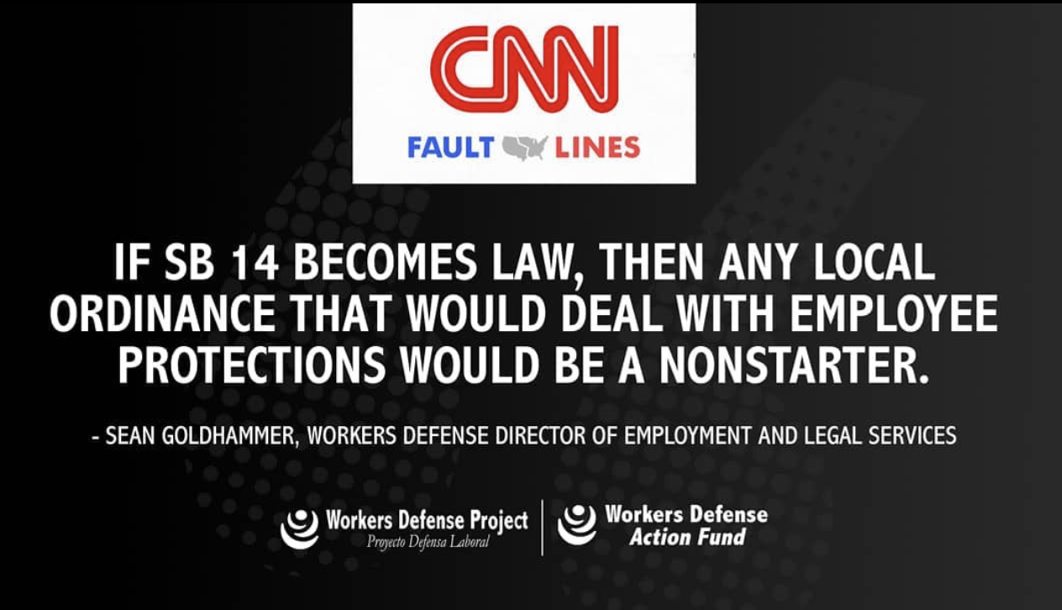
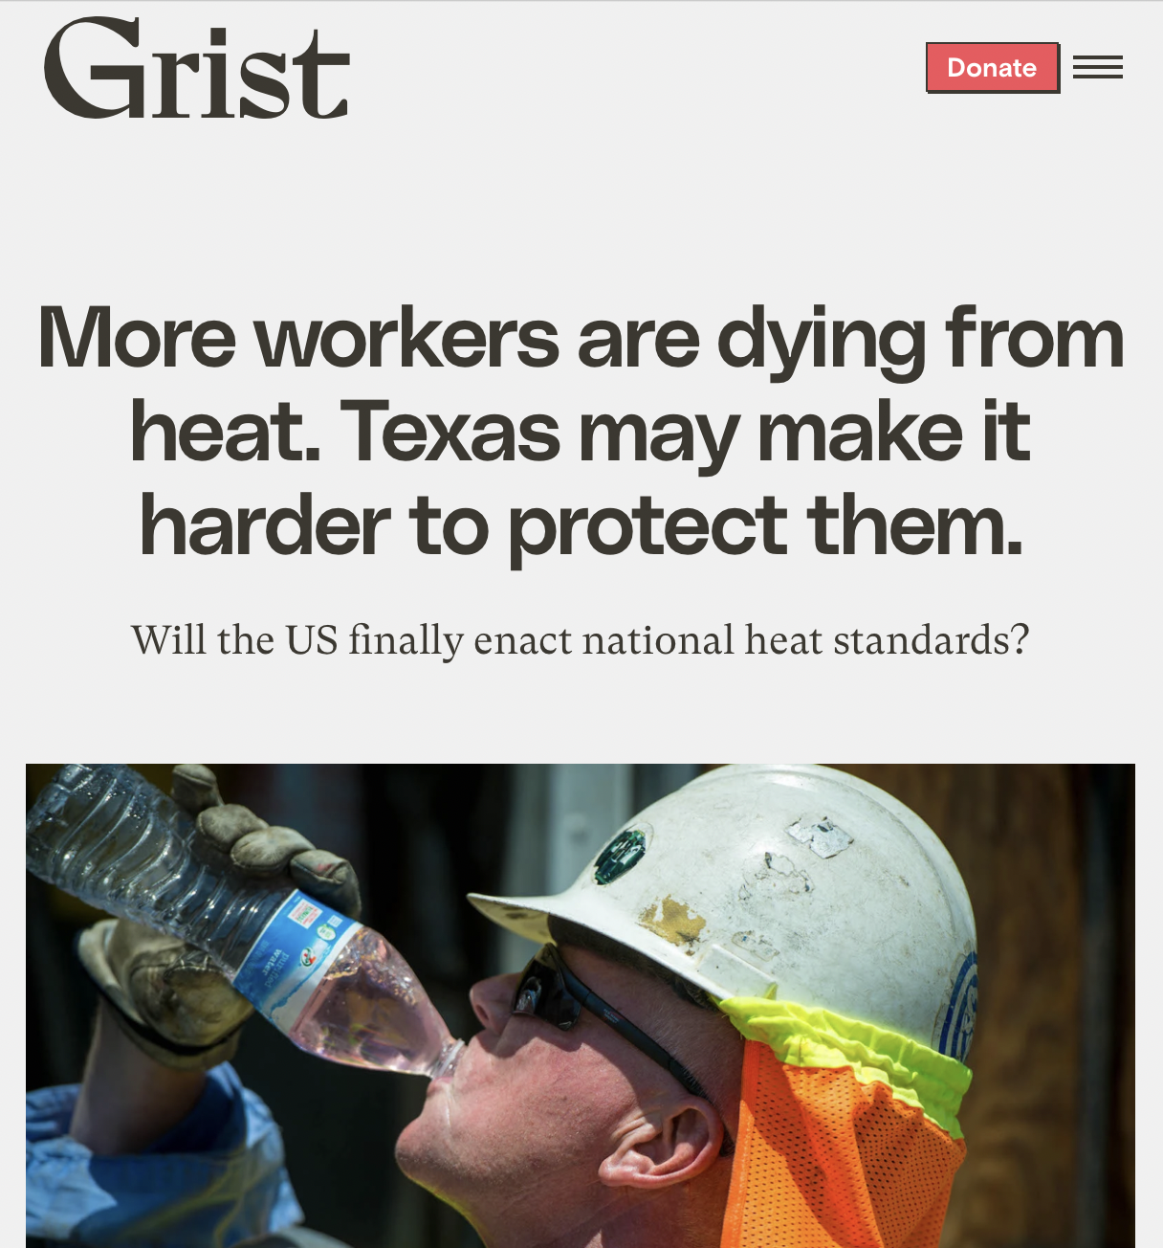
Notes:
Bridging policy and comms for the campaign against Senate Bill 14.
Power of the press, framing, messaging and organizing calls and emails to lawmakers.

Slide 7
Killed SB 14 this Lege Session (and in the 2nd special session)! YAY!
What’s next?

Slide 8
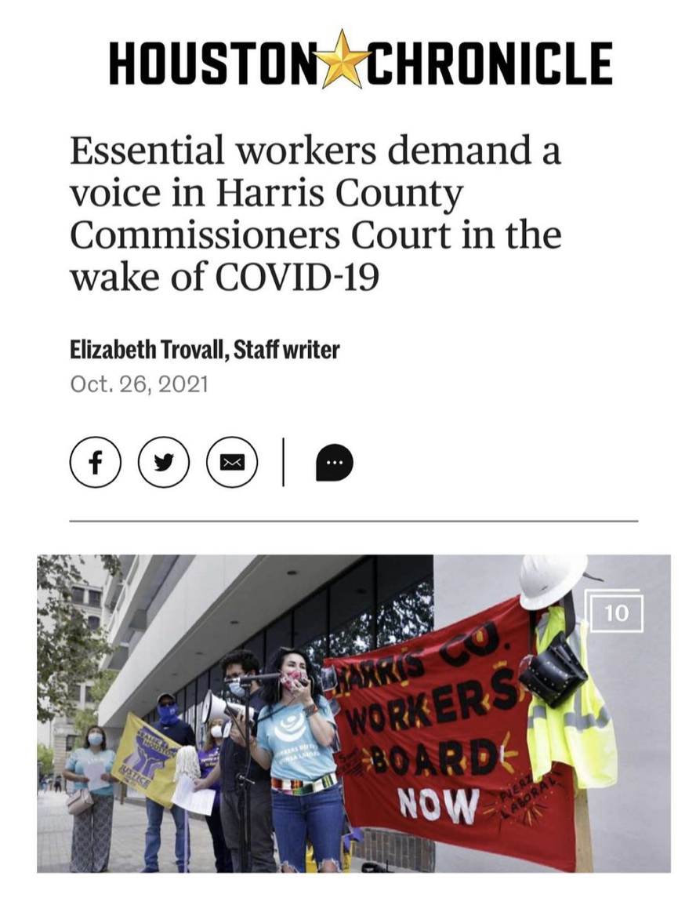
ORGANIZING IN HARRIS COUNTY:
Post-Lege Session, we’re back at it with organizing and building worker power at the local level
The Harris County Essential Workers Board, the first of its kind in the U.S. to be comprised entirely of frontline workers, will give workers a voice in determining workplace health and safety policies and set a strong standard for similar legislation around the country.

Slide 9
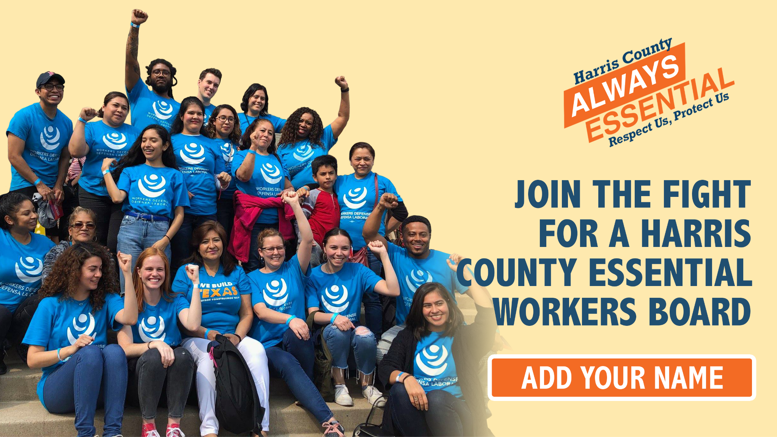

Slide 10
PENDING 11/30 VOTE: HARRIS COUNTY OFFICIALLY PASSED THE ESSENTIAL WORKERS BOARD!
What’s next?

Slide 11
Worker Power in Texas: Local & State Organizing
Juan Benitez, Director of Communications

